Slide 1


An Introduction to
Autism

Slide 2

What Is Autism?
Autism is a ‘hidden disability’, meaning it is not easy to recognise when someone has the condition. When you see the following pattern (on a wristband, card or mobile device) it means someone has autism and wants you to know so that you can support them:
Autistic people often have difficulty in accessing community activities, leisure facilities and other services. Everyone having a better understanding of autism has the power to change lives. The following information is provided to help you to gain a better understanding of autism and suggests ways in which you can support autistic people.
For more information on the ‘Can You See Me?’ scheme, please visit:
https://www.asdinfowales.co.uk/can-you-see-me

Slide 3
What Is Autism?
Autism is also known by other names, including:
Autism Spectrum Disorder (ASD)
Asperger’s Syndrome
Autistic Spectrum Condition (ASC)
Pervasive Developmental Disorder

Slide 4
What Is Autism?
Autism is a lifelong condition and affects people from all backgrounds.
Currently more males than females are diagnosed with autism.
It is estimated that 1 in every 100 people in the UK have an Autism Spectrum Disorder (ASD).
Many people are unaware that they are autistic.
This is especially true for adults.

Slide 5





What Is Autism?
Autistic people have differences in the following areas:
Social Communication &
Social Interaction
Social Imagination and Flexibility of Thought
Restricted, repetitive interests or activities
Restricted, repetitive patterns of behaviour
Unusual sensory responses

Slide 6

Social Communication & Social Interaction

Slide 7
Social Communication & Social Interaction
Autistic people experience social communication differences.
The way this affects a person can vary, and can include difference in the use and understanding of:
speech
language
gestures
tone of voice
eye contact

Slide 8
Social Communication & Social Interaction
How this impacts on day to day life:
People often use body language and sarcasm to convey something.
Autistic people often find these difficult to understand.
Autistic people may be perceived as rude because they avoid eye contact.
Their tone of voice may not always reflect the way an autistic person is feeling.
An autistic person may not be able to use gestures or interpret other people’s gestures.
Autistic people may interpret language literally and so may misunderstand idioms (“pull your socks up”) and metaphors (“my head was spinning”).

Slide 9
Social Communication & Social Interaction
Autistic people experience social interaction differences.
The way this affects a person can vary, and can include difference in the use and understanding of:
engaging in conversation
building and sustaining relationships
understanding humour
giving and receiving compliments
showing concern for others

Slide 10
Social Communication & Social Interaction
How this impacts on day to day life:
Autistic children may find it difficult to instigate or join in play with other children.
Autistic children may find it difficult to take turns and share.
This can cause problems with friendships.
Developing and maintaining friendships and relationships can be difficult for everyone.
Autistic adults have told us that they find this particularly difficult.
This does not mean that they do not want relationships and friends.
Autistic people may not engage in conversation in the same way, and enjoy discussing factual issues rather than small talk.
You may have to be specific when you want to bring the conversation to end.
Autistic people may have difficulty in understanding the rules of social relationships.
This may cause many issues including them offering truthful opinion rather than a tactful one.

Slide 11

Social Imagination and Flexibility of Thought

Slide 12
Social Imagination and Flexibility of Thought
Impairments in social imagination
Autistic people experience social imagination differences.
The way this affects a person can vary, and can include difference in the use and understanding of:
predicting reactions and events
problem solving
relating to others
coping with changes
planning

Slide 13
Social Imagination and Flexibility of Thought
How this impacts on day to day life:
When problem solving, we rely on our social imagination to predict possible outcomes.
This is difficult for an autistic person.
Playing team games often relies on social imagination to predict how other people will interact in the game.
This can be difficult for autistic people.
Autistic people may find it difficult to predict how others may be feeling or how they will react due to problems with social imagination.
Some autistic people have difficulties with creative imagination.
Others have good creative imagination, and only the social imagination is affected.
Planning can be difficult without good social imagination, autistic people often use calendars or planners to help them with this.
Coping with changes can be difficult without good social imagination.
Autistic people usually prefer routines to unpredictability.

Slide 14
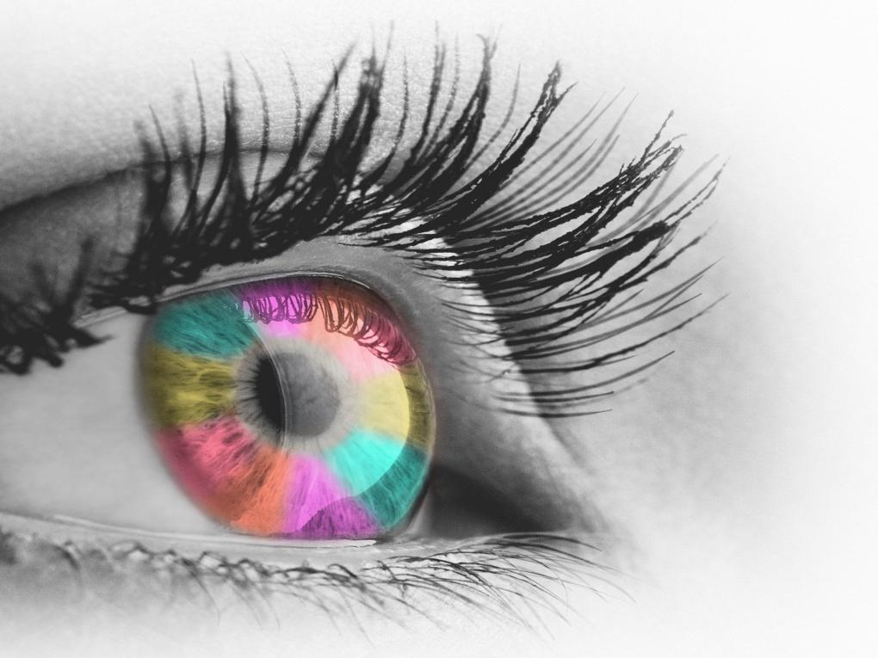
Unusual Sensory Responses

Slide 15
Unusual Sensory Responses
Many autistic people can have sensory issues.
The person’s perception of the senses can be heightened or decreased. All the senses can be affected.
tactile
  (touch)
vestibular
  (movement)
proprioceptive
  (body position)
visual
  (looking)
auditory
  (hearing)
olfactory
  (smell)
gustatory
  (taste)

Slide 16
Unusual Sensory Responses
How this impacts on day to day life, both positively and negatively:
Sensory joy from certain colours
Sensory joy from the feel of certain materials – “stimming”
Decreased feelings of pain
Sensitivity to lighting in shops
Dislike of certain colours
Difficulties around noisy traffic
Inability to tolerate certain smells
Distress/anxiety in busy environments
Sensitivity to touch

Slide 17
What Is Autism?
How you can help:
Being aware of Autism and the differences experienced by autistic people is key.
Ask the autistic person, carers or seek advice from others.
Be understanding, people with autism have a lot to offer but may need support.
Consider how you can adapt the environment to decrease sensory issues (decrease noise, dim lighting, find a quiet space etc.)
Adapt your communication style.

Slide 18
Adapt Your Communication
Communication - adapting your communication can help an autistic person:
Speak slowly and clearly
Allow time for the person to process information
Avoid relying on gesture, facial expression or tone of voice
Don’t use idioms or metaphors
Keep instructions short

Slide 19

Further Information
For further information on autism, please watch the ‘What Is Autism?’ film by visiting:
www.vimeo.com/339305728
To complete the questionnaire and to get your personalised Autism Awareness certificate, please visit:
www.ASDinfoWales.co.uk/asdaware
You can also apply to become an Autism Aware organisation. For more information, please visit:
www.ASDinfoWales.co.uk/asd-aware-organisations

Slide 20




Further Information
For information on the SIGNS of autism, please visit:
www.ASDinfoWales.co.uk/autismchildsigns and www.ASDinfoWales.co.uk/recognise-asd-adult
Further information and links to other resources can be found at:
or email enquiries to ASDinfo@WLGA.gov.uk
ASDinfoWales
@ASDinfoWales

