Slide 1

Supporting Adults with an Autism Spectrum Disorder
An Introduction for
Health and Social Care Practitioners

Slide 2
Overview
This learning tool has been developed to support professionals working with adults with autism spectrum disorder. Based on the identified needs of professionals in Wales, and recommendations from the National Institute of Care and Excellence (NICE), this learning tool provides a useful introduction, and should be used as a precursor to more in depth training.
After completing this learning, you are invited to complete the certification scheme at www.ASDinfoWales.co.uk/ASDaware-practitioner-adults, after registering you will be prompted to answer 20 multiple choice questions.
Successful completion of these will prompt download of your certificate.
Many resources to support the recommendations made in this learning tool are available at www.ASDinfoWales.co.uk, we have marked these with a * to help you.

Slide 3

Autism is a ‘hidden disability’, meaning it is not easy to recognise when someone has the condition. When you see the following pattern (on a wristband, card or mobile device) it means someone has autism and wants you to know so that you can support them:
Individuals with autism have difficulty in accessing services. Support from staff can make a huge difference, understanding autism has the power to change lives. The information to follow is provided to help you to understand autism and ways in which you can support children and adults with the condition to access your provision.

Slide 4

This learning tool aims to improve knowledge and understanding of ASD, and also to provide practitioners with advice about how to adapt their interactions and practice. These have been colour coded throughout as follows:
Knowledge Development
Practitioner Advice
Adapting Your Practice

Slide 5
Knowledge Development –
Autism Spectrum Disorders
It is estimated that 1 in every 100 people in the UK have an Autism Spectrum Disorder (ASD)
ASD is a lifelong condition and affects people from all backgrounds.
ASD affects more males than females, though we are aware that many females with an ASD are overlooked
Many adults with an ASD have not been diagnosed, and therefore may not realise they have the condition.
Individuals with an ASD are more likely to experience mental health issues

Slide 6
Knowledge Development –
Autism Spectrum Disorders
Autism Spectrum Disorders are also known by other
names, including:
Autism
Asperger’s Syndrome
Autism Spectrum Conditions
Childhood Autism
Pervasive Developmental Disorder

Slide 7
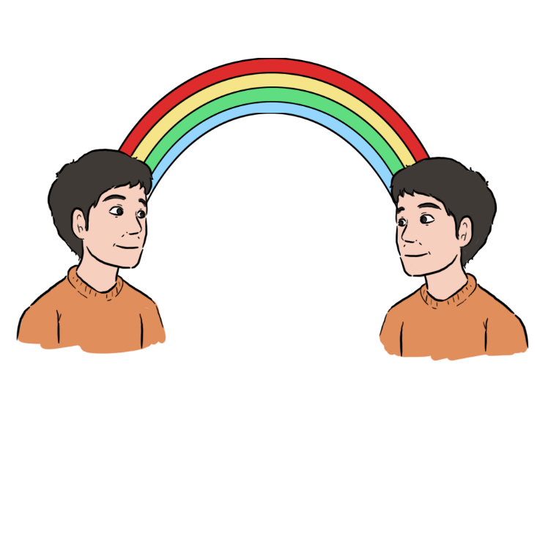
Knowledge Development –
Autism Spectrum Disorders
We refer to an Autism ‘Spectrum’ because of the way in which the condition affects individuals can vary
On one end of the spectrum people with an ASD may have an additional learning disability and be more severely impaired.
On the other end individuals may have an average or above average intellect and may function at a higher level, but still experience difficulties.

Slide 8
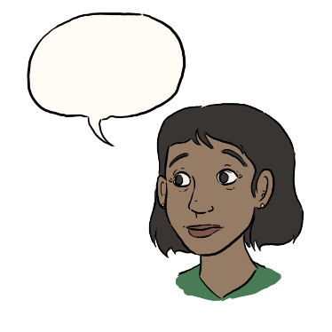
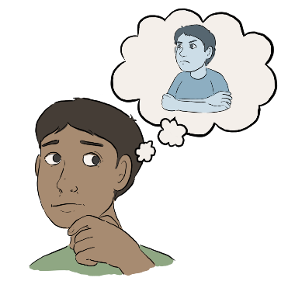
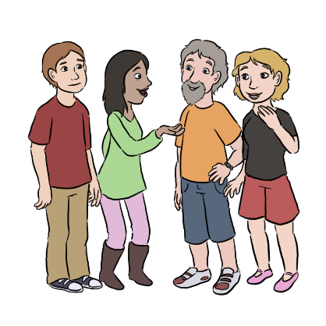
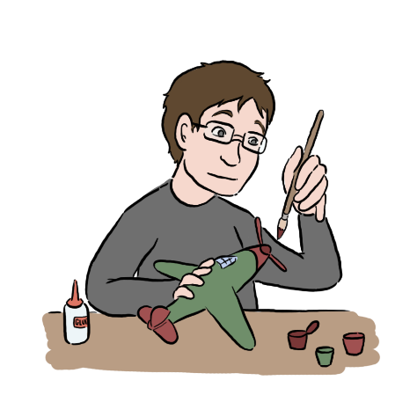
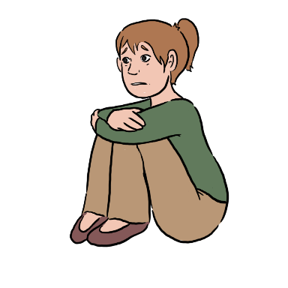
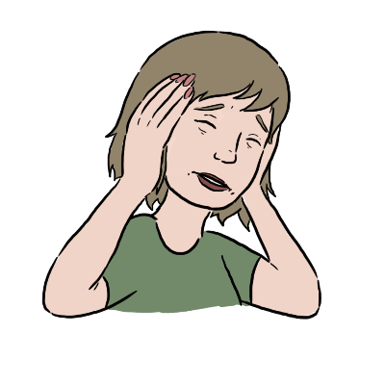
Knowledge Development –
Autism Spectrum Disorders
Individuals with an ASD have impairments in the following areas:
And may also demonstrate:
Social Communication
Social Imagination and Flexibility of Thought
Social Interaction
Restricted or repetitive patterns of behaviour
Restricted, repetitive interests or activities
Unusual sensory responses

Slide 9
Knowledge Development –
Autism Spectrum Disorders
Many adults with ASD are not diagnosed or are misdiagnosed.
They may present to services with support needs, but have an underlying ASD that has not been recognised – these may present as:
Mental health issues or other neurodevelopmental disorder
Including anxiety, depression, psychosis and ADHD.
Rigid and repetitive behaviours
Including odd or unusual activities and mannerisms, OCD type presentations, unusual highly focussed interests which may seem odd.
Unusual level of distress caused by a change or changes
Difficulties in accessing or sustaining employment or education
Issues stemming from problems with social communication and interaction
Including house move, change of job, loss of a loved one as well as day to day changes.
Including never being in education, training or employment, lack of awareness of how to obtain employment, capability issues in employment.
Including problems stemming from misunderstandings, arguments, literal communication, including inability to resolve conflict and not being able to adapt behaviour to different contexts. May include legal issues.

Slide 10
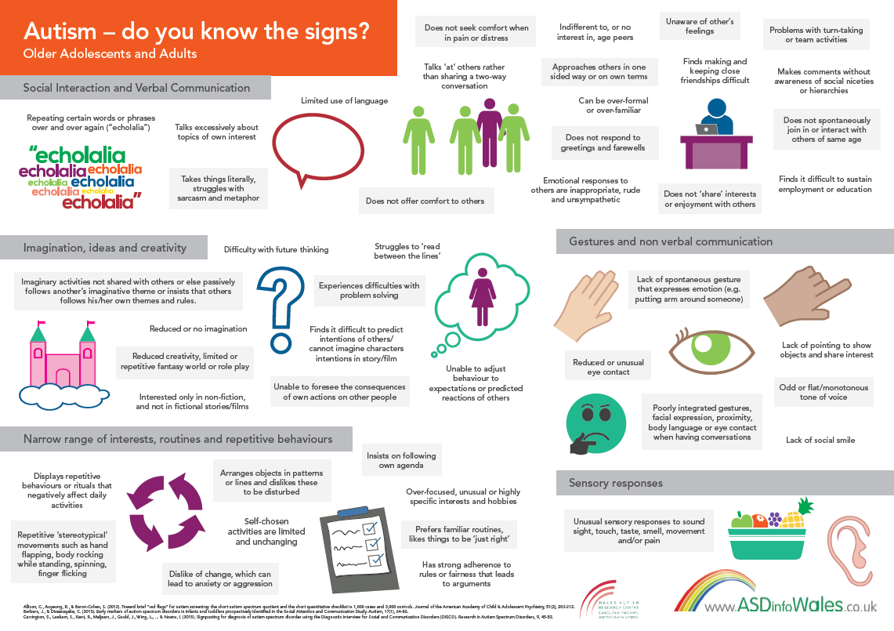
Knowledge Development –
Autism Spectrum Disorders

Slide 11

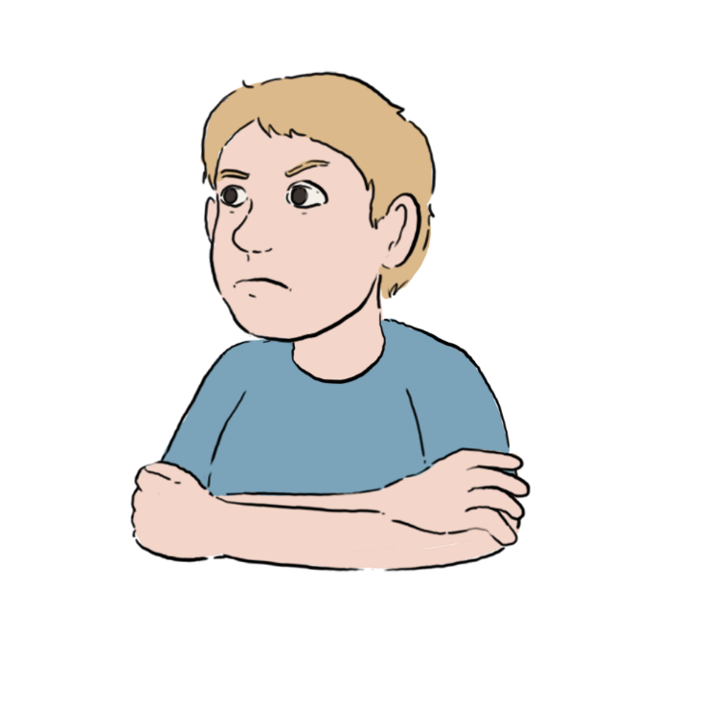
Knowledge Development –
Social Communication
Individuals with an ASD have impairments
in social communication.
The way in which the person is affected varies.
These impairments can include difficulties in using
and understanding:
speech
gestures
language
tone of voice
eye contact

Slide 12

How this impacts on day to day life:
Knowledge Development –
Social Communication
Someone with ASD may not be able to use gesture or interpret others gestures.
In order to understand when someone is being sarcastic, we analyse many non verbal cues. This means that people with ASD may struggle to recognise and appreciate sarcasm.
Speaking in a monotone voice may lead to emotions being misinterpreted by others.
We often rely on tone of voice, gesture and eye contact as well as words to convey our point. People with ASD may not be able to use or understand these easily.
People with ASD may interpret language literally and so may misunderstand idioms (“pull your socks up”) and metaphors (“my head was spinning”).
Avoiding eye contact maybe interpreted as the individual being rude, it is not.

Slide 13
Practitioner Advice –
Social Communication
Don’t use figurative language, avoid idiom and metaphor
Use visual cues such as pictures, lists or written material to support your interaction*
Say what you mean, and mean what you say
Use a calm, consistent tone of voice
Don’t rely on non verbal communication to convey or emphasise a point
Don’t make assumptions about feelings based on body language, facial expression or eye contact
Allow extra time for the individual to process what you are saying
Keep your facial expressions to a minimum to avoid confusion
Be specific, and check that the individual
has understood you

Slide 14

Knowledge Development –
Social Interaction
Individuals with an ASD have impairments in social interaction. The way in which the person is affected varies. These impairments can include difficulties in :
sharing
giving and receiving compliments
offering comfort to others
enjoying conversation
recognising humour or sarcasm
building and sustaining relationships

Slide 15
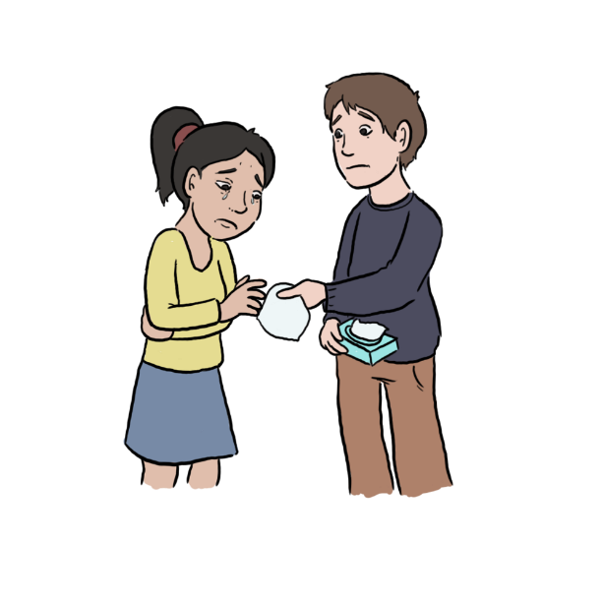
How this impacts on day to day life:
Knowledge Development –
Social Interaction
People with ASD find it difficult to develop and maintain friendships and relationships. This does not mean that they do not want friends.
People with ASD have difficulty in understanding the rules of social interaction. This may cause many issues including them appearing to be aloof or overfamiliar, not respecting personal space or making personal remarks without realising they have offended.
Adults may find conversational turn taking difficult, along with waiting until there is a conversational gap before speaking.
People with ASD may not enjoy conversation in the same way, and therefore prefer to discuss factual issues rather than enjoying the interaction with another. They may not understand signs of the other person wanting to end the conversation etc.
Adults with ASD may find it difficult to guess how others may be feeling or to show empathy and offer comfort. This can make them appear ‘cold’ or uninterested.

Slide 16
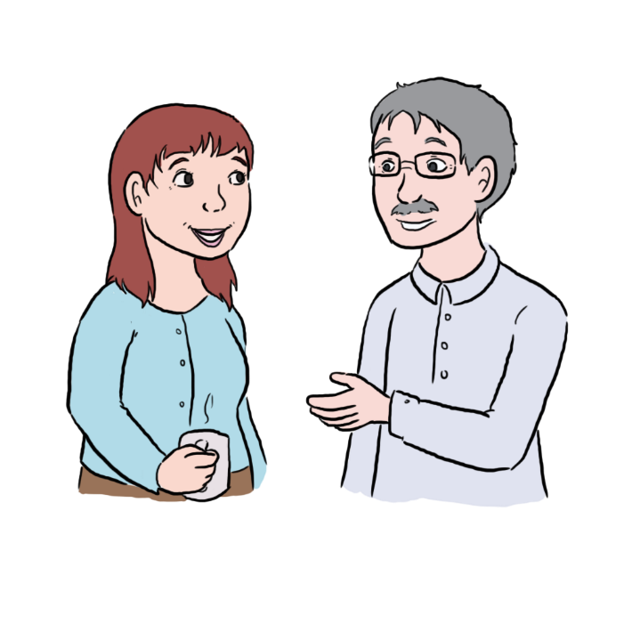
Practitioner Advice –
Social Interaction
Explain your role and the purpose of interaction before starting
Clearly and concisely explain your expectations of the individual, avoid lengthy, complicated explanations
Do not offer telephone only support, many individuals with ASD find this form of interaction very difficult
Beware of the individual’s difficulties in interacting in groups, they may need to be avoided or supported with additional structure*
Ask specific questions, many individuals with ASD will rarely offer more information than they have been asked for and you could be missing something essential
Reduce social niceties, and social chit chat , focus on facts and purpose

Slide 17
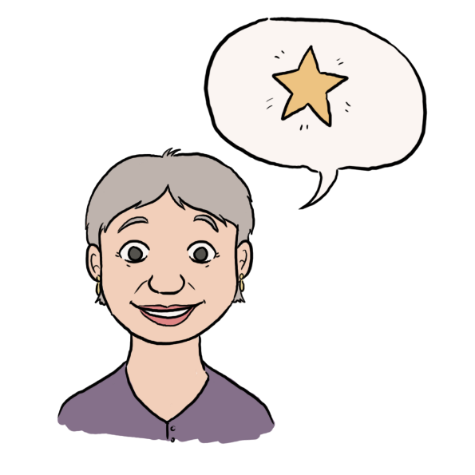
Knowledge Development –
Social Imagination, Restricted or Repetitive Behaviours and Interests
People with an ASD have impairments in social imagination and flexibility of thought and demonstrate restricted, repetitive patterns of behaviour. Again, the extent varies from one individual to another.
The impact of this can affect many areas of daily life and may include difficulties in:
predicting reactions and events
relating to others
planning
problem solving
creative activities
coping with changes

Slide 18
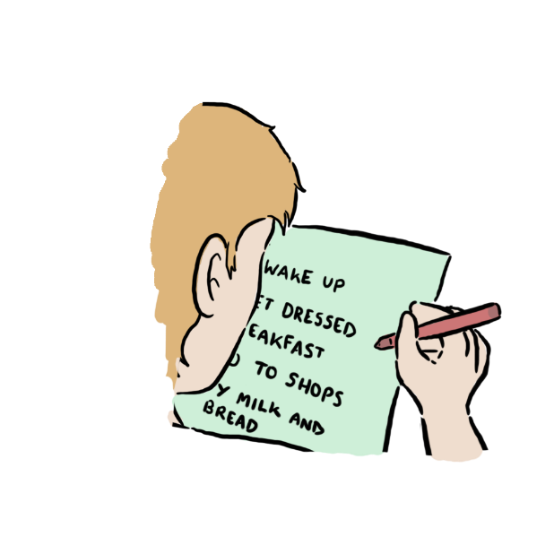
How this impacts on day to day life:
Knowledge Development –
Social Imagination, Restricted or Repetitive Behaviours and Interests
Some people with ASD have difficulties with areas of creative imagination. This can impact on education and employment.
Problem solving can be difficult and the individuals may need additional support or structure with this.
Individuals will struggle to predict others actions, read between the lines or make sense of others intentions.
People with ASD find it difficult to predict how others may be feeling or how they will react.
Many individuals may insist on sameness or have ritualised patterns of behaviour, this makes it difficult to cope with changes, unfamiliar people and activities.
Planning and organising can cause problems and many will need additional support with this. This can cause appointments to be missed or timescales not met.
Repetitive behaviours such as spinning, finger flicking or rocking can impact on social relationships.

Slide 19
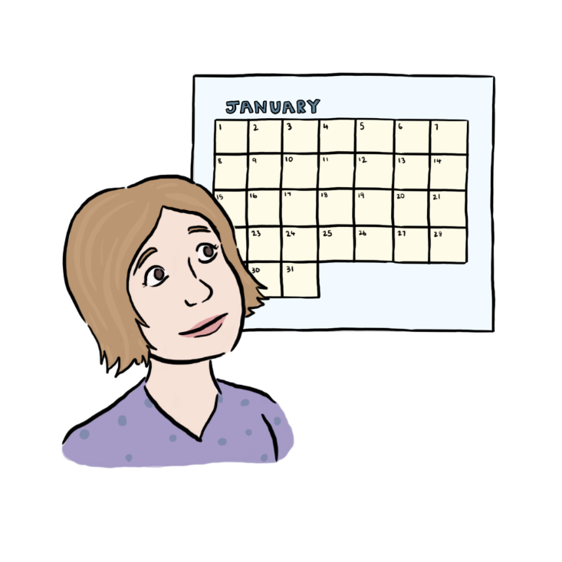
Practitioner Advice –
Social Imagination, Restricted or Repetitive Behaviours and Interests
Keep changes to a minimum, be consistent in your interactions
Provide additional structure within activities that are complex or that rely on social imagination
Use verbal descriptions, flowcharts and visual cues to explain things, rather than ‘imagine if…’ or ‘what if..’ approaches
Provide structure in the form of planners, lists or timetables*
When asking for ‘goals’ or ‘preferences’ provide options to choose if the individual has difficulty making a free choice
Describe your planned actions, do not assume that the individual will recognise what is expected of them based on your body language or movements

Slide 20

Practitioner Advice –
Social Imagination, Restricted or Repetitive Behaviours and Interests
Special interests
Restricted patterns of behaviour can often manifest as the individual having an intense, restricted or fixated interest.
Sometimes the intensity of the interest can cause an impact on daily functioning, impair social opportunities and cause distress for those supporting the individual.
It is useful to remember that for the individuals with an ASD, these interests are often comforting and reassuring. Professionals can utilise these interests as a foundation for building a relationship, as a reward for positive behaviour or as a specialist skill to promote to potential employers.

Slide 21
Knowledge Development –
Unusual Sensory Responses
Many people with an ASD can have sensory issues.
The individual with ASD’s perception of the senses can
be heightened or decreased. All the senses can be affected:
tactile
(touch)
vestibular
(movement)
proprioceptive
(body position)
visual
auditory
(looking)
olfactory
(hearing)
gustatory
(smell)
(taste)

Slide 22

How this impacts on day to day life:
Knowledge Development –
Unusual Sensory Responses
decreased feelings of pain
sensitivity to lighting in shops
difficulties around noisy traffic
inability to tolerate certain smells
food fads / limited diet
distress / anxiety in busy environments
sensitivity to touch

Slide 23
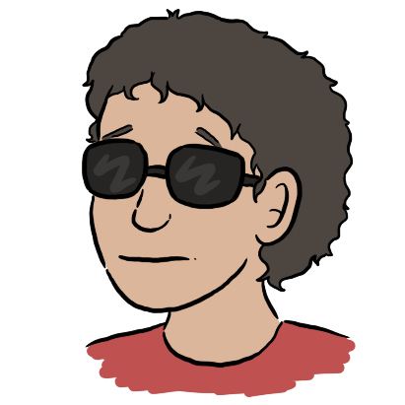
Practitioner Advice –
Unusual Sensory Responses
How you should adapt your practice:
Use a calm, consistent tone of voice
Reduce lighting, switch off fluorescent lights
Look for sensory triggers when looking for causes of distress
Don’t rely on the individual’s recognition or description of pain to assess an injury
Avoid tasks that require using two or more senses at once such as taking notes whilst listening to you
Choose less busy times of day and environments where possible

Slide 24

Adapting Your Practice –
Duties
Services have a duty to make ‘reasonable adjustments’ for individuals with an ASD.
Most of the adjustments outlined here are low or no cost options, and would therefore be considered as ‘reasonable’.
More importantly, making these changes to your practice can improve engagement, reduce missed appointments and essentially mean that the individual is supported to reach their full potential.

Slide 25

Adapting Your Practice –
Contact
Due to difficulties with social communication and interaction, traditional methods of contact are often not suitable for individuals with an ASD
Offer a choice of contact options
Ensure appointment letters are directive, clear, concise and structured
Do not use switchboard or answerphone numbers as means of cancelling or changing appointments
Consider use of email or text messaging as a contact method
Do not offer telephone only contact

Slide 26
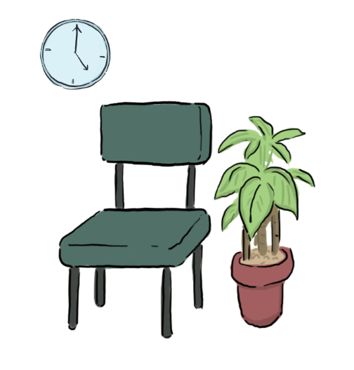
Adapting Your Practice –
Appointments
Attending and waiting for appointments can often be very stressful for someone with an ASD
Offer appointments at less busy times of day
Offer a quieter area to wait in
Try to keep appointments to time, if running late ask someone to let the individual know
Dim lights and switch off fluorescent lighting
Aim for a sensory neutral environment, choose neutral colours and avoid cluttering walls with posters and leaflets

Slide 27
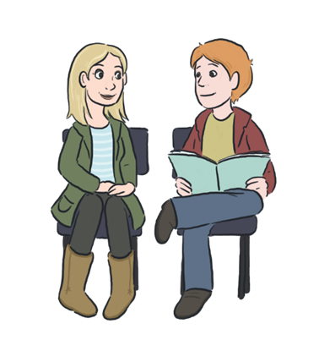
Adapting Your Practice –
Assessments
Due to the range of impairments that individuals with ASD experience, assessments of problems and needs will need to be adapted to ensure accurate information is obtained
Don’t rely on the individual’s description of pain or illness as this may be more severe than reported
Ask specific questions, don’t assume the individual will realise what you are implying
Explain the purpose and expectations clearly
Adapt your communication and avoid social chit chat
Utilise visual cues such as pictures, lists and flowcharts
Explore and clarify answers to ensure information is not missed
Don’t make assumptions based on body language, facial expression or eye contact
If the individual is struggling to describe emotions, support them by asking for physical feelings or examples

Slide 28


Adapting Your Practice –
Identifying Goals and Outcomes
Individuals with an ASD will need additional support to set goals, make choices or identify their preferred outcomes
Explain the purpose of goal / outcome setting
Adapt your communication
Offer options or a limited number of choices
Use a tool*, lists or flow charts to support decision making
Incorporate past experiences or special interests into discussions to make them more relevant

Slide 29
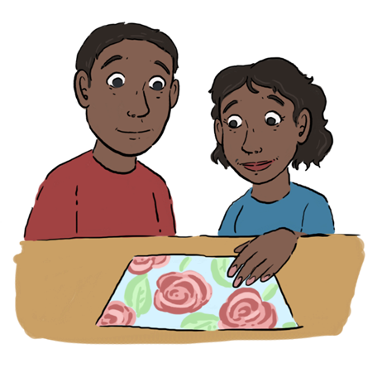
Adapting Your Practice - Interventions
Interventions will need to be adapted when used with individuals with an ASD
Add more structure to any interventions, especially self-directed work
Consider if the individual can undertake work at home, the individual may find it difficult to complete tasks set in one environment in another
If consent is given, ask carers to support work
Provide a plan which includes smaller steps, outcome measures, time scales and clear end points for the intervention
Clearly explain any medical interventions, and don’t rely on body language to convey your intentions
Be specific, use rules and explain any exceptions to the rules.
Utilise visual cues such as pictures, planners, checklists, diaries and flow charts
Use facts, avoid hypothetical discussions and be aware of the difficulties the individual will have in sharing emotions

Slide 30
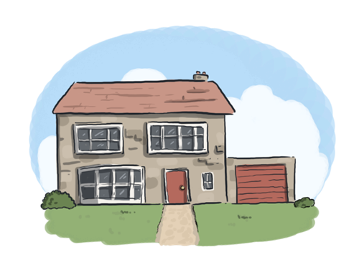
Adapting Your Practice –
Follow up
Individuals with an ASD will need clear information about follow up arrangements, in order to avoid confusion
Ensure follow up arrangements are clearly communicated to the individual
Be specific in your advice, don’t say “take a tablet” if you mean “swallow a tablet”
Ensure the individual is aware of when to return, don’t use vague terms such as ‘if things don’t improve’
If consent is given, provide follow up information to a carer
If referring to a different service / professional advise them of the individual’s difficulties in advance
Provide a profile* of the individual’s needs and ask the individual to carry it with them and share with other people
Provide written information and ensure this has been adapted for individuals with an ASD

Slide 31

further information and links to other resources can
be found at
or email enquiries to ASDinfo@WLGA.gov.uk

