Slide 1
WHAT IS AUTISM?
“Post its” at the beginning

Slide 2
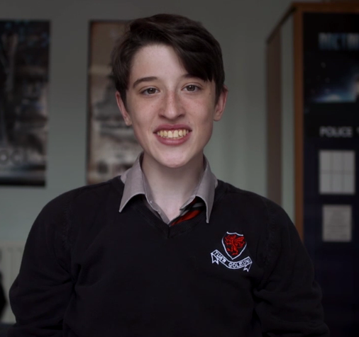
sgilti

Slide 3
Clip 1
What is autism?
What are the signs of autism?
What kind of person is Sgilti?

Slide 4
Clip 2
What has happened to the structure of Sgilti’s day, and why is this important?
What could other people have done to help him?
What does Sgilti think about himself?

Slide 5
Clip 3
What is communication and what ways do we use to communicate?
How do we know if another person understands what we are communicating?
How does Sgilti rate his communication skills?

Slide 6
Clip 4
What are your interests and how important are they in your life?
Is there a difference in how Sgilti looks at his interests?
How can you tell what other people are thinking or feeling?

Slide 7
Clip 5
What is your reaction to Sgilti saying he is stressed almost all of the time?
How can we adapt our behaviour to make things easier for a person with autism?
Is autism what you thought it was?

Slide 8
WHAT IS AUTISM?
“Post its” at the end

