Slide 1
Supporting autistic people in employment
Human Resources Training

Slide 2
Can You See Me?
Autism is a ‘hidden disability’, this means that it is not easy to recognise when someone has the condition. If someone has a wristband, card or screensaver on their mobile device this means that they are autistic and want you to know so that you can support them:
Autistic people often have difficulty in accessing community activities, leisure facilities and other services. Everyone having a better understanding of autism has the power to change lives. The following information is provided to help you to gain a better understanding of autism and suggests ways in which you can support autistic people.
For more information on the ‘Can You See Me?’ scheme,
please visit:
AutismWales.org/en/i-am-autistic/resources-for-you/can-you-see-me/

Slide 3
Equality Act 2010
An individual is classified disabled under the Equality Act 2010 if they have a physical or mental impairment that has a 'substantial' and 'long-term’ negative effect on their ability to do normal daily activities.
'substantial' is more than minor or
trivial

Slide 4
Equality Act 2010
The employer has a duty to make 'reasonable adjustments' in the workplace. The employer's overall aim should be, as far as possible:
"To remove or reduce any substantial disadvantage faced by a worker which would not be faced by a worker which would not be faced by a non disabled person”
The duty contains three requirements that apply in situations where a disabled person would otherwise be placed at a substantial disadvantage compared with people who are not disabled:
Changing the way things are done (ensuring the disabled employee is not at a substantial disadvantage because of a provision, criterion or practice of their employer)
Making changes to overcome barriers created by the physical feature of a work place.
Providing auxiliary aids and/ or an auxiliary service

Slide 5
Why employ an autistic person?
Specific Skill Set
Many hours spent researching, learning and engaging in activities relating to their specific areas of interest
Personality Traits
Good time keeping and att endance, less time gossiping and more time working. Great attention to detail
Investment
A small investment can reap great rewards when employing someone with autism
Notes:
Previous slide stated- “Want a reliable, accurate employee- Employ someone with autism”. Whilst I agree, this a massive generalisation, so changed to Why employ an autistic person.

Slide 6
What Is Autism?
What Is Autism?
Autism is a lifelong neurodevelopmental condition and affects people from all backgrounds
Currently more males than females are diagnosed with autism
It is estimated that 1 in every 100 people in the UK have an Autism Spectrum Disorder (ASD)
Many people are unaware that they are autistic
This is especially true for adults

Slide 7
Many adults remain undiagnosed this is especially true of women
What Is Autism?
Please visit the Integrated Autism Service if you would further information regarding the referral for an autism diagnosis:
AutismWales.org/en/integrated-autism-service/

Slide 8
Autism is not
a learning disability or a mental illness
However some autistic people may have a co occurring learning disability or mental health condition such as anxiety or depression.
Notes:
Not sure if we need this slide

Slide 9
What Is Autism?
Autistic people have differences in the following areas:
Social Communication & Social Interaction
Social Imagination and Flexibility of Thought
Restricted, repetitive interests or activities
Restricted, repetitive patterns of behaviour
Unusual sensory responses

Slide 10
What Is Autism?
Social Communication
Autistic people may have difficulties in social communication. The way in which the person is affected varies. These difficulties can include:
speech
language
facial expression
gestures
eye contact
body language
tone of voice

Slide 11
When communicating with an autistic person you should:
Avoid figurative language, metaphors and idioms can be confusing
Be specific and avoid ambiguity
Not rely on gesture, body language or facial expression to convey or emphasise a point
Use a calm and consistent tone of voice
Recognise that avoiding eye contact is not a sign of disinterest or rudeness

Slide 12
What Is Autism?
Social Interaction
Autistic people may have difficulties with social interaction. The way in which the person is affected varies. They may include difficulties with the following:
enjoying conversation
building and sustaining relationships
understanding humour and sarcasm
giving and receiving compliments
seeking and offering comfort

Slide 13
When interacting with an autistic person you should:
Initiate interactions
Avoid meaningless social chit chat
Try and find out if they have a special interest
Offer help and explanations (some autistic people may not be confident to ask)
Not pressure them to join social activities

Slide 14
Social Imagination and Flexibility of Thought
Autistic people may have difficulties with social imagination and flexibility of thought and demonstrate restricted, repetitive patterns of behaviour. Again, the extent varies from one person to another. The impact of this can affect many areas of daily life and may include difficulties in:
problem solving
predicting others and events
coping with changes
planning
relating to others
creative activities

Slide 15
When supporting an autistic person you should
Provide additional structure
Be clear about expectations, priorities and end points
Recognise that they might find changes difficult and minimise these
Provide additional resources that will help with planning and undertaking tasks
Provide a limited number of choices rather than free choice

Slide 16
Special Interests
Restricted patterns of behaviour can often manifest as the individual having an intense, restricted or fixated interest. An individual's special interest can be beneficial to employers because of the intense level of knowledge. Pursuing this interest may have also led to the development of wider skills such as researching or cataloguing.
Notes:
Include links to Temple Grandin

Slide 17
Reasonable adjustments for autistic employees
Be accepting
Recognise strengths and challenges
Always adapt communication
Be sensory aware and make adjustments
Provide additional structure
Support to engage with Social Interaction

Slide 18
Impact of autism during job interviews
SOCIAL COMMUNICATION Reduced or unusual eye contact Take things literally so will struggle with metaphor and sarcasm May not provide additional information unless asked May repeat words or phrases | SOCIAL INTERACTION Difficulties with social chit chat May not respond to greetings and farewells May not follow social rules and conversations Difficulty using and understanding facial expression, proximity ad body language | SOCIAL IMAGINATION Difficulty imagining situations such as “what would you do if…” Difficulties with problem solving Struggles with ‘reading between the lines’ Unable to take someone else’s point of view | SENSORY ISSUES May have difficulties utilising more than one sense at a time, e.g. looking and listening May dislike shaking hands May be distracted by fluorescent lighting or flickering lights

Slide 19
Adjustments during a job interview
Give clear instructions and information prior to the interview | Interview questions should be provided in advance | Allow the candidate to bring pre-written material to refer to during the interview | Remember an individual’s body language may not be as you expect, this does not mean they are not interested or demotivated
Remember that a lack of eye contact does not mean that an individual is being rude | Avoid social chit chat at the beginning and end of the interview | Use specific questions | Avoid hypothetical questions such as “what would you do if…” instead base your questions on individual’s experiences “describe how you…”
Avoid figurative language, idiom, metaphor and sarcasm | Allow extra processing time for the individual to answer your question | Avoid linked or 2 part questions | Provide questions in a written format

Slide 20
Impact of autism during induction
SOCIAL COMMUNICATION Needs specific information rather than ambiguous inferences Take things literally so will struggle with metaphor and sarcasm Difficulty understanding gestures such as pointing to indicate directions May experience delays in processing information | SOCIAL INTERACTION Difficulties with social chit chat May find being introduced to lots of new people stressful May not understand what is expected of them during introductions | SOCIAL IMAGINATION Difficulties relating to others Difficulty coping with new places, people and activities May not be able to work out arrangements for breaks and lunch without specific rules | SENSORY ISSUES Difficulties managing in loud, busy environments May have difficulties utilising more than one sense at a time e.g. looking and listening Dislikes unpredictability and chaos

Slide 21
Adjustments to induction
Invite the individual to visit the workplace and be introduced to staff members before starting work | Provide written information outlining expectations e.g. what to wear and start and finish times | Provide advice with travel arrangements, if required
Provide information about breaks, lunch options and ‘unwritten rules’ about eating/ drinking at work | Allocate a co-worker, who is autism aware, to buddy | Discuss any adaptations to the work station that could be useful, such as a desk in a quiet area

Slide 22
Impact of autism on Performance Reviews
SOCIAL COMMUNICATION Reduced or unusual eye contact Difficulties in understanding body language, facial expressions or eye contact Struggles with open questions Struggles with ambiguous language | SOCIAL INTERACTION Difficulties with social chit char May make comments with no awareness of social niceties or hierarchies May not read signed of someone wanting to end a conversation Struggles to understand purpose of interactions or may misunderstand | SOCIAL IMAGINATION Difficulty imagining situations such as “what would you do if…” Becomes anxious if meetings are delayed or cancelled Struggles to generate creative ideas and goals Struggles to predict outcomes to hypothetical situations | SENSORY ISSUES Difficulties concentrating in loud, busy environments May have difficulties utilising more than one sense at a time e.g. looking and listening

Slide 23
Adjustments to Performance Reviews
When asking for feedback, ask specific questions rather than asking for general feedback | Provide structure so the individual has something to follow when giving feedback | Be specific when giving feedback and avoid terms such as ‘quite’, ‘normal’ and ‘average’
Provide additional structure if you expect the individual to set goals. Give limited choices and don’t expect the individual to generate their own goals | If reviews are conducted via meetings, prepare the individual before hand by telling them what the meeting is about and what will be expected of them | Allow the individual to have a co-worker or advocate for support
Choose a quiet area to meet | Give advance notice of meeting and avoid changing times or cancelling | Write feedback down in a structured format

Slide 24
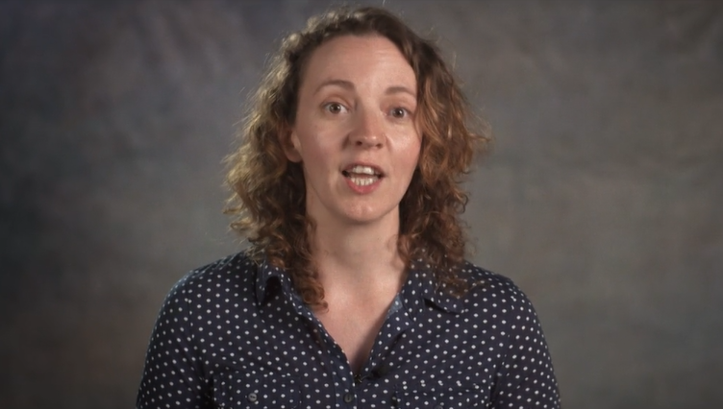
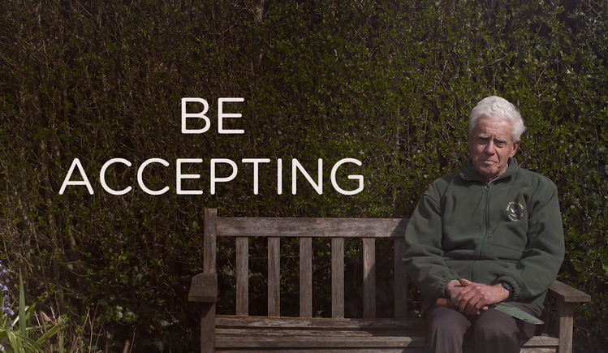
To find out more about autism watch our ‘What is Autism’ and ‘Living with Autism’ films:
AutismWales.org/en/parents-carers/what-is-autism/
AutismWales.org/en/parents-carers/information-for-parents-carers/living-with-autism-film/

Slide 25
Further information and links to other resources can be found at:
or email enquiries to ASDinfo@WLGA.gov.uk
ASDinfoWales
@ASDinfoWales

