Slide 1


Supported employment in wales:
emerging issues in challenging
times for supported employment
providers and employers
Dr. Elisa Vigna & Dr. Stephen Beyer
National Centre for Mental Health
Cardiff University

Slide 2
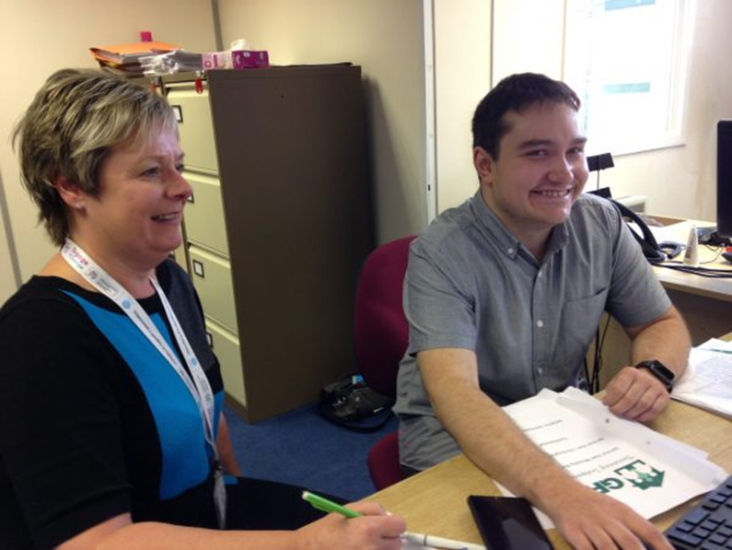


Supported Employment
Job Coaching
Travel Training
Job Coaching central to the Supported Employment Model

Slide 3
Research on the concerns of employers
Employing a person with learning disability or autism may:
  require more costly supervision and training
  lead to poor productivity and can lower performance
  be challenging because we do not have suitable jobs
  have more accidents
  generate more compensation claims
Employers who had no experience of employing people with a learning disability or autism had more concerns

Slide 4
Research on what helps employers
Employees with learning disabilities are more likely to receive higher ratings of work performance when employers perceive a good job-employee match ^{21,22}
Job Matching
Job coach support is crucial:
        On-site training
        The physical presence of a Job Coach at the job site
        On-going availability to call for assistance¹⁵
        Help and advice for supervisors
Employers with experience of employing people with learning disability have positive views on “work performance and employment costs”.

Slide 5
Employer rated benefits of employing people with a learning disability & autism
Positive views of their employability and performance:
  accepting authority, and being accepted by the public ^{1,2,3,4,5,6,7}
  dedication, involving job coach assistance ^{8,9}
  lower turnover rates⁵; willingness to learn; job satisfaction; unlikely to cause trouble; friendliness; honesty; hardworking; strength; timekeeping; reliability; appearance; dependability; motivation; and sickness record ¹⁰

Slide 6
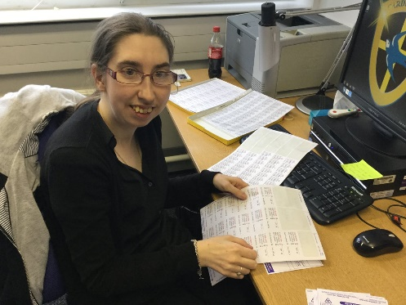
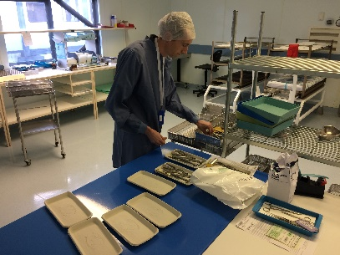
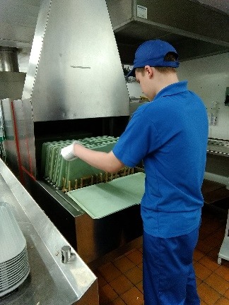


Engage to Change
http://www.engagetochange.org.uk

Slide 7


How many people have we worked with?
610 people with Learning Disability or ASC
388 paid work placements
224 people have a job

Slide 8

Employer satisfaction with employees with a learning disability or autism
398 employers
satisfaction with following safety rules high
attendance good
quality and quantity of work achieve high rates of employer satisfaction

Slide 9
Staff and public reaction
68% of our employers say that having an employee with a learning disability/autism had a positive effect on the productivity of their other staff
72% said employing a person had positive effect on the attitudes of other staff to work
81% said employing a person had a positive effect on their company’s approach to creating a diverse workforce
71% said it had a positive effect on the public image of their company
65% said it had a positive effect on their Customers
X has fitted in very well within the workforce. He is an avid and conscientious
worker, always happy to chat and explain what he is doing.

Slide 10

COVID-19 issues for employers
Survival!
  Particularly in certain Sectors
Uncertainty
  Close downs, market for goods, Brexit if exporting or importing
If survive doing more with same staff and not recruiting
Recruitment decision even more important now
Shift to home working
Dealing with Furlough
  Staff disengagement and re-engagement over lockdowns for employers

Slide 11


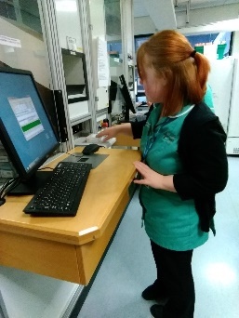
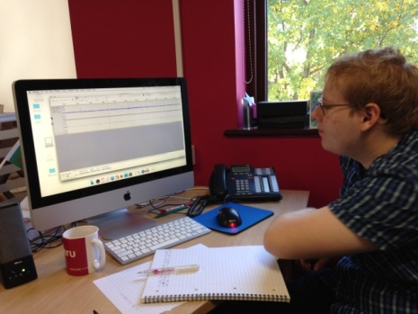
Engage to Change: Why employ people with a Learning Disability or Autism?

Slide 12

Supported Employment offers:
  Pre-sifted recruitment with job match
  Not over-qualified who move on
  Support at every stage
High levels of loyalty from recruits
Good staff performance rates
Help to access other incentive schemes (ELITE a Kickstart gateway provider)...
Employer Development Grants in Wales
Additional services from Supported Employment Agencies
  Diversity awareness, advice on diversity training,
  Support for Autism Aware course, Disability Confident status
”We do not expect preferential treatment, just fair access to the jobs that are there."

Slide 13
Discussion
This is the experience of E2C and leading supported employment programmes
Does this resonate with you as employers and service providers?
  Are the right issues highlighted?
  Do you face different issues?
  Do you have experience of employing people with disabilities?
  What help would you require to employ people?

Slide 14
Dr. Elisa Vigna
&
Andrea Meek and Dr Stephen Beyer
National Centre for Mental Health
Cardiff University
Hadyn Ellis Building
Maindy Road
Cathays
Cardiff
CF24 4HQ
Tel: +44(0)29 22510774
Email: E2C@cardiff.ac.uk

Slide 15
Acknowledgements
Thanks to the Engage to Change Consortium for employment photographs, Learning Disability Wales for Inclusion photographs

Slide 16
References
1. McFarlin, D.B., Song, J. and Sonntag, M. (1991). Integrating the disabled into the work force: A survey of Fortune 500 company attitudes and practices. Employee Responsibilities and Rights Journal, 4, 2, 107-123.
2. Kregel, J. and Tomiyasu, Y. (1994). Employers' attitudes toward workers with disabilities: Effect of the Americans with Disabilities Act. Journal of Vocational Rehabilitation, 4, 165-173.
3. Kregel, J., Unger, D. (1993). Employer perceptions of the work potential of individuals with disabilities: An illustration from supported employment. Journal of Vocational Rehabilitation, 3, 4, 17-25.
4. Kregel, J., Parent, W. and West, M. (1994). The impact of behavioral deficits on employment retention: An illustration from supported employment. NeoroRehabilitation, 4, 1, 1-14.
5. Shafer, M. S., Hill, J., Seyfarth, J. and Wehman, P. (1987). Competitive employment and workers with mental retardation: Analysis of employers' perceptions and experiences. American Journal of Mental Retardation, 92, 3, 304-311.
6. Shafer, M.S., Kregal, J., Banks, P.D. and Hill, M.L. (1988). An analysis of employer evaluations of workers with mental retardation. Research in Developmental Disabilities, 9, 377-391.

Slide 17
7. Olson, D., Cioffi, A., Yovanoff, P. and Mank, D. (2001). Employers perceptions of employees with mental retardation. Journal of Vocational Rehabilitation, 16, 125-133.
8. Nietupski, J., Hamre-Nietupski, S., Vanderhart, N.S., Fishback, K. (1996). Employer perceptions of the benefits and concerns of supported employment. Education and Training in Mental Retardation and Developmental Disabilities, 31, 4, 310-323.
9. Sitlington, P.L and Easterday, J.R. (1992). An analysis of employer incentive rankings relative to the employment of persons with mental retardation. Education & Training in Mental Retardation, 27, 1, 75-80.
10. Harrison, B. and Tomes, A. (1990). Employers’ attitudes to the employment of people with mental handicaps: An empirical study. Journal of Applied Research in Intellectual Disability, 3, 2, 196–213.
11. Blanck, P.D. (1991). The emerging work force: Empirical study of the Americans With Disabilities Act. Journal of Corporation Law, 16, 4, 693.
12. Lysaght, R., Sparring, C., Ouellette-Kuntz, H. and Marshall, C.A. (2011). Injury incidence and patterns in workers with intellectual disability: A comparative study. Journal of Intellectual & Developmental Disability, 36,4, 280-284.

