Slide 1
Cymru’n Gweithio
Working Wales

Slide 2
Cymru’n Gweithio / Working Wales

Slide 3
Newid Dy Stori/Change Your Story
What is a Careers Adviser?
We work with people of all ages, once they have left fulltime education
We strive to be Accessible to all.
We have Hearing Loops in reception
areas, and we are able to offer BSL
interpreters. We offer telephone or
video sessions, as well as face to face,
or even text or email.
At Careers Wales have inhouse Employability Coaches, who can help with CVs, Job Search and Interview Skills.

Slide 4
Newid Dy Stori/Change Your Story
Redundancy Support
We can offer Online tools, like the Job Matching quiz, and Job Information Pages to work on at your own pace.
We can Signpost to specialist Support organisations and Employability Skills programmes to help prepare you for work.
We can help you explore Volunteering to gain skills, experience and confidence.
We can sign you up for our weekly Vacancy bulletin, so you get emailed a list of vacancies in your local

Slide 5
Today we are going to talk about…
1. I am going to help you understand what employers mean when they ask about your skills and qualities and explain the difference between the two.
2. We are going to explore some of the things in our lives that give us skills and qualities.
3. You will identify some of your own skills and qualities
4. We will explore easy ways you can build on the skills and qualities you’ve already got
5. We will have a look at a useful tool to identify your skills, and the careers that are suited to you.
6. We will watch a short film about a young lady called Ellie who, with Careers Wales help, achieved her dreams.
7. We will finish with a question session. If you think of a question during the session, pop it into chat and at the end of the session we will go through them, and answer as many as we can.

Slide 6
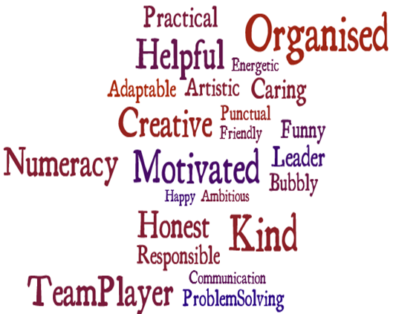
What is the difference between a Skill and a Quality? A Skill is something you can do. A Quality is something you are.

Slide 7
Transferable Skills
What are Transferable skills?
They are skills that you currently use, which can also be used in a job or a different job.
So they are transferable.
Think about the different skills you use in everyday life.
Think about the skills you use in your hobbies.
Can any of these skills be transferred to a job?

Slide 8
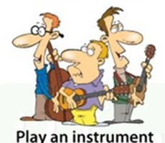
Can you think of any skills or qualities these activities would demonstrate?

Slide 9
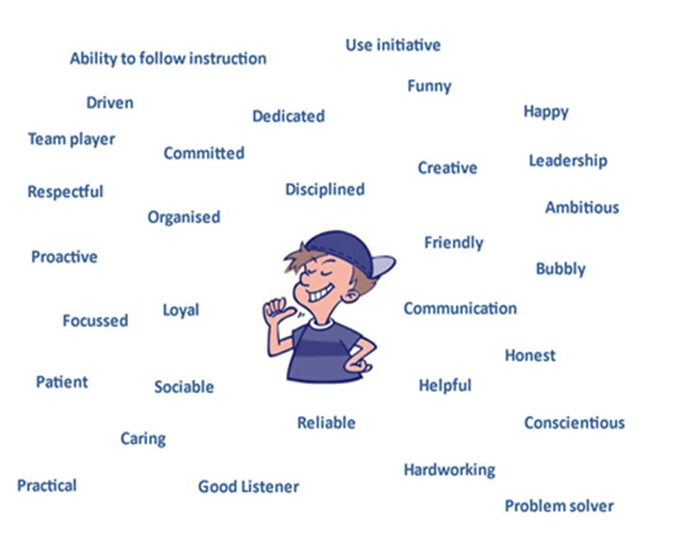
Activity- Make a List of Your Own Skills and Qualities

Slide 10
Can you think of any activities that can help increase your skills and qualities?
Sports
Volunteering
Helping-out around your home
Helping-out in the garden
Helping friends and family with things like childcare or cleaning
Free online and community courses

Slide 11
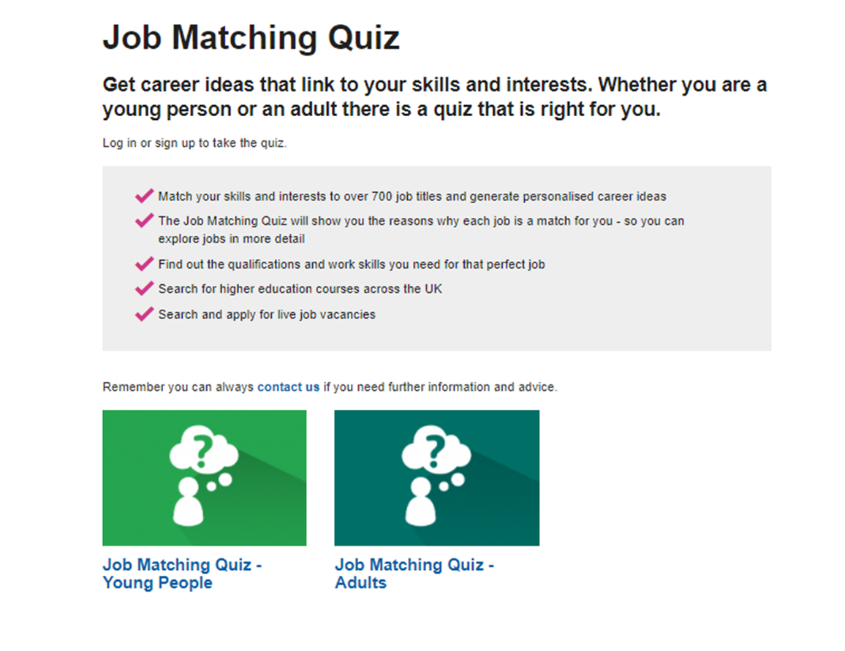
Careers Wales | Careers Wales (gov.wales)

Slide 12
Cefnogaeth ar ôl colli swydd
Stori Ellie / Ellie's story

Slide 13
Any Questions
Pop them into chat or raise your hand

Slide 14
Cefnogaeth ar ôl colli swydd
Sut i gysylltu ni/ How How to find us?
0800 0284844
https://workingwales.gov.wales/
post@workingwales.gov.wales
Careers Centres

Slide 15
Cymru’n Gweithio
Working Wales
0800 0284844

