Slide 1
What to expect from an interview and how to respond to interview questions.
Joe Powell, Chief Executive
All Wales People First

Slide 2
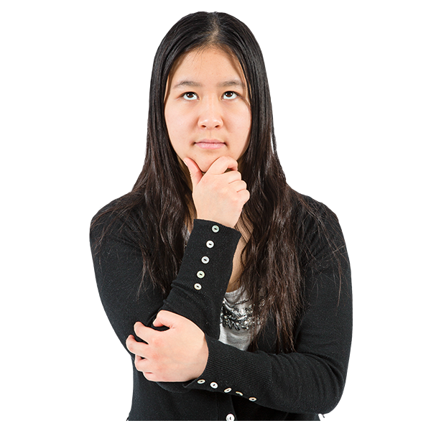
How to get an interview?
Read the person spec
Match the person spec with the application form
Read about the organisation

Slide 3
What to expect at an interview?
An interview panel
Questions
Activity (sometimes)
To be scored

Slide 4
What is an interview?
‘A formal meeting in which an applicant is asked questions to determine their suitability to do the job.’
(OED Definition)

Slide 5
You can do the job
That you understand the job
That you are right for the organisation
‘What are the interview panel looking for?’
That you are reliable

Slide 6
Making a good impression?
Body language
Be friendly and polite
Good appearance
Think about small talk

Slide 7
Making a good impression?
Show respect
Give good answers
Ask good questions
Be on time

Slide 8
How do you give good answers?
You need to guess what they may ask in advance?
What are the usual questions?
What might they ask you about their organization?

Slide 9
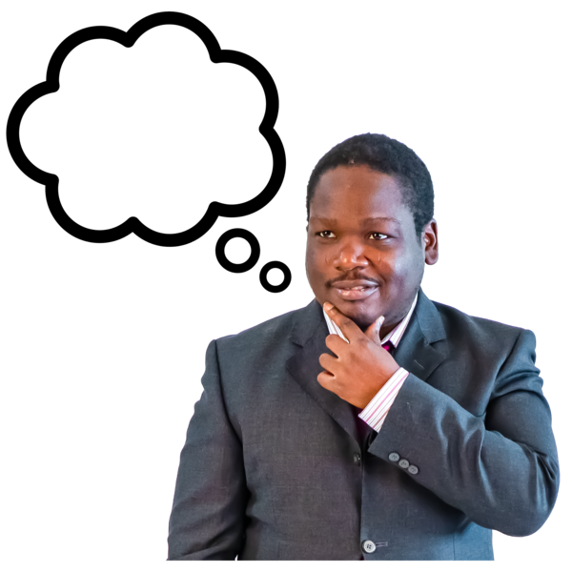
The usual questions?
Tell me about yourself?
Why do you want to work here?
What do you know about our organisation?
What are your strengths?

Slide 10
The usual questions?
What are your weaknesses?
What is your experience?
What would you bring to this role?
Can you work as a member of a team?

Slide 11
Tell me about yourself?
They don’t want to hear about your hobbies
They want to hear about how you work
Use of power words
Hard working, enthusiastic, dedicated etc.

Slide 12
Why do you want to work here?
They need to see your passion
Show your values meet their own.

Slide 13
Behavioural questions?
“Tell me about a time when……….”
“Describe a situation where…..”

Slide 14
S.T.A.R
Situation
Task
Action
Result

Slide 15
Can you give an example of a time you worked as a member of a team?
Situation (We were short staffed at the office and there was an increase in the workload)
Task (We had to make sure the work met the deadline)
Action (We split the work up between us)
Result (The task was completed on time)

Slide 16
How to answer interview questions
What might they ask about their organization?

Slide 17
“All Wales People First is the united voice of self-advocacy groups and all people with learning disabilities in Wales. It shares knowledge and information to achieve equal rights and a positive image.”
All Wales People First – Mission Statement

Slide 18
“All Wales People First is the united voice of self-advocacy groups and all people with learning disabilities in Wales. It shares knowledge and information to achieve equal rights and a positive image.”
All Wales People First – Mission Statement

Slide 19
What might they ask about All Wales People First?
Person spec, job description, Business Plan, political manifesto
What is the National Council?
What does being member-led mean?
Can you do Easy Read?
What is co-production?

Slide 20
What might they ask about All Wales People First?
Person spec, job description, Business Plan, political manifesto
What is the National Council?
What does being member-led mean?
Can you do Easy Read?
What is co-production?

Slide 21
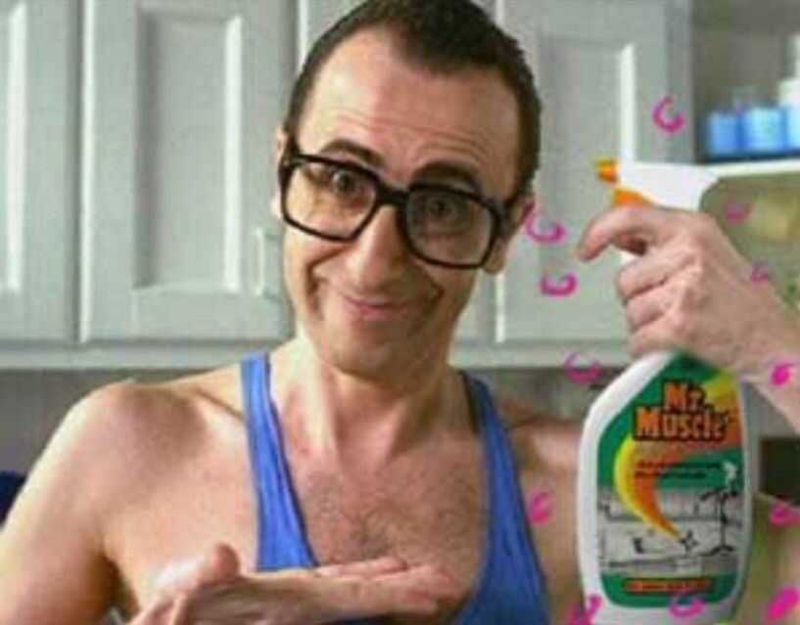
What are your weaknesses?
Everyone has a weakness.
Make sure the weakness isn’t an important part of the job.
Follow the weakness with a positive.

Slide 22
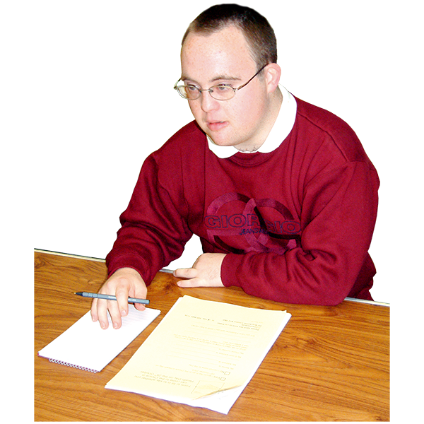
Do you have any questions for me?
Why do you like working here?
How will my work be evaluated?

Slide 23
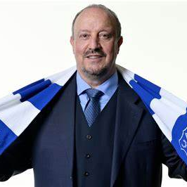
How to conquer nerves
Prepare and practice

Slide 24
Joe’s tip (1) Make a quiz – go over and over it
It will make it much easier for you to answer the questions on the day and will reduce your nerves.

Slide 25
A quiz example
Q: Why do you want to work for All Wales People First?
A: I believe in the aims and the values of the organisation. Having lived in learning disability care homes for eleven years I have personal experience in the issues the members face on a daily basis. I believe self-advocacy is the best form of advocacy and that everyone should be empowered to speak up for themselves………..
Q: Why are you right for this role?
A: As someone who has lived for many years in the care system I have first hand experience in the issues that affect our members. I have extensive experience of ………….

Slide 26
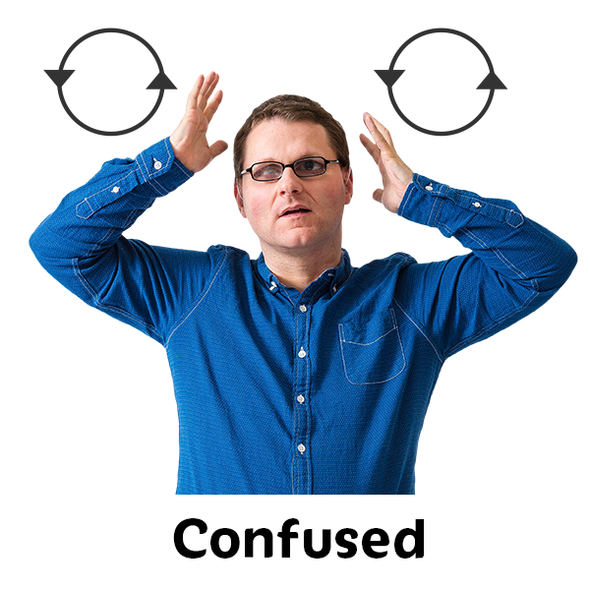
Joe’s tip (2) Don’t ever wing it
You will just
make yourself more nervous

Slide 27
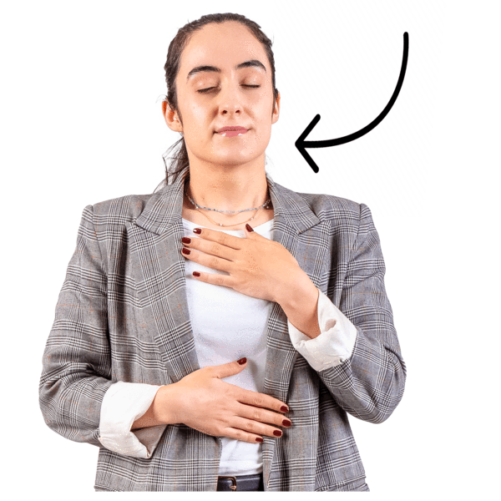
Joe’s tip (3)
Que sera sera

Slide 28
Reasonable Adjustments
Application forms should have guidance to explain what they want from you
and a section for reasonable adjustments.’

Slide 29
Reasonable Adjustments
Remember the word is ‘reasonable’
Disclosure – eye contact
Accessible information – Easy Read
Bring in support to the interview

Slide 30
Reasonable Adjustments
Autism and body language.
No abstract questions.
Ask for a phone interview.
Or a Zoom interview.

Slide 31
Reasonable Adjustments
Ask for interview questions 2 days before the interview
Ask for clear information
Map to the venue
Clear instructions of what to do when you get to the interview

Slide 32
Reasonable Adjustments
Who you will meet when you get there
Clear instructions of what to do when you get to the interview

Slide 33
Reasonable Adjustments
Be told who will be on the panel with pictures.
Ask to meet the panel before the interview
Ask for help to move on if question answered or going off topic
Ask for prompts – as aid memoir

Slide 34
Reasonable Adjustments
Travel expenses
Extended application deadlines
Reduction in panel numbers
Written confirmation of any plans not written down

Slide 35
Helpful links
Some helpful video links to advice on answering interview questions.
Top seven interview questions and answers
TOP 7 Interview Questions and Answers (PASS GUARANTEED!) - YouTube
How to answer ‘Tell me about yourself.
How to Answer: Tell Me About Yourself. - YouTube

Slide 36
Helpful links
Seven most difficult interview questions and answers
7 MOST DIFFICULT Interview Questions & ANSWERS! (PASS GUARANTEED!) - YouTube
10 things you should never say in an interview
10 Things to Never Say in an Interview | Interview Tips - YouTube

