Slide 1
An introduction to Autism

Slide 2
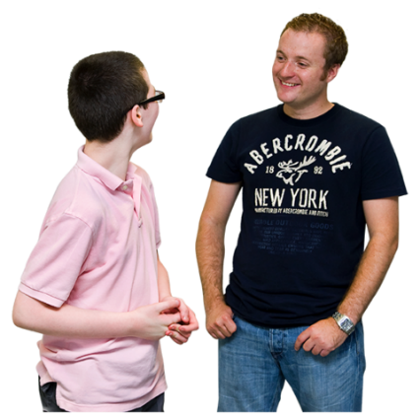
What is Autism?
Autism is a hidden disability. A hidden disability is a disability that you can’t see.
Some Autistic people carry something with this pattern on it. Like on a wristband, card or mobile phone.
The pattern means they have Autism and they want you to know. They might need you to support them. For more information, go to our website page Can You See Me

Slide 3
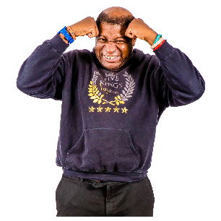
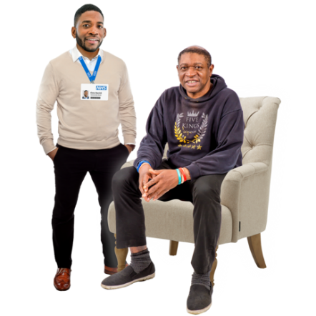
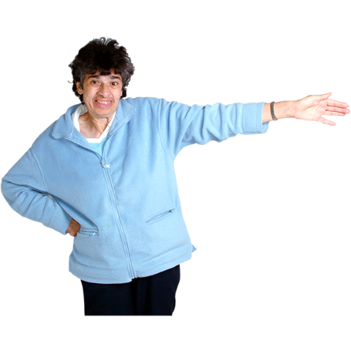
What is Autism?
Sometimes Autistic people find it hard using services. Like leisure facilities or community activities.
If everyone understands Autism better, it makes life much easier for the Autistic person.
This presentation is about Autism and how you can help Autistic people.

Slide 4
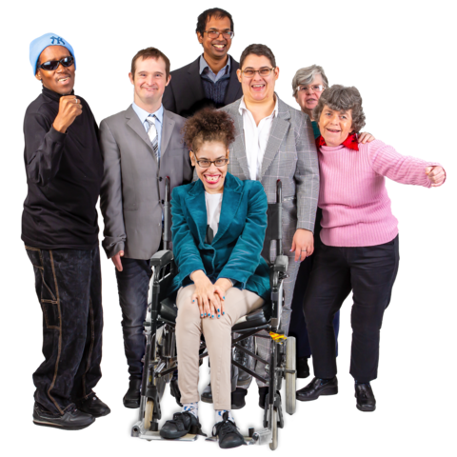
What is Autism?
Autism is also known by other names, including:
Autism Spectrum Disorder (ASD)
Autistic Spectrum Condition (ASC)
Asperger’s Syndrome
Pervasive Developmental Disorder

Slide 5
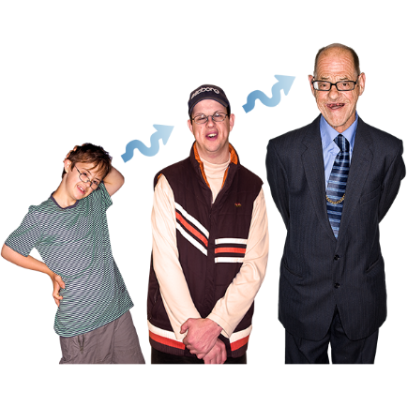
What is Autism?
Anyone can be born with Autism. If someone has Autism, they have it their whole life.
More men than women are diagnosed with Autism. Diagnosed means a health professional has checked things like your behaviours and health and has said you have Autism.
Lots of people who are Autistic don’t know they are Autistic. Especially adults. 1 in every 100 people in the UK have Autism

Slide 6
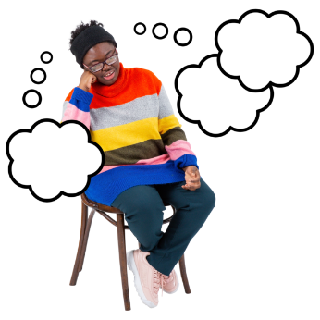
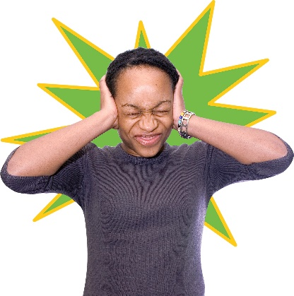
What is Autism?
Autistic people are different from other people in
certain ways:
The way they talk, listen and understand things
The way they socialise
The activities they like to do and how they like to do them
The way they think
How much they like things like touch, light and sound

Slide 7
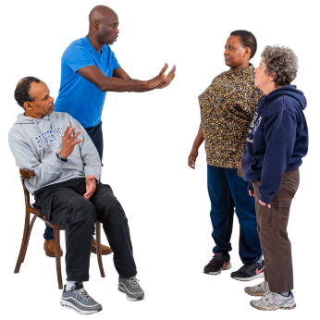
Being sociable
Autistic people can be different from other people in social situations.
Some Autistic people can be different in the way they use and understand:
speech
language
tone of voice
gestures
eye contact

Slide 8
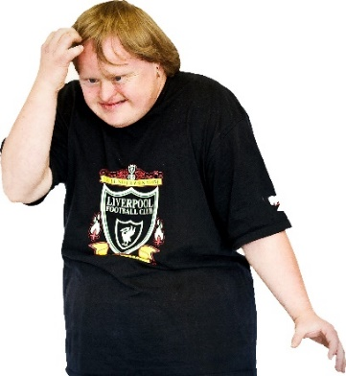
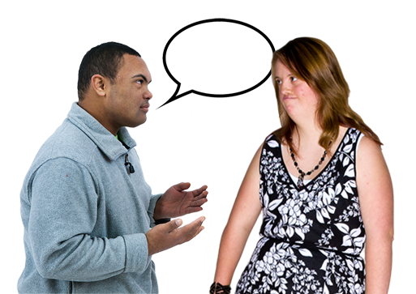
Being sociable
Being in social situations can be hard for Autistic people.
Things they can find hard are:
using and understanding gestures
understanding body language
making eye contact
speaking in a way other people understand
Autistic people find it easier if people just say exactly what they mean.

Slide 9
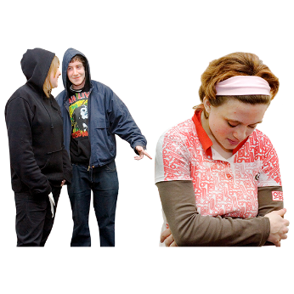
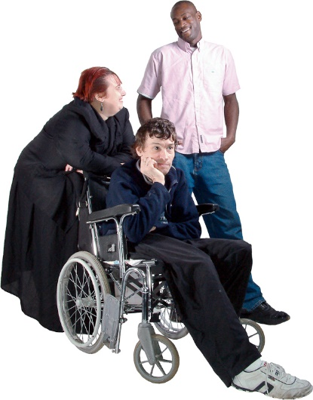
Being sociable
In social situations, some autistic people find the following things hard:
meeting new people and making new friends
having a conversation
understanding humour
showing they care about someone

Slide 10
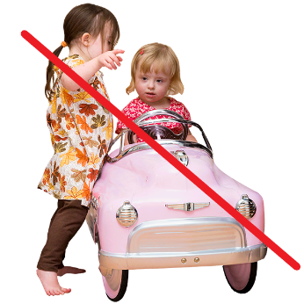
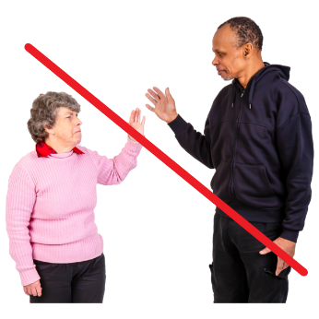
Being sociable
In day to day life, Autistic people might find the following things hard:
playing, taking turns and sharing things
having to be polite instead of being honest
knowing how to build friendships and relationships
understanding when to end a conversation

Slide 11
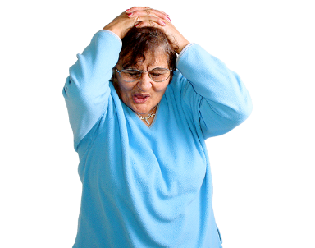
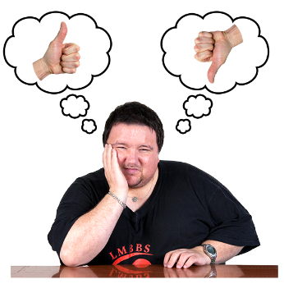
Thinking and using imagination
Autistic people think and use their imagination in different ways to other people.
Some Autistic people find the following things hard:
dealing with unexpected changes
making plans
thinking into the future
fixing problems

Slide 12
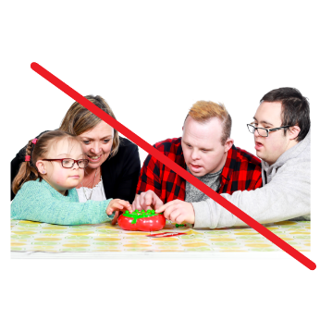
Thinking and using imagination
In day to day life, autistic people might find the following things hard:
playing games with lots of unwritten rules and pretend play
understanding how things might work out
understanding how other people might think or feel
changes to routines and plans

Slide 13
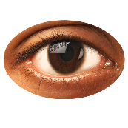
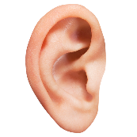
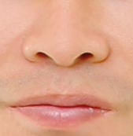
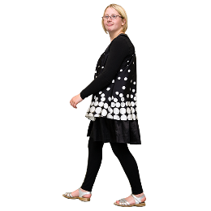
The senses
Our senses are:
touch
sight
sound
taste and smell
how we move and hold our bodies

Slide 14
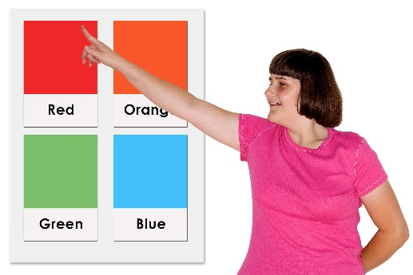
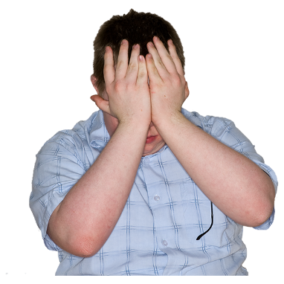
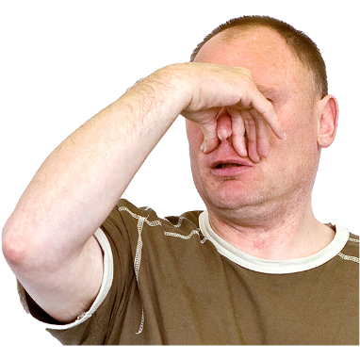
The senses
Some Autistic people feel their senses much stronger than other people.
In day to day life, autistic people might:
love certain colours
feel less pain than other people
find bright lights uncomfortable
get stressed in noisy and/or busy places
hate certain smells
Use behaviours like hand flapping, rocking using an object to get sensory pleasure – a nice feeling.

Slide 15
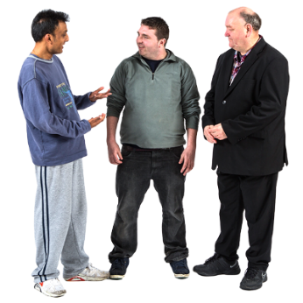
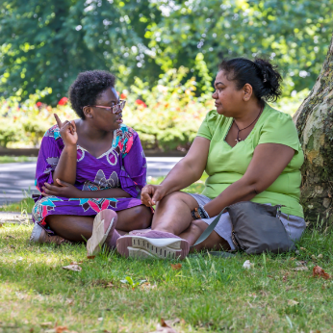
How you can help
Learn more about Autistic people and be supportive.
Ask Autistic people how you can help them.
Think about how you can make an Autistic person more comfortable. Like talking somewhere quiet.
Change the way you talk to Autistic people so they can understand better.

Slide 16
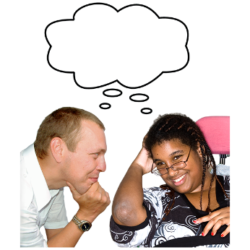
How you can help
The best ways to talk to Autistic people:
don’t expect autistic people to understand hand gestures or tone of voice
speak slowly and clearly
keep it short
say what you mean
give autistic people time to think about what you say

Slide 17
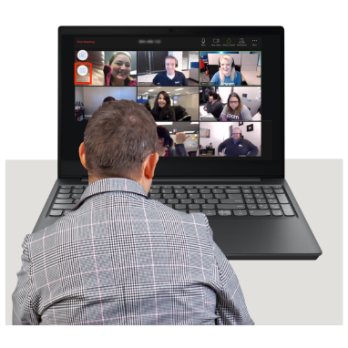
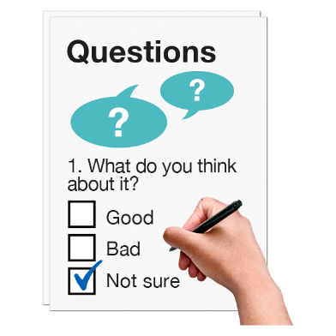
More information
Go to our website: autismwales.org/en/parents-carers/what-is-autism/
Watch the film What Is Autism?
Complete the questionnaire
Get your Autism Awareness Certificate

Slide 18
More information
Apply to become an Autism Aware organisation.
For more information about becoming and Autism Aware organisation, visit our website:
https://autismwales.org/en/education/

Slide 19
More information
For more information on the signs of Autism, go to our website:
AutismWales.org/en/community-services/i-work-with-children-in-health-social-care/the-birthday-party/
AutismWales.org/en/community-services/i-work-with-young-people-adults-in-health-social-care/clinicians-toolkit-adults/

Slide 20
More information
For more information and resources go to our website.
Or email: AutismWales@WLGA.gov.uk
Or visit our social media page:
AutismWales
@AutismWales

