Slide 1
Autism and Family Dynamics
20th March 2024

Slide 2
Programme
Accommodating autism at home
Friendships
Intense emotions
Passionate interests
Stages of autism through the lifespan
Effects on the family of having several autistic children
A mother or father with autistic characteristics
Sibling rivalry

Slide 3
Prevalence of Autism
Centers for Disease Control and Prevention
One in 36 8-year-old children are autistic
Male: Female ratio 4:1
However, the adult ratio is 2:1
Prevalence excludes those diagnosed as teenagers and adults
59% IQ in the normal range

Slide 4
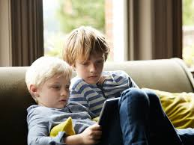
Recurrence Rates
Brian et al Autism 2016, Vol. 20(7) 888-892
Older sibling diagnosed with ASD
Recurrence rate for a subsequent sibling at age 9 years
35%

Slide 5
Parents Occupation
Dickerson: Research in ASD 8:9
Fathers in technical fields more likely to have an ASD child
Engineering: Twice as likely
Finance: Four times
Health care (medical): six times
Higher risk of severe autism if both parents are in technical fields

Slide 6
Parental Mood Disorders
Schnabel et al (2020) Autism 24 26-40
Meta-analysis of studies
33% had anxiety disorders
31% had depressive disorders
No significant difference between mothers and fathers

Slide 7
Accommodating Autism at School: Camouflaging
Observing, analysing and imitating
Learning social and friendship rules
Supress autistic characteristics and avoid being rejected and bullied
Surface sociability but a lack of social identity
Socializing is a source of anxiety and stress
Inconspicuous at school, so autistic burnout is not noticed

Slide 8

The Mask
Emily masks in public and will meltdown the second she is out of the situation.
Dr Jekyll and Mr Hyde
I can dance. I can dance with anyone who wants to dance with me, but it is always their choreography.
Notes:
Humiliating
Embarrassing
Set in stone

Slide 9
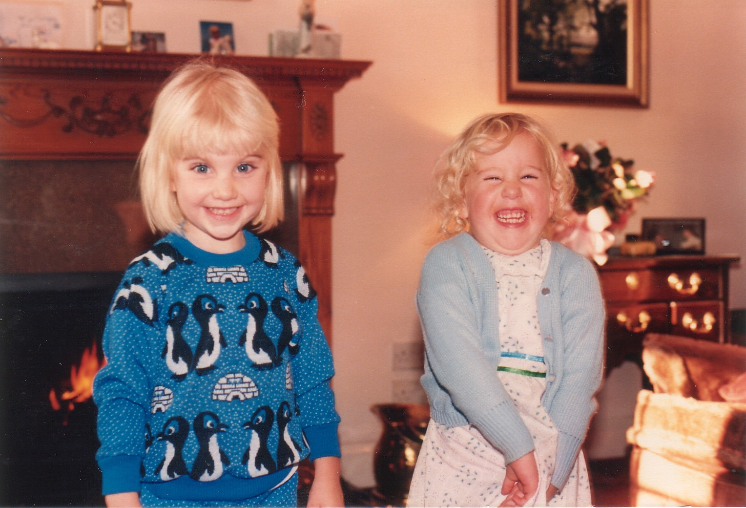
Friendship: Stage 1 3-6 Years

Slide 10
Strategies: An Adult ‘Acting’ As a Friend
Observe the natural play of the child’s peers, learn the games and rules.
Learn ‘child’ speak.
Turn taking.
Ask for help.
Video replay of social play scenes at school.
Pause button.

Slide 11

Social Stories
Sometimes children help me. They do this to be friendly. Yesterday, I missed three math problems. Amy put her arm around me and said, “ It’s okay, Juanita.” She was trying to help me feel better. On my first day at school, Billy showed me my desk. That was helpful. Children have helped me in other ways. Here is my list:
I will try to say, “thank you” When children help me.

Slide 12

Two-Person Hugs
Sometimes two people hug one another. It’s a two-person hug when both people hug at the same time.
A two-person hug often means hello or goodbye.
Sometimes, people use two-person hugs to share their feelings. These hugs may mean, I love you, We are both happy, or We are both sad
When two people hug each other at the same time, they often:
Stand close facing each other
Wrap one or two arms around the other person
Squeeze a little but not a lot
The hug ends when either person begins to relax their arms

Slide 13
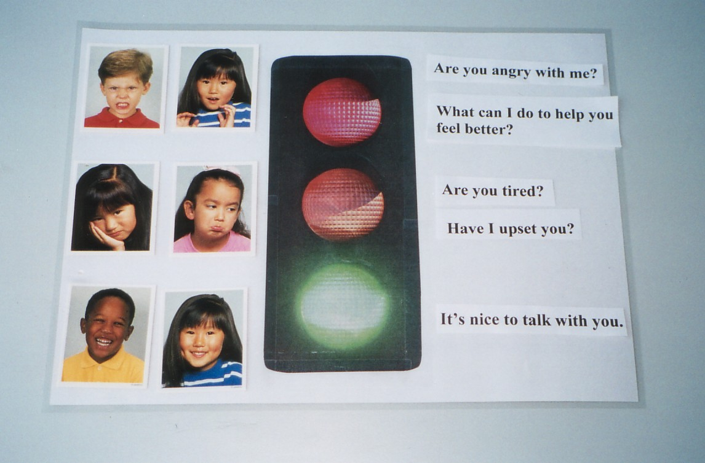
Stage 2 6-9 Years
Social Signals
Road signs: Traffic lights

Slide 14
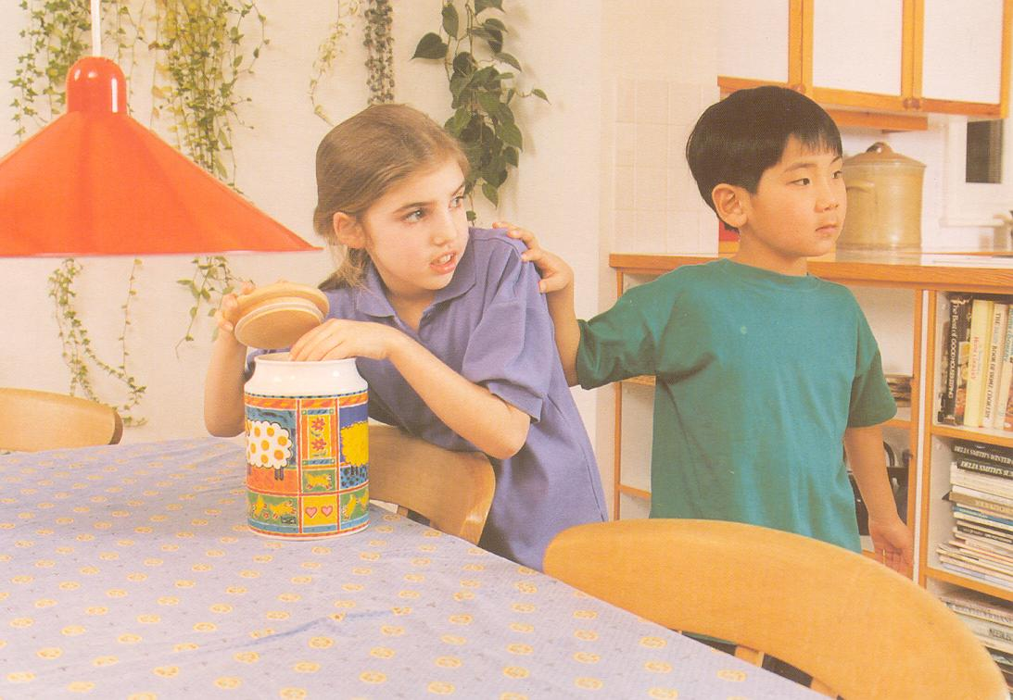
Ability to Attribute Social Meaning
Noticing objects and facts rather than thoughts, feelings and intentions.

Slide 15
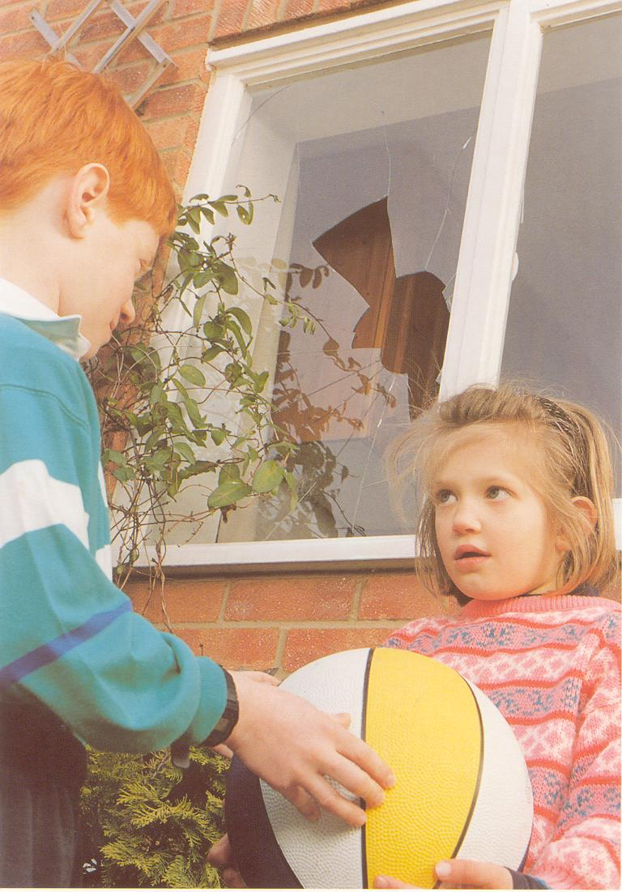
Descriptions of pictures and events may not include thoughts and feelings.

Slide 16
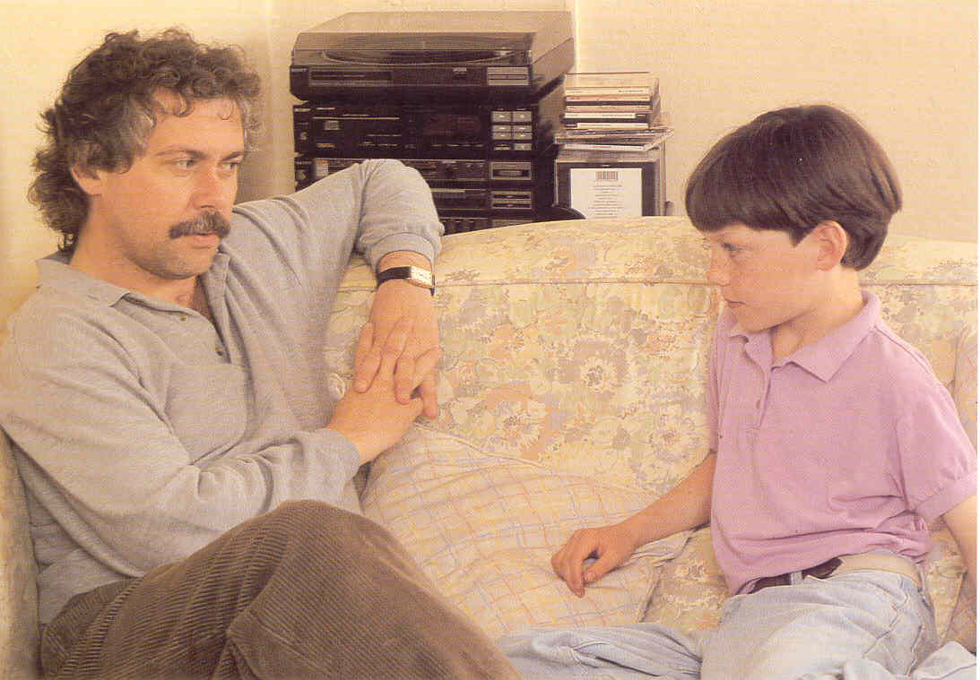

Slide 17
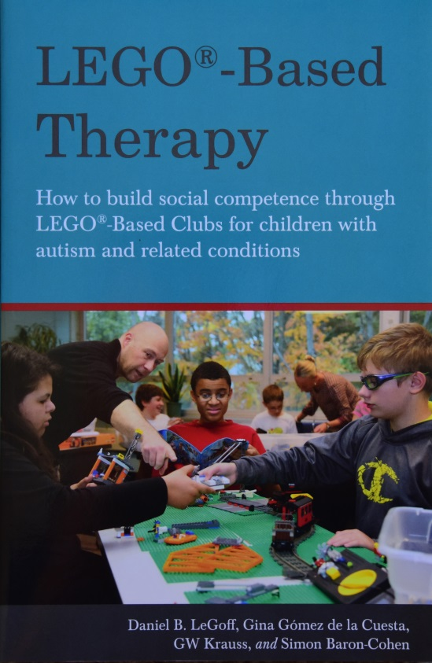
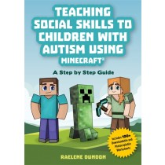
Friendship Opportunities
Develop friendships through the special interest
Lunch and after school clubs based on special interests such a movie trivia, computer games
Lego Therapy and Minecraft

Slide 18
Stage 3: Friendships
Social ability gap with peers increases with each grade
Less able to rely on intuition , must rely more on cognitive abilities to process social situation
Peer interactions confusing, overwhelming and sometimes aversive
Experience bullying, teasing, rejection and humiliation
Not having a friend to repair or refute derogatory comments and restore a sense of trust
Difficulty in friendship situations that have not been seen before or rehearsed
Criticized by peers for making a simple social error

Slide 19
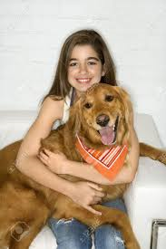
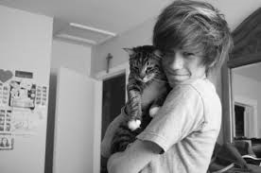

Animals as friends
Internet friends

Slide 20
Stage 4 Friendships Age 13+
Recognition of not being popular
I wasn’t rejected but did not feel completely included
I was supported and tolerated but not liked
Blame themselves or being autistic for peer rejection
Affects self-esteem, self-identity, mood and perception of autism

Slide 21
Autistic Friendships
Anxious about making a social mistake
I live in constant fear of performance anxiety over day-to-day social encounters
Before falling asleep reviewing the social experiences of school – ruminating on social performance
Conscious retreat into solitude
I’d rather just be alone, but I can’t handle the loneliness

Slide 22
Autistic Friendships
Yearning for a sense of connection
Experience rejection from popular friendship groups
Accepted by marginalized teenagers that engage in activities and interests that cause concern for parents
Alcohol and drug use, eating disorders
The group ‘adopt’ the autistic teenager
A new intense interest in information valued by the group

Slide 23
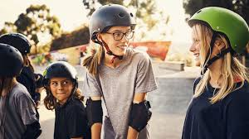
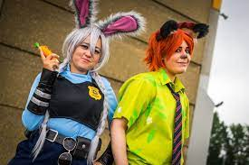
Friendship Encouragement
An autistic friend
Find each other on the periphery of social activities
Similar interest groups such as robotics, computer programming, science projects, playing music and singing together
Sitting beside each other, drawing
Comic Book, Cosplay and fan conventions

Slide 24
Friendship Activities for Parents
Puzzling Peers
Peers congregating and talking about nothing of substance or about boys
Someone talking about her experiences and opinions and thinking that I (and others) would be interested
Awkward situations
You walk into class late and everyone turns to look at you
A friend says “I’m so fat” and looks at you for a comment, probably anticipating a ‘white lie’

Slide 25
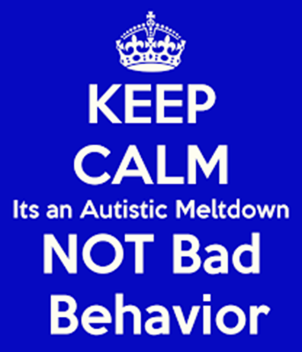
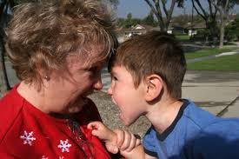

Meltdowns
Two types of meltdown
Outward directed and ‘blind rage’, try to strike out and destruction Explosion
Inward directed, despondent, a depression ‘attack’ Implosion

Slide 26
Managing a Meltdown
Do
Stay calm
Affirm and validate the child’s emotion
One person dealing with the situation
Confirm the feeling will go
Keep other people away
Minimal speech
Special interest as an ‘off switch’
Seek a safe place for solitude
Not Do
Interrogation
Focus on punishment and consequences
When I’m upset, the last thing I want to do is talk to someone
I can hear but my brain can’t process what people say
Try not to jolly up or use comfort and affection
Human comfort has always been a mystery

Slide 27
Special Interests (Passions)
Thought blocker anxiety
Knowledge overcomes Fear (Liliana and spiders)
Source of pleasure (superior to interpersonal pleasures, - addiction?)
Means of relaxation calming
Source of friendship
Explore an emotion or experiences watching movies with a related theme

Slide 28
Special Interests
Attempt to achieve coherence Putting things in order, categorizing
Understand the physical world Science and the natural world (psychology)
Comforting Certainty of facts and information
Create an alternative world from dinosaurs to science fiction and fantasy worlds in literature and Internet role-playing games
Sense of identity The interest defines who you are, being proud of achievements, Superheroes (Harry Potter) and respect

Slide 29
The Stages of Autism Through the Lifespan: Puberty and Adolescence
Anxiety (all types)
Depression
Eating disorder
Situational mutism
Self-harm
Borderline Personality Disorder
Gender Dysphoria

Slide 30
Autistic Adult Well-Being: Maja Toudal Survey
To not be disturbed
Not having to act a certain way just because it is supposedly normal or appropriate
Having my own place to hide
Being able to express and be understood
Being able to excel in what you love to do

Slide 31
Autistic Well-Being: Maja Toudal Survey
Space to pursue interests/hobbies
Daily engagement with special interests
Freedom from excess sensory pain/disturbance
Having a purpose in life
Accepting my autism and working with it to create harmony in my life instead of difficulties

Slide 32
Ageing and Autism
Research conducted by Berthine Ommensen
Ten mature autistic adults
Mean age 63.3 years
Intensive interviews
Analysis identified four overlapping themes
Autistic identity
Emotional regulation
Social instinct
Positive outlook

Slide 33
Ageing: Emotional Regulation
Anxiety and depression
Recovery from depression was slow and lengthy
Experienced mental health problems since their teenage years, but not understanding what they were going through
7/10 reported that as they had grown older, they had experienced an improvement in their mental health
Stress of work and working for a boss who has no ethics

Slide 34
Ageing: Emotional Regulation
Being stressed and overwhelmed by relationship difficulties, including perceived failure to meet the emotional needs of their partners
Distrust and disdain for most forms of treatment and health professionals, particularly medical doctors
Not listened to or understood
Unfairly judged or misrepresented by health professionals
They were not interested in me. They’re interested in the drugs they can sell
Aversion to medication a common theme (side effects)

Slide 35
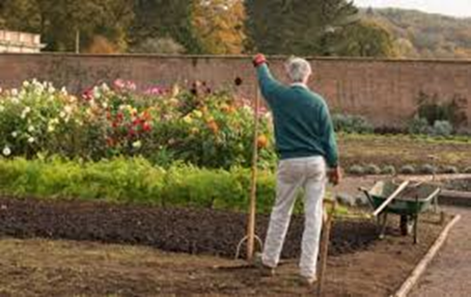
Ageing: Emotional Regulation
Coming up with strategies themselves through reading and experimentation rather than advice from health professionals
Exercise, self-talk “you can manage this”
Mindfulness, meditation, spiritual and physical activities such as gardening for emotion regulation
Enjoyed as solitary pursuits
I can be a bit kinder to myself
Stoicism, toughness and lack of self-pity

Slide 36
Ageing: Social Instinct
Feeling drained by socializing
Socializing is effortful
Remained a lifelong problem
Awkward social interactions, fraught relationships and solitariness

Slide 37
Ageing: Positive Outlook
I can look back now and cut myself a bit of slack
Being comfortable with who they are
I’ve become more accepting of myself
New rewarding activities, volunteer work, community groups, and work schedules that suit them without concern for negative judgement
No pressure to conform to society’s standards, focus on activities that bring pleasure and a sense of fulfilment
Sense of humour

Slide 38
Several Autistic Children
Different levels and profiles of autism – even in identical twins
Compatibility: Magnets that attract or repel
All need personal space
Crisis management - ‘putting out fires’
Parental exhaustion
Effect on a non-autistic child

Slide 39
Maintaining the Relationship for Parents of an Autistic Child
Sim et al (2019) Research In ASD 58, 39-51
We are in this together
1 Shared Beliefs
Acceptance
Focus on the positives
Existential meaning

Slide 40
Maintaining the Relationship for Parents of an ASD Child
2 Teamwork
Nurturing the family
Nurturing self
Nurturing the relationship
3 Shared Experiences
Communication
Humour
Emotional support

Slide 41
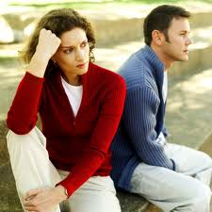
Divorce Rates
Freedman et al 2012 JADD 42:4
Media implies a divorce rate of 80%
Survey of 913 families
No evidence to suggest a greater risk of divorce
Symptom severity was not a factor
There was lower marital satisfaction

Slide 42
Being an Autistic Mother
Pohl et al (2020) Molecular Autism 11:3
355 autistic mothers, 132 control
More likely to:
Experience both prenatal and postnatal depression (60% had postpartum depression)
Feel the birth had not been adequately explained to them
Find motherhood as an isolating experience

Slide 43
Being an Autistic Mother
Feel that their parenting was being judged
Unable to ask for support when they needed it
Report they were not coping
More concerned about
Multi-tasking demands of parenting and domestic responsibilities

Slide 44
Being an Autistic Mother
Creating socializing opportunities for their child
Felt they should be offered extra support because of their diagnosis
Difficulty communicating with professionals about their child
Greater anxiety when needing to interact with a professional
Feel misunderstood by professionals, which could result in conflict
Equally able to:
Prioritize their child’s needs above their own
Seek opportunities to boost their child’s self-confidence

Slide 45
Clinical Experience: Support group for NT children
Qualities of an Autistic parent
Helping with homework but pedantic and long winded
Practical and he helps us with fixing things
He is very good in emergency situations
Great memory for facts and information
He took up windsurfing and practiced till he could sail perfectly
He is a great inventor, only he has ideas but they don’t go anywhere

Slide 46
Issues for the Autistic parent
Understanding natural childhood abilities and behaviour.
The role and responsibilities of being a parent.
Wants the children to succeed but using criticism not compliments.
Discipline- marital conflict
Not understanding why children need so many friends

Slide 47

Siblings
Conflict resolution (alternative perspective)
Sabotage programmes
Could feel neglected, having to be well behaved, not wanting to burden a parent with their problems
Autistic child’s jealousy for social siblings

Slide 48
www.attwoodandgarnettevents.com
25 Online courses that can be downloaded and available for up to 60 days on:
Friendships
Emotion management
Relationships
Autistic burnout
Autism and ADHD
PDA
Autistic girls and women
Employment

