Slide 1


Neurodivergence and Advocating for your Child or Young Person
Ceri Reed
April 2024

Slide 2

Introduction
Parents Voices in Wales CIC – social enterprise company
Established in 2018, disconnect between families, education and services
Advocating for families : neurodivergent conditions and/or mental health
Online community – safe space for parents/carers
In person adult and parent/carer in person groups Cwmbran, Newport, Bridgend, Cardiff – public social media pages
Work across the whole system to improve outcomes ie schools, school consortia, Welsh Government and Health Boards
We aim to support the early help and enhanced support of neurodivergent learners
What is Neurodiversity and Neurodivergence?

Slide 3
What is Neurodiversity & Neurodivergence?

Slide 4
What is Neurodiversity?
Neurodiversity; a paradigm of human difference
Biodiversity of plants
Neurodiversity Movement; support needs & harness strengths
Neurodivergent notable differences between strengths and challenges
The movement calls for a strengths focused approach
Identify strengths/talents; aspirations, purpose; main identity, wellbeing
1 in 5 learners have learning differences eg ADHD, Autism, Dyslexia, Dyspraxia
Medical Model, threshold to obtain a diagnosis -----> support
Neurodivergent people can 2 or more conditions – not all diagnostic levels
'Cooccurrence of conditions is the rule and not the exception' (Prof Amanda Kirby)

Slide 5
Neurodivergent or Additional Learning Needs?
1 in 5 learners think and learn differently
Majority of neurodivergent children and young people have an average to high IQ
Neurodivergence includes everyone – majority don’t have LD
More Severe/Complex Needs – ALN Register/IDP
Missing Middle not identified ie not on ALN Register
Missing Middle not meeting threshold for assessment/diagnosis
One condition diagnosed, others not
Behavioural/emotional concerns (dysregulation) eg EBSA, anxiety, depression, self harm, eating disorders, anger, risk taking behaviours
It is why we require robust needs led inclusive environments to cater for all learners
Whether they have a diagnosis or not!

Slide 6
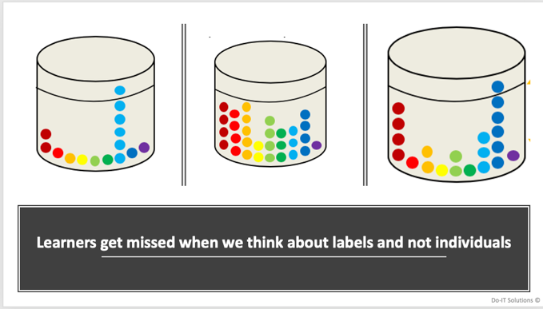

Balls in a Bucket
Prof Amanda Kirby, Do It Solutions

Slide 7
Research Evidence
Link between neurodivergence, trauma leading to mental health challenges
Neurodivergence, risk of Trauma and poor mental health (Prof Helen Minis, 2021)
  Leading to poor mental health - 'carry a heavier load'
  Accumulation of social stressors eg neurodivergence, trauma, poverty etc higher risk of poor health challenges (Prof Anita Thapar, Wolfson Centre)
Neurodivergence and low school attendance linked to poor mental health outcomes (Prof Ann John 2021)
All Wales study by Parents Voices in Wales and ADHD Foundation in 2021 65% on CAMHS waiting lists were ND/seeking assessment (900 participants)
Important to reduce the load of these learners by meeting needs early
It takes a village ie whole system : ALN Reform and Whole School Approach
Working closely with inreach teams from camhs, early help services, third sector
Emotional, Social and Educational Needs
Estyn highlights the need for collaboration with parents and carers

Slide 8
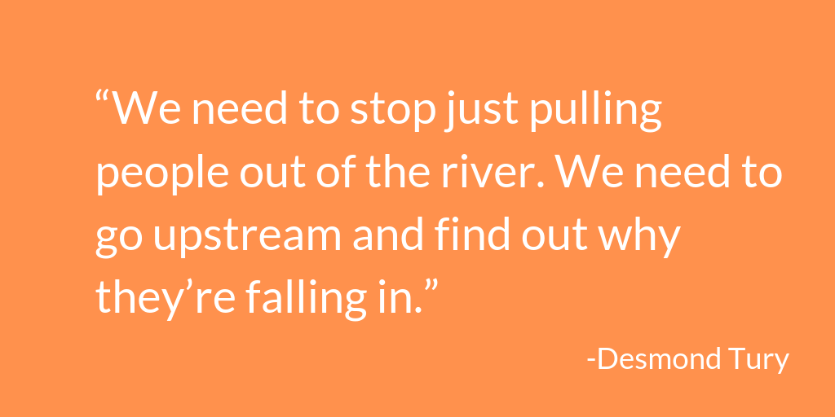
Justification for Needs Led Approach

Slide 9
What is a Needs Led Approach?
United Nations Convention on the Rights of the Child

Slide 10
A Needs Led Approach
Culture of a school – relational, trauma informed and inclusive approaches
Understanding on neurodivergence and what needs led looks like in practice
Universal Support – all learners and supports common presentations
  All adults to coregulate
  Grounding to aid regulation on transition to classroom
  Overview of lesson, recap and consolidation
  time management – break down tasks and use of visual timers
  understanding/remembering instructions – writing on the white board
  Vocabulary lists/topic words
  Frequent movement breaks
  Access to sensory toys/doodling
  Starting/completing tasks – gentle prompts
  Support writing – mind maps/vocab lists/ipads
  Chairs/Seating for Peer support and regulation

Slide 11
Needs Led Approach
Additional Learning Provision – neurodivergent learners who require
  Does not require an IDP but can be arranged with ALNCO via TAC/F
  ALP may change depending on needs/presentation - flexibility
  Shared access to classroom support Teaching Assistant
  Access to assistive technology for dyslexia/dysgraphia/dyspraxia
  Additional study sessions/small group work
  Flexible start and finish times/timetable/peer mentoring
  Exit pass to allow movement breaks/sensory room for regulation
  Graduated response – if not meeting needs may progress to IDP
Individual Development Plan
  Legislative document
  Bespoke plan – multidisciplinary team
  Annual review
  Long process and requires threshold of severity
  Impact on learner/family whilst waiting for IDP

Slide 12
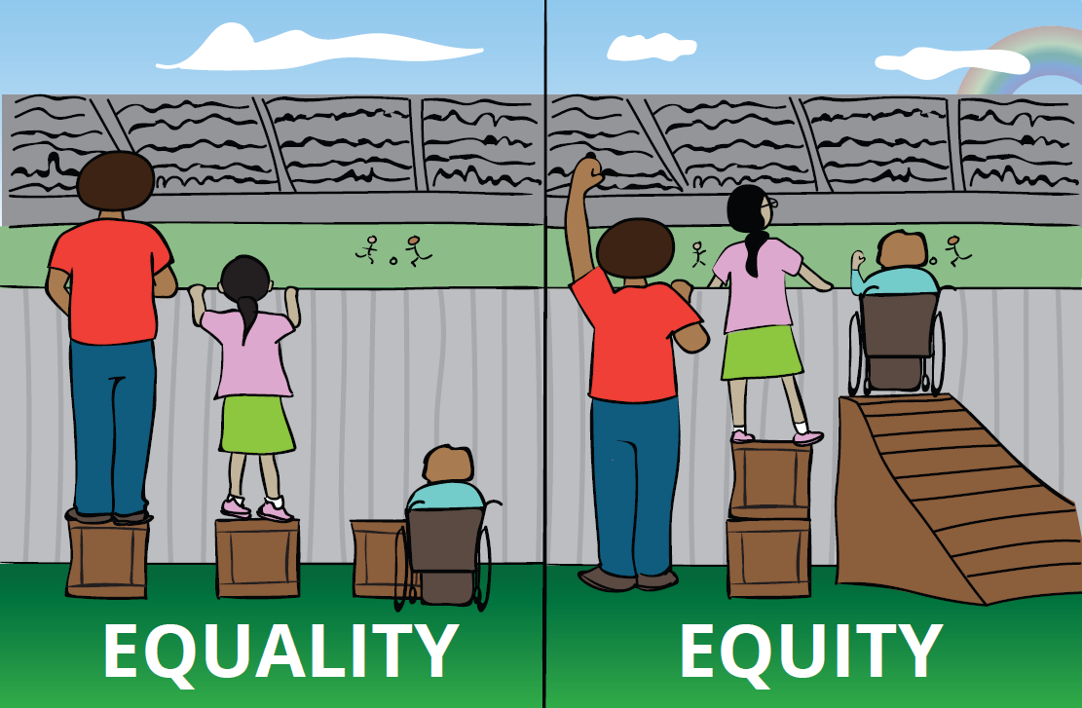
Equality and Equity
Universal Support is Equality
Additional Learning Provision is Equity
Some learners will thrive with one and some will thrive with the other
Equity meets the Rights of the Child on an individual basis

Slide 13
UNCRC
United Nations Rights of the Child (UNCRC) adopted in 1989
Legally binding agreement - protect Human Rights up to age 18 years
Welsh Government formally adopted in 2004
There are 42 Articles within the UNCRC underpinned by four core principles
  Non discrimination (Article 2)
  Best interest of the child (Article 3)
  Right to life survival and development (Article 6)
  Right to be heard (Article 12)
In Article 27 of the Rights of the Child it states that 'children and young people should be able to live in a way that helps them reach their physical, mental, spiritual, moral and social potential'
Childrens Commissioner for Wales - The Right Way and a Guide for Parents/Carers

Slide 14
UNCRC within the ALN
UNCRC is underpinning in the ALN Reform
In School – the Additional Learning Needs and Educational Tribunal (Wales) 2018 Act states that :
  Schools need to help learners as early as possible to reach their full potential based on their individual needs
  Children and families should participate in developing individual plans
  This is a legal document which stipulates that professionals must consider the Rights of the Child when they make decisions

Slide 15
Advocacy, Communication & Language

Slide 16
Why is Advocacy Important?
Children and young people cannot advocate for themselves
Trusted adults and/or parents to speak on their behalf
Children should thrive in safe and nurturing environments
Children have the Right to thrive at home and school
  Emotional wellbeing
  Social experiences
  Education and ability to learn
  Spiritual/Cultural wellbeing
  Share their views to meet their needs
Whole School Approach – a culture of shared language and understanding

Slide 17
Schools Perspective
Culture of the School
Emotional wellbeing of staff
Walk in their shoes
Number of students
Don’t assume knowledge about your child
Staffing levels/knowledge of neurodivergence and ALN?
Workplace inclusion/Whole School Approach for staff
The better the culture – positive ripple effect
They are not the experts in your child
They may not have your depth of knowledge
They are led by school policies, framed by culture
Required to work collaboratively
Quality of relationships and dialogue
Blog on PV website

Slide 18
Parent/Carer Perspective
Disparities in presentation between home and school
Relationships have been strained
Extended waiting times for CAMHS and ND services or school support/understanding
Helplessness - Parental Mental Health and Family Income
100% parents report stress/poor mental health & 76% primary care for mental health support
48% had reduced income from caring for their learner
Community Groups for Support eg online groups
You are not isolated and support in navigating help
Culture shift in Wales – NEST/NYTH Framework, Whole School Approach
Positive relationships benefit our wellbeing
Let's think about what we can do to keep communication constructive

Slide 19
Communication
Shelve the frustration!
Plan your communication
What do you need from them + need to know = support
Emotional, Social and Educational
Emails time efficient - copy in relevant
Is this urgent?
Identify your point of contact? Positive relationships?
Build on what is strong
Trusted Adult? Child's Advocate?
Do you require support?
Ask for adjustments ie appointment reminders, agendas pre meetings, inclusive communication
Consistent and safe relationships – whole school approach

Slide 20
The Power of Language
Appreciation and empathy
Respectful dynamic and keeps dialogue open
Acknowledge disparities – walk in their shoes
  'I understand that my child's presentation …...... Perhaps we could meet and discuss as I am concerned about…..'
Behaviour is not a diagnosis!
  Consider the childs needs/triggers?
  What needs to change to keep them regulated?
  Trauma informed approach
Pupil Voice – important to include this in every step
Meet the child where they are – build on the trust
Parents as collaborator and strategist

Slide 21
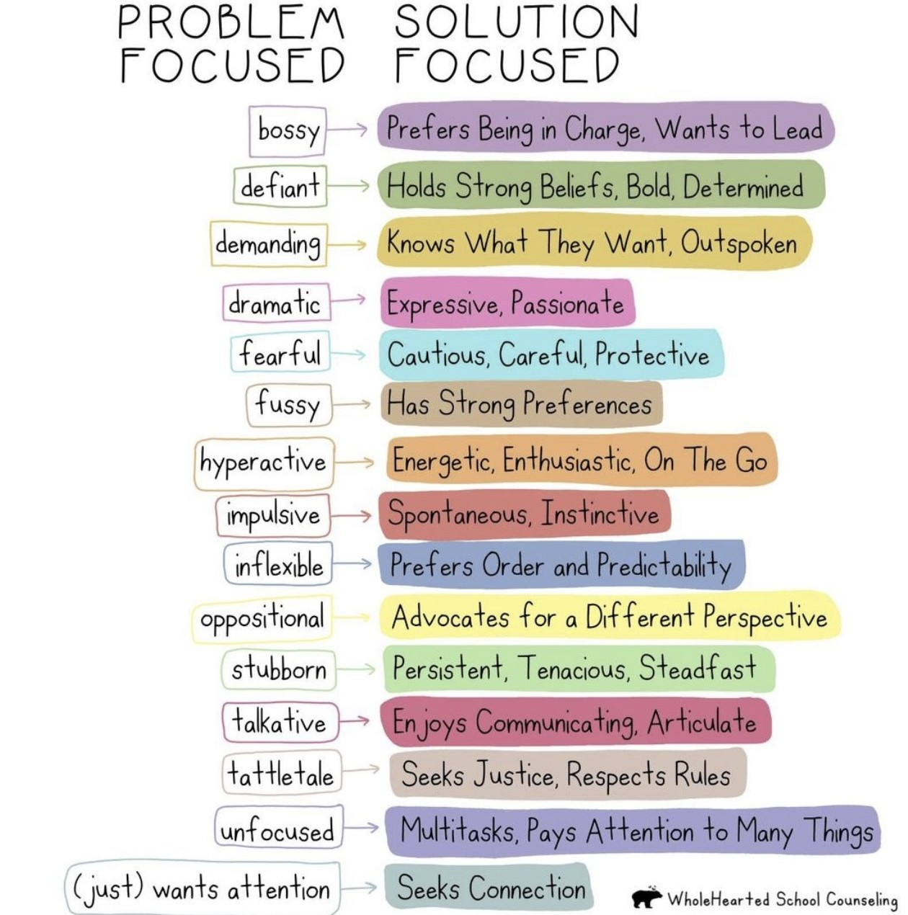
Trauma Informed Language
How do adults describe learners ?
Describe them by their strengths and needs
From home to school
'Don’t make their worst characteristic their main identity' (Dr Karen Treisman)

Slide 22

Language in an IDP
Not open to interpretation
Stipulate specifics :
Needs of the child
Name staff by role/specialism
Pupil Voice!
Details of time allocation of staff and arrangements in their absence
Days and times of interventions/therapies
Details of mode of monitoring, evaluation of outcomes and plan of action to adapt interventions
Details in advance of meetings, those attending and why
Request a note of meeting
Ask to be included in any emails, discussion with services
Pre meeting to the annual review

Slide 23
Language at Home
Avoid negative language
Validate but rationalise
Do not frame school as an unsafe place
Impact learner perception of school – ripples or waves
Demonstrate a union of support eg 'Team Child Name'
Name professionals 'Team Child Name'
Remember positive experiences/achievements
Embedding self belief …...'that was difficult for you but you did it'
Provide hope for the future – difficult periods are a journey not your final destination
Mirror neurons – model problem solving

Slide 24
Coregulation
Neurodivergence – carry a heavier load – reduces window of tolerance
Coregulation to reduce anxiety and stress at baseline
Connection before Correction or Regulate and Relate
Lower the voice, talk more softly, slowly
Consider body language – keep it open
Consider your facial expression
Think about the words you use
Model calmness
Walk away from triggering situations
Skill to be learned – home and school
Dr Pooky Knightsmith – Podcast/Webinar on Coregulation and Window of Tolerance

Slide 25
How to Advocate for Your Child
Relationships, communication, language and coregulation
Relationships + dialogue = needs led appproach
How we communicate and what we communicate will be central to process
Basic examples
  Social – peer mentoring, safe places at breaks, anti bullying intervention, toileting
  Emotional – exit pass to regulate, trusted adult, access to counselling, teach self regulation, address the worries of the child
  Educational – gentle prompting to start/stay on task, movement breaks, laptop for classwork, shared TA support
Providing solutions more helpful
SNAP Cymru/Parent Groups that can support you
Pupil Voice Resource on PV Website

Slide 26
Do's and Don’t's of Advocacy
Do...... | Do Not...
Identify your trusted person and request they be your point of contact – build on what's strong | Expect everyone in the school/service to know about your child or your situation
Work to build a positive relationship with the trusted person and show your appreciation of their efforts | Raise your voice/shout
Put important information in an email and request a follow up meeting/email | Overly chase a response – is it urgent?
Outline the issue and suggest a solution it can help frame support earlier | Telephone when upset/angry it may delay progress
Take someone with you to meetings to take notes | Go to meetings alone, take a trusted person
Ask for agenda pre meeting, who will be in attendance and ask for a copy of the notes of meeting | Waste time on past issues, make the most of the time you have in the meeting
Request Advocacy for a child or young person from a trusted person or SNAP Cymru or NYAS for cared for children Advocacy - Snap Cymru Parent Advocacy | Parent Advocacy Service | NYAS | Forget to ask for a follow up meeting to monitor outcomes of agreed interventions/support

Slide 27
Strength Focused Approach

Slide 28
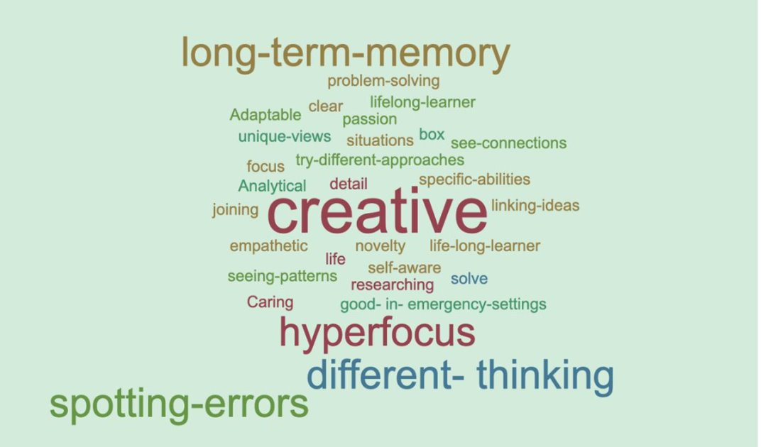
Neurodivergent Strengths

Slide 29
Strength Focused Approach
Meeting Needs and Creating Aspirations
What are they good at + What do they enjoy = Aspirations
Identify and name strengths daily
Make their strengths their main identity!
  Compassionate + Animals = Veterinary Nursing
  Energetic + Cooking = Chef
  Reading + Science = Researcher/Teacher
  Problem Solving + Maths = Accountant/Maths Teacher
  Social Justice + Socialising = Politics/Third Sector/Entrepeneur
How can strengths be used in school?
Look at Career Wales – work backwards to find their path

Slide 30
Support for Families

Slide 31
Families Experiencing EBSA
Do It Profiler – Childrens profiles, age 7 to 16 years (£25 per person)
Not diagnostic but identifies needs/strengths - provides report
Objective assessment – share with school ALNCO
Coproduce a plan for support
Small steps – child led not parent/school led
'Meet the child where they are' and build slowly
Social, Emotional and Educational Needs
Relationships with Trusted Adult important
Strengths focused approaches and coregulation important
Consistent connection leads to regulation – connection before correction
Join a parent led group to support you/signpost to information

Slide 32

Importance of Self Care
As parents/carers your wellbeing is paramount
You cannot pour from an empty cup
So you can function better you need time for you
Please make time every day fit in 5 minutes regularly
Remember children and young people mimic our behaviours so set an example of self care
Immersing yourself in your interests is good
Who can support you – you need time
Check out the Dewis Database online, the Family Information Service or your local third sector and find out what is available near you :
  Arts and Crafts
  Family Walks
  Sports and Exercise
  Wellbeing Support eg Mindfulness
The more room in your cup, the more effective the coregulation at home

Slide 33
Info/Support for Families
Families First/Family Information Service – early help for children/YP and families
WLGA Neurodivergence Team website – information/resources
Parents Voices in Wales CIC – online group/meet ups
Childrens Commissioner for Wales
  Information and Advice service - All children up to age 18
  Looked after children up to age 21 or if still in education up to age 25
  NYAS – can provide advocacy and advice for care leavers
SNAP Cymru – helpline and resources on website
Welsh Government – information and advice for parents/families on website

Slide 34
Info/Support for Families
  Action for Happiness – Family Advice to promote positive wellbeing
  ADHD Foundation Neurodiversity Charity - ALCN
  Autistic UK/National Autistic Society – website and local groups
  British Dyslexia/Dyscalculia Association
  British Dyspraxia Association – charity is closing soon
  Creative Education – Dr Pooky Knightsmith webinars/resources
  Disability Wales – Equality Act 2010 Advice and Support
  FASD Cymru – parent support group/information
  Kidscape – antibullying and helpline
  Learning Disability Wales – Equality Act 2010 Advice and Support

Slide 35
Info/Support for Families
  Mental Health UK – advice for parents and carers
  Neurodiversity Celebration Week
  Neurodiversity in Business – neurodivergent friendly companies
  PDA Society – Pathological Demand Avoidance/Opposition
  RADLD Campaign – Developmental Language Disorder
  ReachOut ASC – Lynn McCann
  Scope Charity – support with applying and finding employment
  Tourettes Action UK – Tics and Tourettes
  Witherslack and Neurodiversity Celebration Week : free webinars and resources

Slide 36
Thanks for listening!
Follow us on...
Twitter & Facebook @PCAMHS

