Slide 1
Supporting Siblings
- Emma Durman – Autside Education & Training -

Slide 2
Having a neurodivergent sibling: considerations
Being able to understand the diagnosis
Feeling different
Family unit being impacted
Potentially adjusting their life to meet siblings needs
Caring roles/responsibilities
Parents may struggle to divide time and energy equally when one or more children have complex/additional needs
Different schools, developmental trajectories, social opportunities etc.

Slide 3
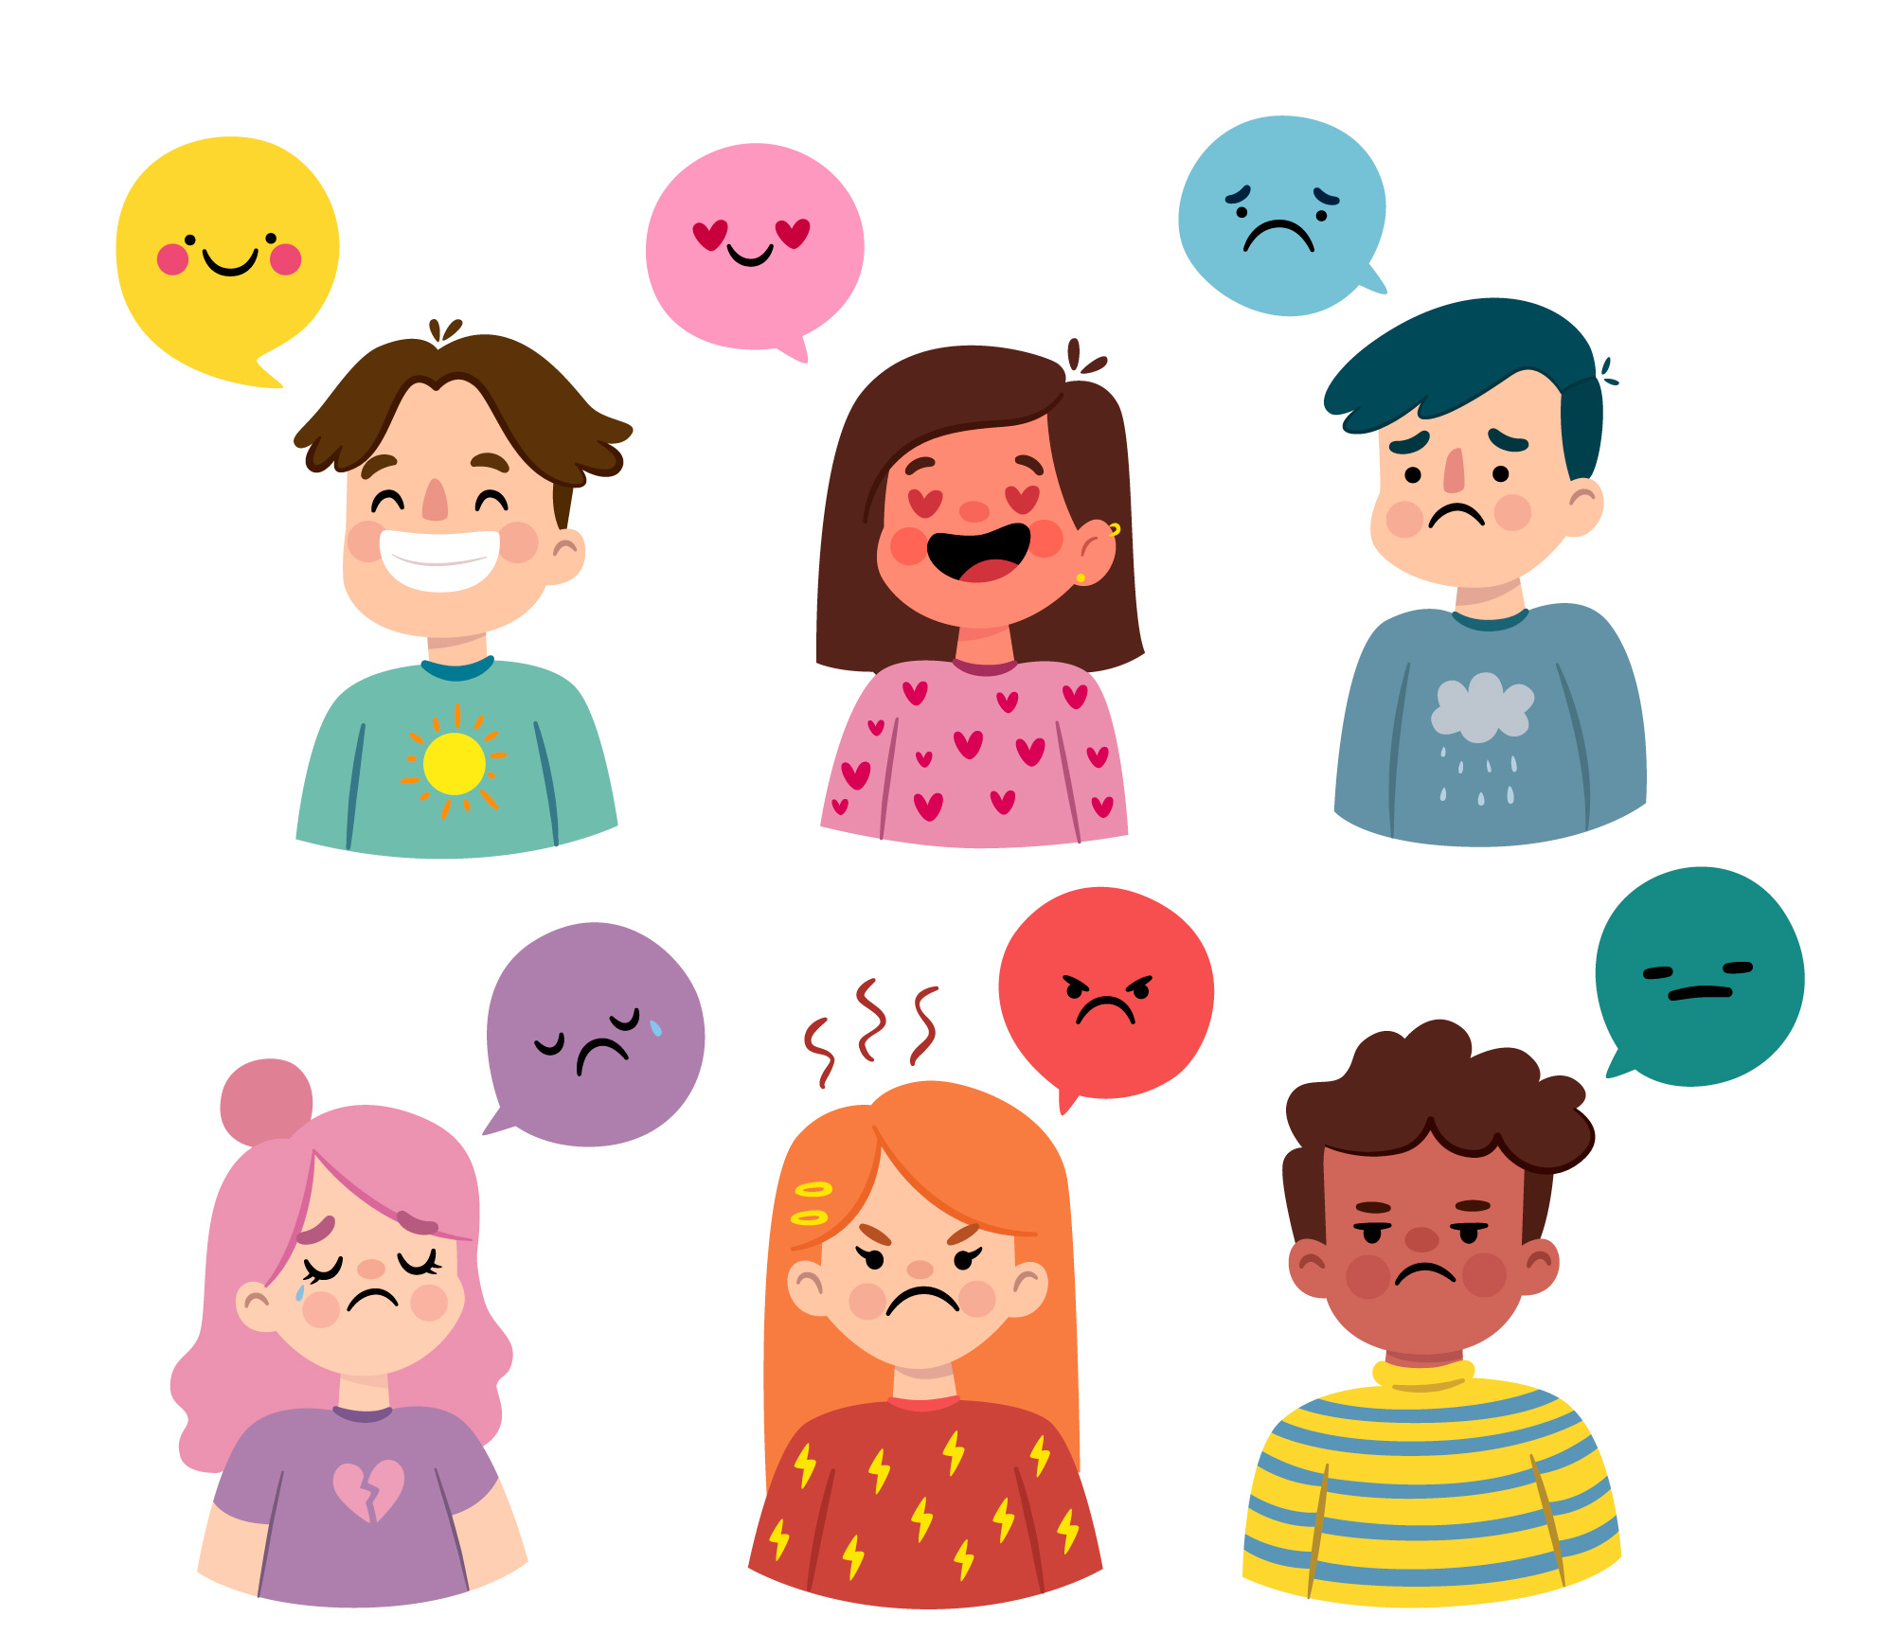
How might siblings feel?
Jealous
Scared
Proud
Angry
Loving
Protective
Guilty
Embarrassed
Lonely
Overwhelmed

Slide 4
Can this sometimes be complicated where more than one sibling has additional needs?
Conflicting sensory needs
Needing different adjustments to meet individual needs
Being triggered by each other’s needs/behaviours
Intense interests can be affected – items may be touched/moved or broken
Domino effect when overwhelmed and meltdowns affect the other sibling

Slide 5
Impact for siblings
Time
Finances
Difficult to take holidays/trips or enjoy certain activities
Friends
School
Privacy and belongings
Sleep disruption
Coping with anxiety, anger, meltdowns/shutdowns
Worries about parents and/or the future
There are positive impacts too:
Positive attributes such as empathy, compassion, kindness and patience
May be protective of their sibling and of others with disabilities
May be mature and independent
Understanding of difference
Can lead to positive career choices

Slide 6
Explaining Additional Needs
It is vital that we teach siblings about additional needs in an honest, factual way, relevant to their family member and age/developmentally appropriate
Whilst acknowledging neurodivergence can sometimes bring challenges we should also highlight the positives, reinforcing that everyone has different strengths and challenges, likes and dislikes
As parents/Carers we should be open to questions and able to validate concerns – if timing of these questions isn’t ideal we can ‘pop a pin in it’ as long as we ensure we come back to the topic at a better time

Slide 7
Explaining Additional Needs
We may not always have all the answers – and that’s ok! Be honest about that and explain you don’t know, if possible you can find out or learn more together
Everyone can experience different reactions to diagnosis – sometimes it is an emotional rollercoaster for family members including parents, siblings and the person with additional needs
Prepare yourself beforehand – think about what questions might arise and what is important for them to know at this stage
This doesn’t have to a big one-off conversation!
Drip feeding information over time is helpful, and being open throughout children’s lives will normalise the conversations…

Slide 8
Use Resources to help you!
There are lots of resources out there that can help you explain and to help siblings understand including:
Books
Leaflets
DVDs
Media representation
Internet
Advocates/others
Professional support
Other parent/carers advice

Slide 9
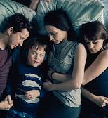
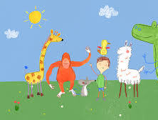
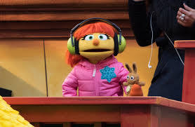
Use Resources to help you!
Even when you do not completely agree with the representation of characters and their lives on screen – they can be valuable discussion jumping off points – what do we relate to, what do we think they could have done better etc.?
The resources you use will depend on your child’s age, level of understanding and personal views.

Slide 10
Key concepts to explore
There can be lots of different questions…. Some of the questions might seem random or silly, but it is important to validate the sibling’s curiosity and worries, and explore them openly, honestly and factually
Social differences
Sensory needs
Intense interests
‘wired differently’ – brain works and develops differently
Strengths and difficulties
Equality – doesn’t always mean everyone gets the same thing – but that everyone gets what they need
Explanations of why certain things can be particularly difficult – i.e. regulating emotions, completing tasks etc.

Slide 11
Encourage ongoing discussion
Encourage sibling(s) to continue to ask questions as they arise and come to you with any new thoughts or concerns
Give them a ‘safe space’ to share their emotions and feelings, and to discuss other people’s perceptions and reactions – positive or negative
It can be useful to arm siblings with handy responses or simple explanations to questions or comments they might come across when you are not with them
Extend this discussion to any other diagnoses your child(ren) may have and the impact of these co-occurring conditions

Slide 12
Equip them with strategies for successful communication
Use their brother/sister’s name to get their attention
Speak slowly and clearly and allow processing time
Say one thing at a time/break down information into manageable chunks
Say what you mean – and mean what you say
Use visual supports

Slide 13
Protected Time and Attention
Set aside special time with sibling(s)
Prioritise events and activities that are important to them where possible
Respite - as with parents/carers, siblings can benefit from their own time and space apart from their autistic brother/sister to decompress
Encourage them to express their emotions and devote special time to this when you can focus on and engage without distraction if possible
Relaxation strategies can be helpful for siblings, things like listening to music, mindfulness, ASMR etc.
It is important to boost the sibling(s) self esteem whenever possible, and express appreciation for their support and understanding

Slide 14
Helpful Family Strategies
Visual supports/schedules/communication aids, social stories
Family rules
Clear routines with calendars etc.
Practice and promote turn taking
Space and time when needed – maybe before or after school, at bedtime etc.
Rewards/motivators
Consistency is key for many neurodivergent people – so having siblings ‘on the same page’ with household strategies and rules is beneficial

Slide 15
Being with each other
Dedicated spaces of their own, whether rooms or zones
Rewards for being kind and compassionate with each other, or for modelling good behaviour
Safely store treasured belongings
Dedicated technology items or protected time for each sibling
Encourage activities both siblings enjoy
Promote games without focus on winning/losing

Slide 16
Managing/Expressing Emotions
Create opportunities for sibling/s to talk about/express how they are feeling
Share your feelings with them too
Use books, TV shows, movies or experiences to explore feelings
Make emotional toolkits, where the whole family engages in regular emotional literacy
Focus on positives as well as challenges
Use visuals to help you with this too

Slide 17
A Meltdown/Shutdown Plan
It can be helpful to have a meltdown/shutdown plan:
where all family members have clearly defined roles – for a sibling this might be removing themselves to a pre-allocated ‘safe space’ or pairing off with another parent/carer sibling etc.
With information about things that can cause anxiety/overload
What behaviours they might see/experience and why these might happen
Considering that different actions/strategies might be needed in different environments
Even equipping siblings with simple knowledge around reducing sensory overload, talking, noise etc during meltdown / shutdown can have a big positive impact

Slide 18
Planning for the Future
Siblings can sometimes think/worry about their role in their brother/sister’s future
It is important not to dismiss these feelings/concerns but to validate and explore them
Explain that while it is impossible to know exactly what the future holds you can discuss likely outcomes and plans together
This can be difficult for parents/carers, especially when discussing what might happen when they are no longer around, but it can be vital to make plans as children get older and begin to think about these issues

Slide 19
Look for local/online support
Siblings can feel alone or different to their peers
Having networks of others in their situation to connect with can be beneficial
They may feel more able to talk openly about their lives, feelings or worries if they feel understood by others experiencing similar situations
Local Carer’s centres, NAS branches or social services may have sibling(s) events or support networks
There may be online groups for information and support that could be helpful

Slide 21
Find us online…..
www.autsideeducation.co.uk
You can find Autside online at:
Web
Facebook
Twitter
Instagram
Youtube
And check out our Autcasts:
Facebook
Twitter
YouTube

