Slide 1


Autism & Anxiety
Understanding & Supporting our Children
Melissa Hutchings
Autism Advisor/Project Manager Pembrokeshire
Melissa@asdfamilyhelp.org
Notes:
We are a level 1 organisation that offers support to our families and young people – if you are ever worried contact your GP or call 111 option 2

Slide 2

Learning Objectives
Identifying
What is Anxiety, it’s causes and how it impacts our young people
Learning
How to support our young people by amending and changing our approach to help them feel safe and relaxed.
Looking
Looking at some approaches and techniques to support our autistic young people
Notes:
Level 1 support – if your child is in a crisis situation you may need to access a higher level of support

Slide 3


What is Anxiety
Something we all experience
“a feeling of worry, nervousness, or unease about something with an uncertain outcome:” (oxford dictionary)
Everybody experiences anxiety at some point in time.
It becomes a problem when it STOPS your child from enjoying normal life by affecting their school, work, family relationships, friendships or social life

Slide 4
Different Kinds of Anxiety
Separation anxiety: fearfulness re: safety of self and loved ones. My mum will have a car crash – A monster will come into my room – I will miss you and cannot cope – you will forget to pick me up
Social anxiety: associated with shyness, fear of embarrassment, social inhibition. I will get told off – People will laugh – No one will like me – People will think I am stupid – I don’t know to say or do
Generalised anxiety: excessive worry about daily events, past & present (e.g., homework, tests, popularity, health…). I will do badly at my work – I will fail – My friends and I will fall out – I am not going to be able to get to sleep – something bad will happen
Notes:
Negative thoughts, they can catastrophise
Black and white thinking – good and bad thoughts, right or wrong – no shades in between
9 out of 10 will never do – self critical
Theory of mind
Negative memories – believing it will happen a gain
If I go it will be bad
Because this happened before it will happen again

Slide 5
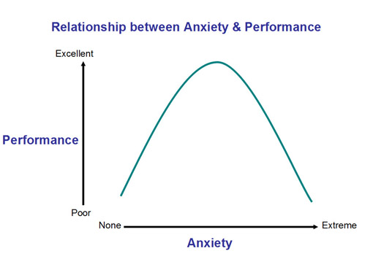
Relationship between Anxiety & Performance
A bit of worry can help us – it can enhance our performance, by making us more alert and tasked-focused.
However too much anxiety over a longer period of time can begin to interfere with our performance. Our ability to concentrate diminishes as we shift away from the task.
When anxiety overstays it’s welcome, exhaustion results. Which can lead to burnout / shut down / meltdown
We are not designed to perform well under these conditions
Notes:
It turns out we actually perform better when we experience a little anxiety. This is especially true in sports and similar performance situations. Low to moderate levels of anxiety, over a short period of time, heighten our arousal in a beneficial way. This arousal makes us more alert and tasked-focused. It also serves to motivate us to rise to the challenge at hand. This increased arousal is due in part to the release of chemicals in the body such as adrenaline and noradrenalin. However, beyond a certain point, too much anxiety over a longer period of time actually begins to interfere with our performance. Our ability to concentrate diminishes as we shift our focus away from the task, and toward distressing bodily signals. Moreover, when anxiety overstays its welcome, exhaustion results. Human beings are not designed to perform well under these conditions.

Slide 6
Why do children become anxious?
Often, we develop anxiety following a series of stressful life events – so this can include school as well as family issues
We do have to consider the ALN as well their own sensitivities
Child anxiety
Genes
Parent anxiety
Temperament
Life events
Thinking styles
Learning experiences
Our children will pick up on our own anxieties.
Anxious people tend to expect the worst scenario will always occur. So, find it hard to relax
When we are under threat or feel danger. It helps us with our fight & flight preparing us for a quick response
It has also been suggested that anxiety has family ties.
Notes:
Research has pointed to several possible contributing factors, including genetic (heredity) and non-genetic (environmental) factors. Dr Fiona Knott Reading Uni
Thinking Styles – There are many
Am I only noticing the bad stuff? Am I filtering out the positives? Am I wearing those ‘gloomy specs’? What would be more realistic?
Catastrophising - Imagining and believing that the worst possible thing will happen
OK, thinking that the worst possible thing will definitely happen isn’t really helpful right now. What’s most likely to happen?
Black and white thinking - Believing that something or someone can be only good or bad, right or wrong, rather than anything in-between or ‘shades of grey’. Things aren’t either totally white or totally black – there are shades of grey. Where is this on the
spectrum?

Slide 7
Indicators of anxiety :
Separation difficulties
Volume
controlling
Self-harming
Burnouts / Exhaustion
Withdrawing from social contacts/activities
Destructive behaviour /anger/ everything is boring!
Headaches / tension
Inappropriate laughter
Sensory seeking
Tearful
Sleep Issues
Increase use of toilet
Eating issues
Feeling irritability or down
Increase in obsessions
School – Non attending
Repetitive questions
Dealing with change
Tummy aches
Avoidance or refusals
Masking / Shutting down
It's so important that we help them feel safe
Notes:
By watching and observing them we start to see and identify their indicators

Slide 8

Learning to Beat Anxiety
Remember there are times when we ALL feel worried, anxious, uptight or stressed. This is NORMAL and often there is a reason.
Other times these feelings can feel so strong that they take over and my STOP us from doing the things you want to or must do in life.
We just want to hide…
When this happens, we try to take control and learn how to beat these feelings. Often our children lose control, become overwhelmed and distressed, help and guide them with this. There can be days of the build-up and then afterwards days to feel better.
Notes:
Our Children can loose control and feel overwhelmed

Slide 9

Ideas and tips to think about
Modify your expectations - When things don’t meet your expectations, it can lead to negative feelings. Consider their emotional age and what they can do – beware of the level of your child’s needs.
Modify the environment – be aware of your child's sensory difficulties – the environment often can play a big part in anxiety
Look at how you can support their executive functioning skills
Present it visually – timetables, write lists, create structure. It helps to take away uncertainty. Make some parts of the day that always happen the same time in the same way
  Let them know, how long, where and when
  Let them know what to expect - be honest
  Let them know you are there and on their side / collaborate
  with them
  Be available to play and talk to them
Prepare - if you think something is going to be problematic
Notes:
Connect with your child
First and then
Task Strips
Tie tables
Cue Cards
Society and others – values, attitude and knowledge

Slide 10
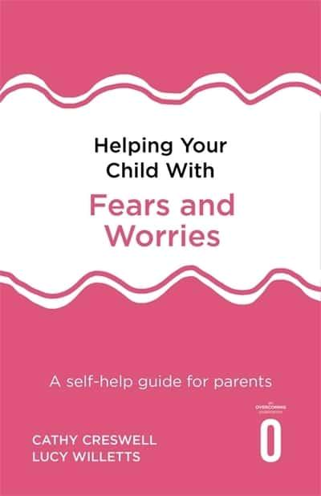
Helping Your Child With Fears and Worries
Addresses specific fears and phobias as well as general anxiety and 'worrying'.
Provides step-by-step practical strategies.
Includes case studies, worksheets and charts.
Encourages you to help your child problem solve for themselves
Based on the authors' experience at their anxiety disorders clinic at the University of Reading and developed from a programme based on working almost exclusively with parents.
Notes:
Dr Fiona Knott – Reading Uni

Slide 11

There are five steps to help your child overcome their fears:
1st Step: understanding your child and their anxiety
What makes your child anxious?
What are the signs that you have noticed?
How does it feel in their body?
Identifying and recognising them in your child can really help.
Put together visuals to help them understand – you may have to work on their emotional regulation skills
Notes:
Share in the chat – friendships/ connecting with peers / schools/ crowds / environments / sensory/communication /
Swan on the lake
Biting of nails – remember the indicators
Noises
Movements
Removing themselves / going quiet /avoiding
Connect with them and always ask why?

Slide 12
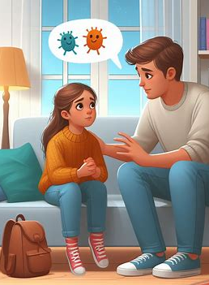
Step 1: Talk about Fears and worries
Encourage your child to be open about any fears and worries - This won’t make it worse, be honest and accurate. However, listen, please do not judge, long pauses are ok. Encourage them to talk freely…. They may struggle to explain what is happening or what they are feeling, but may expect you to understand
  Tell them what makes you anxious when you were young
  Ask them what makes them worry, using open questions.
  What do they think will happen? You can look at the evidence
  Use comic strip conversations or social stories or just general drawing / doodling on a page can help
  Give an older child a feelings journal
  Music (lyrics) may help/poetry/ images google or books
  Timing and the way you ask are important considerations.
  Sometimes take the worry away for them
  Your empathy will increase the chances that your child will accept your guidance and discuss his or her fears with you in the future.. Try not to be critical or express frustration. Accept their worries are real for them. Sometimes we do not have the answers, we can only be there to support them and acknowledge how they feel
Notes:
Have some worry time
Some are good at sharing while others are not
Evidence experiments
Try and identify what the root cause of the anxiety is and is it linked to their autism – is it school, friendships, a family situation, a demand that has happened

Slide 13
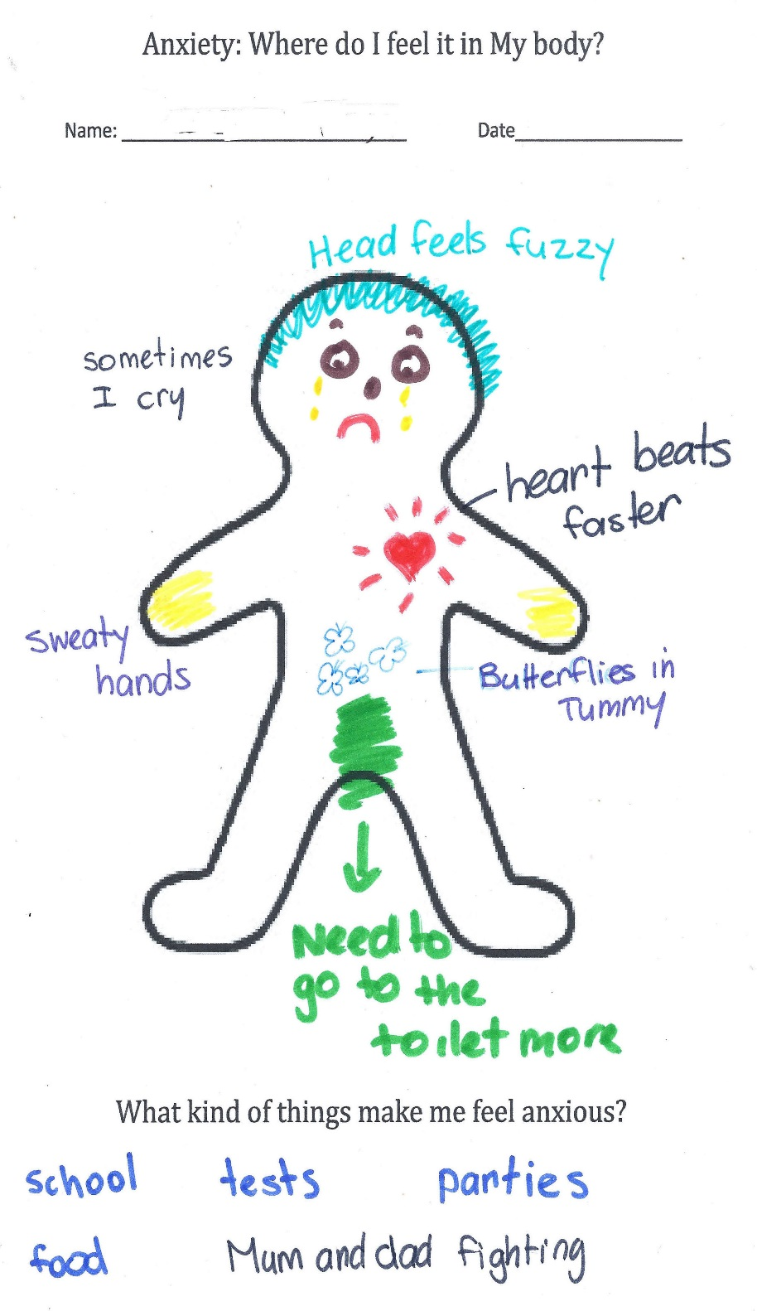
Draw a gingerbread person and give it a name. Get the young person to draw/write on the person all the physical things they notice about what happens when they are worried/anxious.
Notes:
It helps to start to recognise physical symptoms of anxiety

Slide 14
Try using Phrases like:
Using phrases that reassure a child they are physically and emotionally safe can be deeply reassuring.
Acknowledging and validating how a child feels without trying to explain or dismiss it can be very powerful.
I’m here.
I’ve got you
It’s okay, you’re safe
I’m going to stay with you
You’re going to be okay
It’s okay to cry
You’re not in trouble
That must be really hard
I’m sorry that X is making you anxious
Let's begin to unpick your worry
Do you want to talk about it?
You're worried, how can I help?
It’s not silly, if it’s making you feel like this
Autistic people often seek tangible answers, because they may lack executive functioning skills, the immediate need is not an emotional one, try and give a practical one, with solutions / choices or a backup plan.
Notes:
Give An answer that is concrete and one, they can perceive the outcome or link to it

Slide 15

Step 2: Limit reassurance
Too much can lead to more anxiety!
  No matter how much reassurance you give, an anxious child sometimes they want more. It only relieves your child’s anxiety in the moment.
  Does hearing “Don’t worry. Relax!" help you when you're anxious about something? It probably doesn't comfort your child much, either. It’s important to acknowledge that your child’s fears are real.
You may like to…….
  Distract / redirect if you can
  See if they can produce the answer
  Let them know that others can feel that way to - Normalising
  Work together for a solution/plan/scaffold
  Present suggestions as a question rather than a statement – so they can say no, that is not what I am worried about
  Write it down: Social story, Comic strip Conversations/post it notes
  Check you have understood – reflect back
  Pick your timing – try and make it fun (if you can)
Notes:
Post it notes – placing them in order

Slide 16

Step 3: Encourage them....
Builds on self-esteem and confidence
Encourage them to become more independent, try not to do everything for them or feel you must fix it, walk alongside them. Show them what to do – let them know they have got this. Make sure they feel safe, and they do have autonomy
    Break the task down with them, so they can achieve – what can you change to help make it work.
    “I feel this as well, its tricky, together we can do this”
Believe in them, praise small attempts as well as big ones (make praise clear and specific). Celebrate success.
Give rewards, rewards can also offer further encouragement if you feel this will help.
Notes:
Can make them feel empowered and more likely to do it.

Slide 17

Step 3: Lead by example
Using positive language – take out negative comments about them/ the situation, try not to feed the anxiety
Try and stay relaxed and connected with your child, what are they trying to communicate to you?
Beware of showing your own fears and anxieties
Model being brave, show them, show them!
Don’t expect children to know when to ask for help and don’t expect them to know what they are thinking /worrying about
Make time to have fun and laugh together

Slide 18

Discourage Avoidance
A natural reaction to a threat is to get away from it. In the short term this is the best solution, however, by not facing your fears you never learn whether you can overcome it or was it really that bad!
Try not to let them avoid too much, encourage “Have a go” even for 5 minutes. Break it down, scaffold the task. Do it together to start off with.
Take teeny tiny steps, so that failure is very unlikely
This will help build confidence and self esteem
Remember …It’s ok to acknowledge the fear
It's also ok for them to say “No” – and we try another day
Remember how can we make them feel safe and have autonomy to lead to better independence

Slide 19

Step 4: Step Ladder Approach – Reducing anxiety when facing a worry or fear
The step-ladder approach for the treatment of anxiety is medically known as graded or hierarchical exposure.(Step by Step) It’s one of the ‘behavioural’ components of cognitive-behavioural therapy (CBT) and it’s useful to know about when encouraging your child to address their fears.
This step-by-step approach allows your child to practice coping with their anxiety in manageable doses. In this way, your child also experiences successes along the way which builds up their confidence and sense of achievement.
Notes:
Is part of the CBT approach

Slide 20
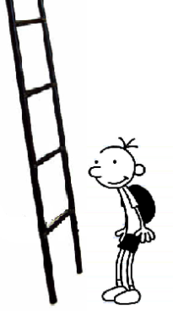
Example of Ladder
Going up stairs on my own…
  I stay upstairs for 5 mins
  I walk upstairs and into my room on my own
  I walk up to the top of stairs on my own
  Mum stands at bottom of stairs I go to the top
  Mum stands at bottom of stairs, I go up half way
Notes:
If you need to go back a step that’s ok.

Slide 21
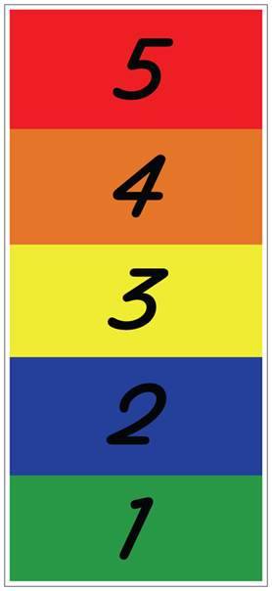
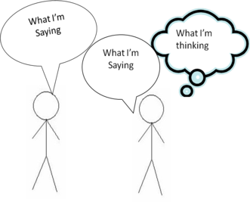
Step 5: Learn to Problem solve
Help your child recognise anxiety – become detectives and look a possible solutions and how they can have ago
Teach them about self-regulation skills….about emotions/ feelings / how their body feels
Teach the autistic child what it means to be autistic
Use the 5 point scale / Zones of regulation
Comic Strip Conversations
Social Stories
Visuals
Model bravery and role play
Notes:
Emotions – alexithymia becoming overwhelmed with emotions an emotional implosion
Unpick the problems / brainstorm solutions / have a go / how did you do?

Slide 22

Teach Relaxation techniques to help manage the physical symptoms of anxiety
Having fun and laughter www.actionforhappiness.org
Deep breathing techniques – Box / Belly
5 Things you can see, 4 Things you can hear, 3 Things you can touch, 2 Things you can smell, 1 deep cleansing breath.
Mindfulness
Encourage children to think of happy memories – show photos – make scrab books
Exercise
Listening to and playing music
Spend time with friends and family
Cuddle with pets and loved ones
Doing these things together can help.

Slide 23
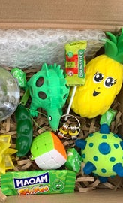
Stage 5: what can I do about it?
Produce a list of ideas with your child – remember baby steps lead to bigger steps – what works, what doesn’t work, what is important to them and what isn’t
Make a Self Soothe bags and Happy Boxes can be a good here, and lists, or Velcro choice boards can work too. Calm spaces, breathing, relaxation exercises, Make it visual
The Aim: Is for your child to know what helps them relax and bring them back down to a 2 or a 1

Slide 24

Helping to keep them relaxed & safe:
A Hug
Chill out Zone
Time alone – door signs – not in the mood leave me alone!
Rating scales – Colours, Numbers,
Physical Activities
Talk things through
Staying calm/relaxed yourself – do look after yourself
Sensory snacks
Controlled Breathing
Deep Pressure
Write or draw things down
Listen to loud Music
Put Together Visuals to help them remember
Notes:
2.15
Colour wrist bands for their moods
WHAT Works for your child.

Slide 25
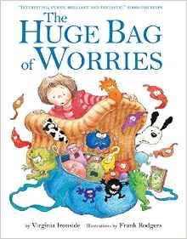
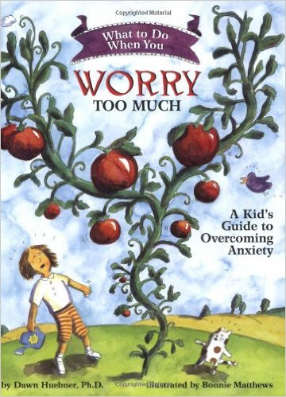
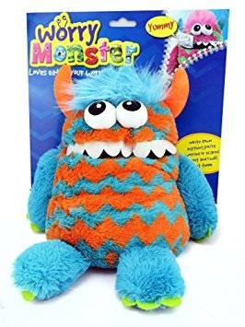
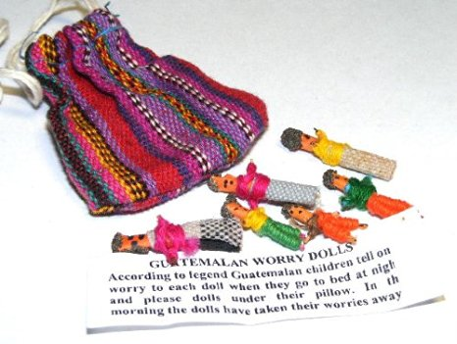
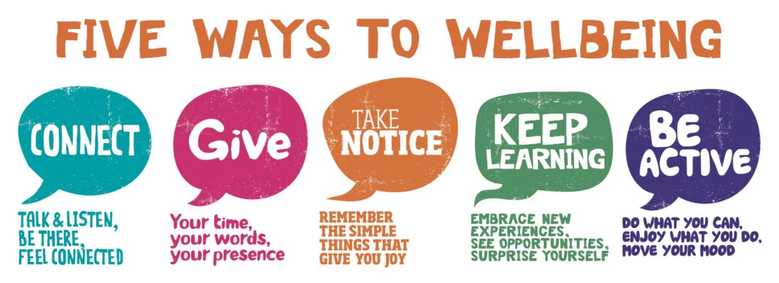
Other resources

Slide 26




Just a few other links of support
If you become concerned always contact your doctor or call 111 option 2 for professional help and guidance
www.mind.org.uk
www.youngminds.org.uk
www.charliewaller.org
www.childline.org.uk
Notes:
Seek support from those who truly understand and you trust

Slide 27
Thank you for listening
Any questions?

