Slide 1
This is a title page
What support can your neurodivergent child expect in school?
Catrina Lowri
By Catrina Lowri

Slide 2
Who?
Catrina Lowri; experienced SENCO, qualified SEND teacher and founder of Neuroteachers. I am neurodivergent myself; dyslexic and bipolar.
What?
We will begin with introduction to Neurodiversity. Discuss how this affects behaviour in the classroom and how the educators can support this.
A Neuroteachers Perspective

Slide 3
This will include:
About the session
-What is neurodiversity?
-Neurodivergent conditions
-Your 'child in mind'
-The offer in Welsh schools
-The teaching standards
-Universal support and individual needs
-Working in co-production with your school
-Making a plan for your child
-Your questions answered
What we will cover today

Slide 4
What is Neurodiversity?
The term neurodiversity comes from the words ‘neurology’ and ‘diversity’ and refers to the variety of different minds and brains across the human genome.
It is a social construct rather than a diagnosis.
The term first came into popular usage in the late 1990s in various online forums for autistic and ADHD adults.
Neurodivergence originally referred to only autism and ADHD but has been expanded to include all types of neuro difference that are not neurotypical.

Slide 5
People minds and brains that develop as a typical rate and in a typical way are called ‘neurotypical’.
This description was first used as a tongue in cheek phrase devised by neurodivergent people to show that they were proud that their brains developed along different line.
For example; typically children develop single word speech at between 10- 18 months. Public health practitioners call this age spread a ‘ normal range’ ie it is statistically average.
We would expect neurotypical infants to develop speech within this range.
If a child develops single word speech before 10 months or after 18 months in medical terms they may be considered a-typical.
What is meant by Neurotypical?

Slide 6
This includes
*All hereditary conditions which cause a difference in neurology
Neurodivergence
*All hereditary mental health conditions
*All acquired neurological difference such as those caused by injury

Slide 7
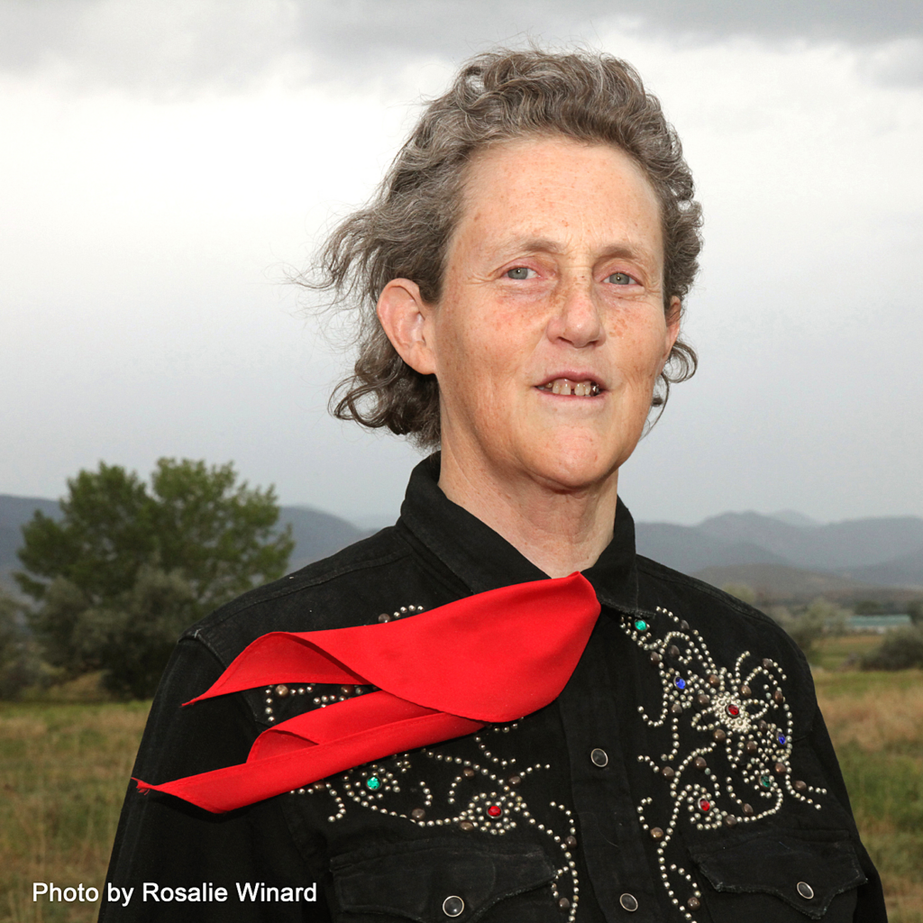
How divergent is Neurodivergent?

Slide 8
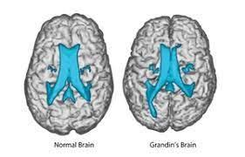
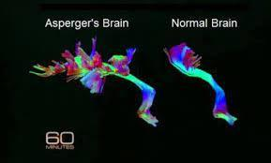
How divergent is Neurodivergent?
View from above
Speech centre

Slide 9
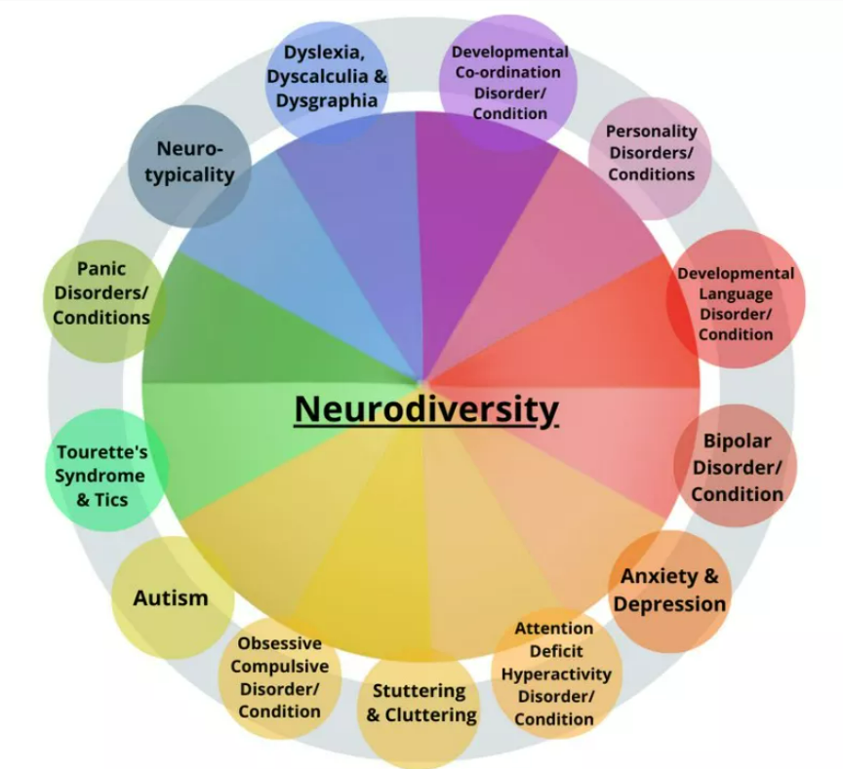
Co-occurring Neurodivergent Conditionsnditions
These include common conditions such as Autism, ADHD, Dyspraxia (DCD), Dyslexia, Dyscalculia and Developmental Language Disorder (DLD)

Slide 10
The Fruit Salad Approach

Slide 11
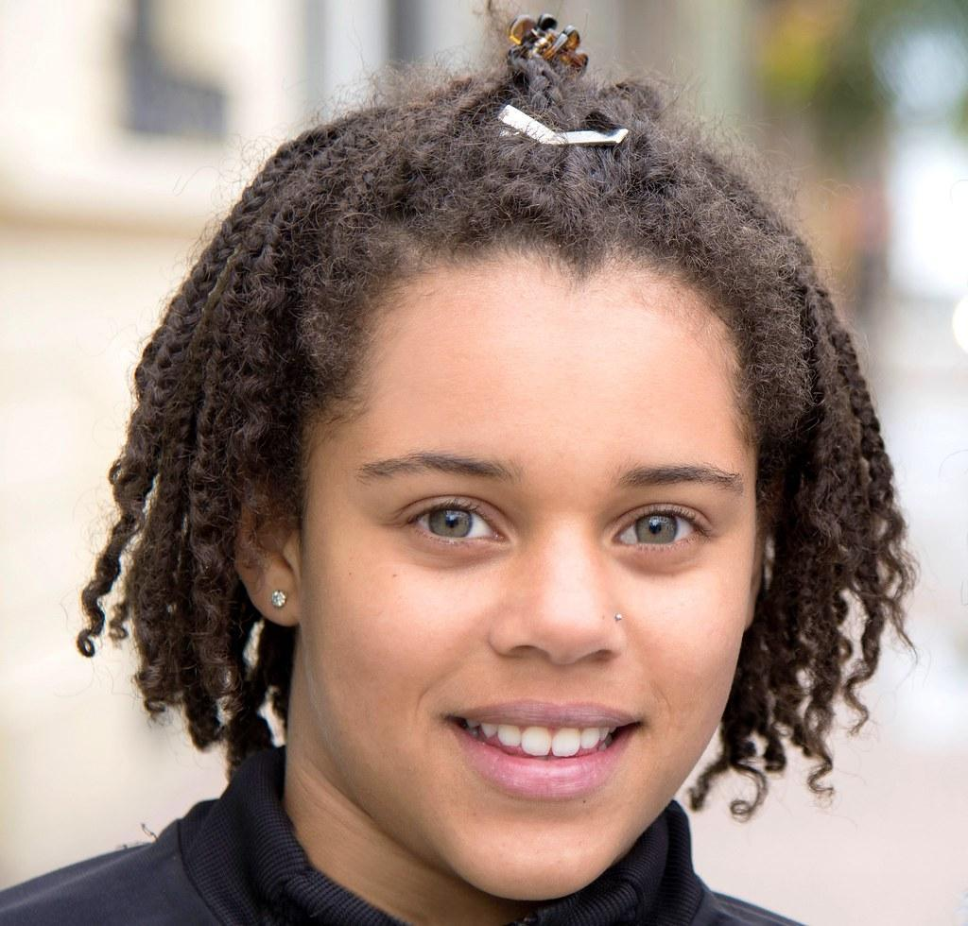
Your ‘child in mind’

Slide 12
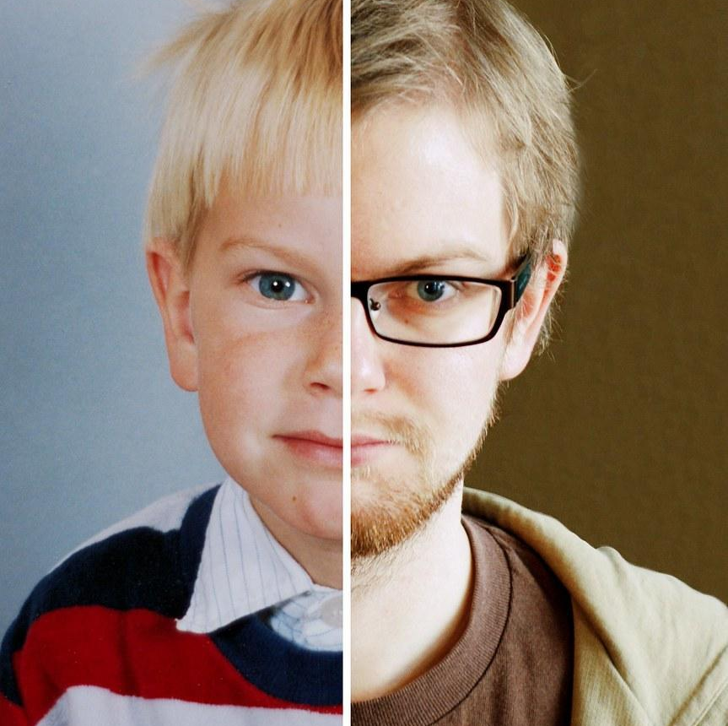
Ages and stages

Slide 13
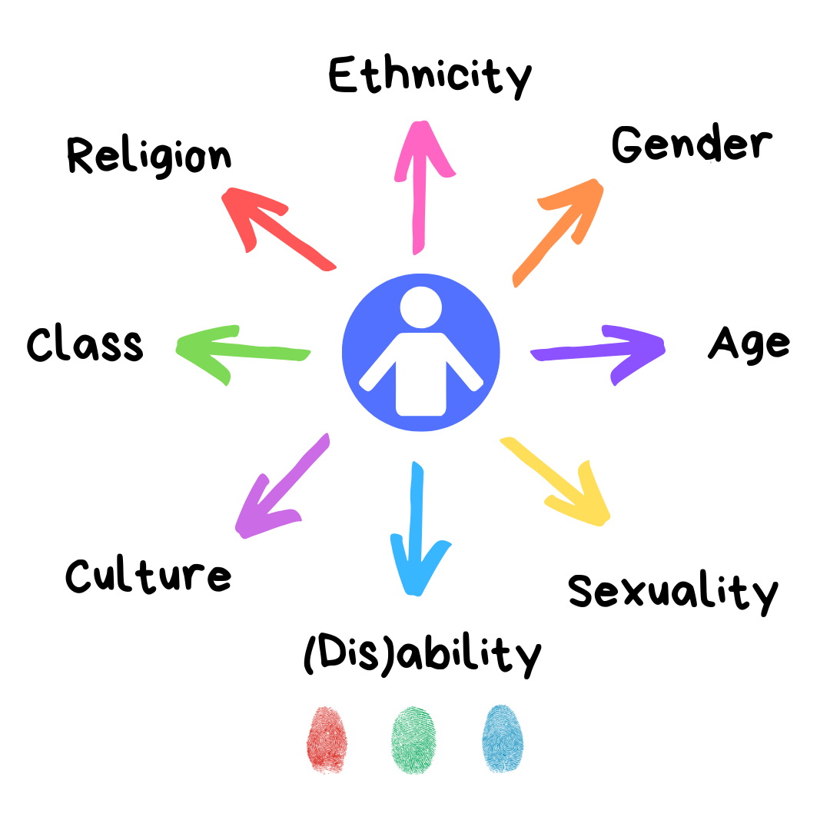
Intersectionality
And neurodivergence

Slide 14
The offer in Welsh Schools
What is Universal Provision?
What are Individual Development Plans?
This Photo by Unknown Author is licensed under CC BY
Notes:
chrome-extension://efaidnbmnnnibpcajpcglclefindmkaj/https://www.estyn.gov.wales/system/files/2023-09/The%20new%20additional%20learning%20needs%20system_0.pdf
chrome-extension://efaidnbmnnnibpcajpcglclefindmkaj/https://business.senedd.wales/documents/s145577/Research%20brief.pdf
https://www.gov.wales/progress-schools-and-local-authorities-supporting-pupils-additional-learning-needs-html

Slide 16
Teaching Standards
5 Standards; pedagogy, leadership, professional learning, innovation, collaboration
Overarching values and dispositions
Professional standards in teaching and leadership
Notes:
chrome-extension://efaidnbmnnnibpcajpcglclefindmkaj/https://hwb.gov.wales/api/storage/19bc948b-8a3f-41e0-944a-7bf2cadf7d18/professional-standards-for-teaching-and-leadership-interactive-pdf-for-pc.pdf

Slide 17
The Pedagogy
What assessment?
Which colleagues ?
Which other agencies ??

Slide 18
Differentiation strategies
Strategy | Description
Adjust rate | More time to process, to complete a task, to demonstrate knowledge
Adjust volume | Change amount of material to process or produce
Adjust complexity | Change number of details or complicated ideas to create or interpret
Staging of tasks | Tasks completed in logical steps or increments instead of all at once
Prioritisation | Certain task components are stressed or de-emphasised during a complex activity or task
Change presentation format | Information is presented in a way that pupil can process more effectively, e.g. more visual medium
Change production format | Pupil is allowed to demonstrate competency using a different medium
Change evaluation system | Performance is assessed differently for the pupil
Use of support or aids | Specific tools are used to facilitate learning or output e.g. laptop
Notes:
Next we are going to look at 9 common types of differentiation these will be things you do day to day, but as I say, I want you to be relational and tactful in your approach.
and I’m going to provide a worked example of how you might adapt these for my learner in min who is a 6 year old girl called Sophie

Slide 19
Processing
Processing Time
Did you know the average NT person takes 6 seconds to process and instructions?
ND people may take several minutes to process the same information.
Try leaving longer between each instruction to give more processing time

Slide 20
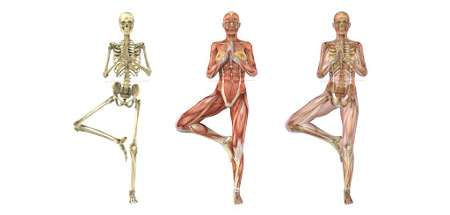
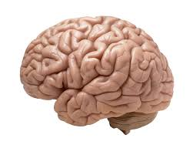
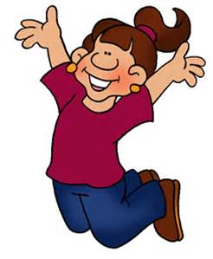
Sensory Differences

Slide 21
The window of tolerance
Notes:
Mention Dr Dan Siegal and sympathetic and parasympathetic

Slide 22
Executive Function
Organisational skills
Impulse control
Task Initiation
Emotional Control
Flexible thinking
Planning and prioritising
Self-motivation
Working memory

Slide 23
Social communication and Interaction
*Strategies to support some of the building blocks for social communication
Joint Attention
Language
Perspective
This Photo by Unknown Author is licensed under CC BY-SA-NC

Slide 24
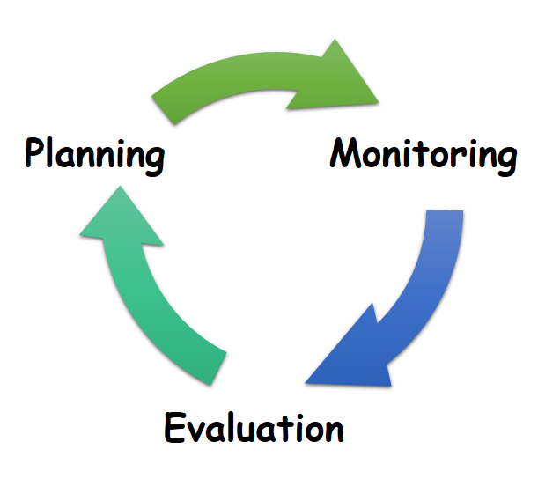
Individual Development Plans
What is an IDP?
Who can ask for an IDP?
Who is responsible for for the IDP?
What is included in an IDP?
How often will they be reviewed
This Photo by Unknown Author is licensed under CC BY-SA
Notes:
https://www.snapcymru.org/get-support/idps/

Slide 25
Working in co-production with your school
Recognizing value: Ensure that all contributions are valued and that people are recognized as assets
Building relationships: Develop reciprocal relationships and encourage peer support
Recording discussions: Record discussions that take place during and after activities to gain insight
Providing opportunities: Offer a range of activities, such as art, interviews, and short films
Training professionals: Train professionals to be empowered to take on a co-production role
Celebrating contributions: Record and celebrate young people's contribution

Slide 26
Making a plan for your child

Slide 27
Questions?

