Slide 1
Being a Neurodivergent Parent
My journey towards diagnosis
Expectations versus the reality
Managing the diverse needs within the family
Feeling overwhelmed and avoiding burnout
Maintaining boundaries and balance
Buffering and belonging

Slide 2
About me
ADHD person
Neurodivergent parent
Over 20 years' experience working with children, young people and their families

Slide 3
Becoming a parent
“All you need are rules, routines and boundaries“

Slide 4
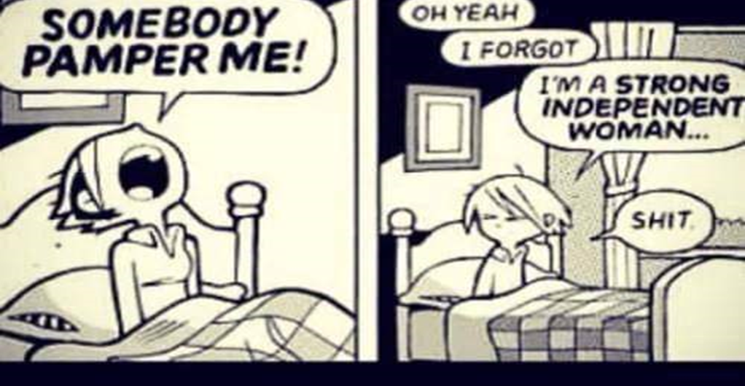
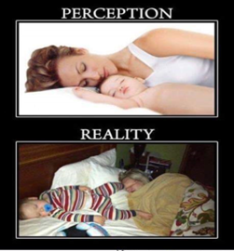
Expectation V’s The Reality
It takes a village to raise a child
Parent job description
Hormonal changes
Different presentation in females
Sensory sensitives and triggers
Executive function and dopamine

Slide 5
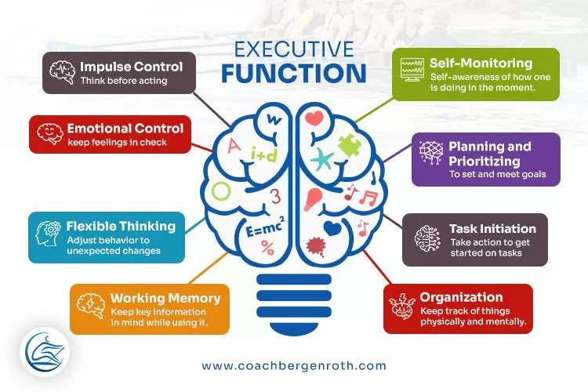
Why is this so hard?

Slide 6
What’s it like having a neurodivergent parent?
Funny
Kind
Great at helping us with our problems
You get how we feel
Late
Burning food
Grumpy in the morning
Panic cleaning

Slide 7
Traits versus Impact
We don’t fit inside one box
Frequency
Since childhood
Developed coping strategies
Impacts different areas in life – sense of self, relationships, job and your overall health and well-being.

Slide 8
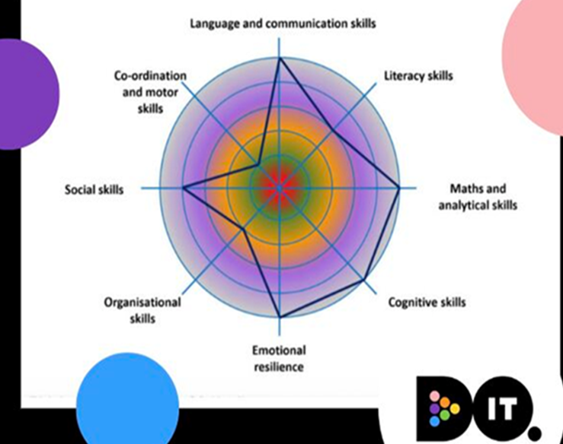
Strengths and challenges
Spikey learning profile

Slide 9
WHAT’S YOUR FLAVOUR? ADHD
Sensory differences
Overwhelm
Anxiety
Demands
Time blindness
Arithmetic
Reading
Processing
written information
Burnout
Implode – withdrawal, overthinking
Explode – emotional vomit
Specific interests
Routines
Social interaction v’s exhaustion
Ability to regulate:
Attention
Emotion
Energy

Slide 10
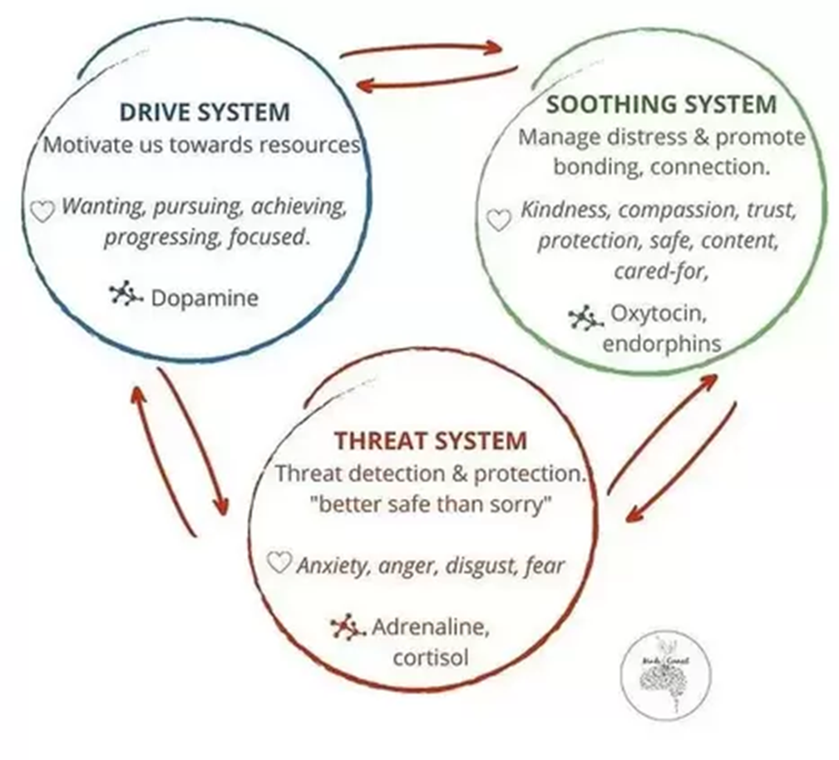
How my brain works

Slide 11
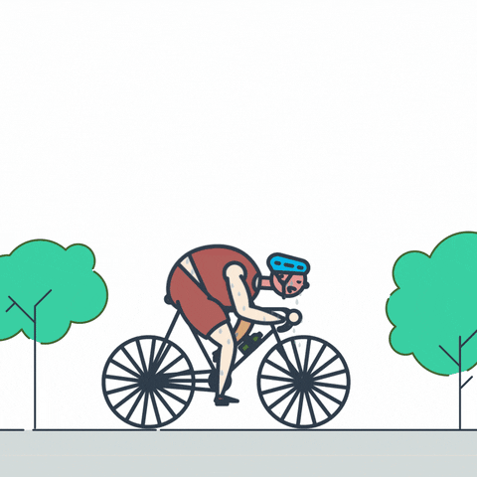
Boundaries Notice and map your burnout cycle
Expectations from self or others
Lack of downtime or buffering
People pleasing
Poor boundaries – Know your limits and when to say NO!

Slide 12
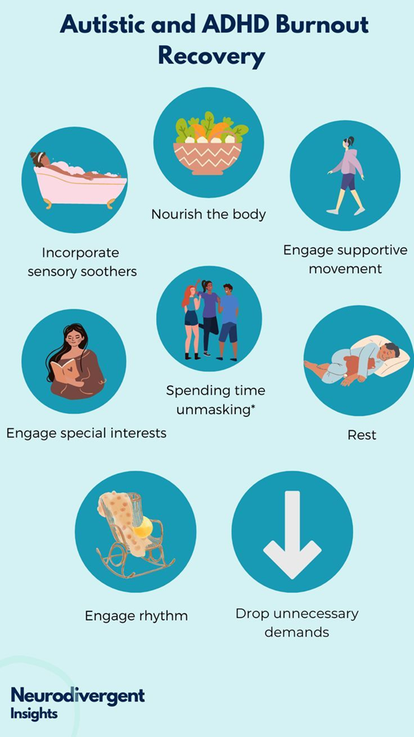
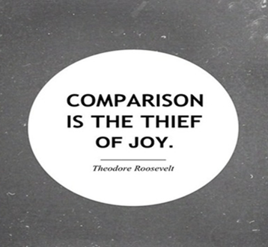
Follow your own path
Beliefs, goals and values

Slide 13
Co-regulation and putting on your own oxygen mask first

Slide 14
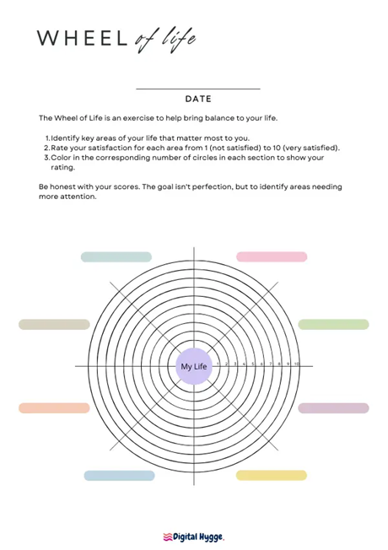
Balance Wheel of Life
What is taking up most of my time and energy
How to can you bring more balance into my life
What are my boundaries. When to say NO!

Slide 15
Become a sensory detective
Touch
Smell
Taste
Hearing
Vision
Vestibular – balance
Proprioceptive – body awareness
Interoception – state of internal organs (pain, heat, illness, hunger, toileting etc)

Slide 16
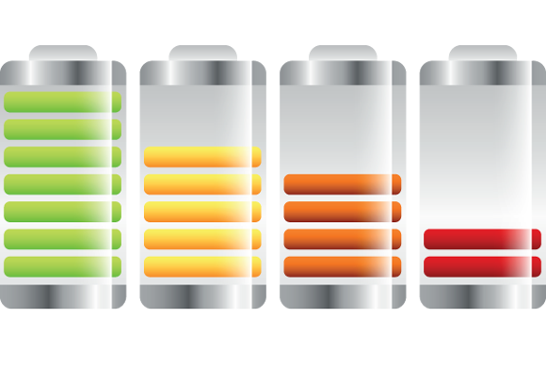
What makes you tick and what gives you the ick!
What am I feeling?
Where in my body do I feel it?
What is happening in my environment / life right now?
What’s available to me currently?
Body scanning
Sensory seeking or avoiding
Stress tolerance
Energy levels
Sensory soothing toolkit – calm the chaos or activate bounce back

Slide 17
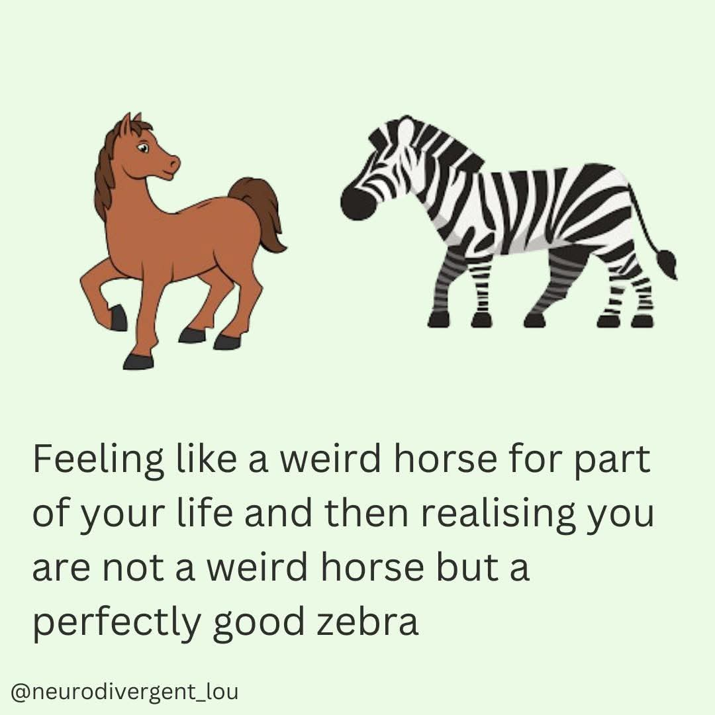
Belonging “The opposite of belonging is fitting in” Brene Brown

Slide 18
Belonging

Slide 19
Belonging Imagination Give it time
Connect with others – Vitamin C
Delegate tasks
Problem solve as a team
Communicating your own needs
Respect your feelings – unmasking
It’s OK to ask for help
Have fun as a family
Lean into learning

Slide 20
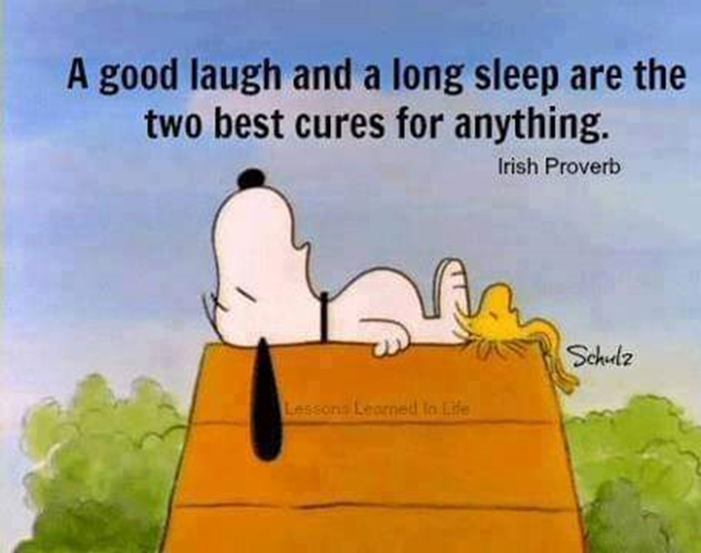
Buffering - Self Survival Hacks
Self regulation = co regulation
Self care
Routines and predictability
Write it down – lists and journaling
Habit stacking
Priority matrix
Pomodoro technique
Gamification
Body doubling Accountability buddy
Chunking – break it down
Timers, apps and technology
Energy bank accounting
Mini deadlines and mind mapping
Tech free time
Pause and be in moment
Music and movement
Processing skills – auditory, verbal and visual
Multi-tasking myths
Recharge – creativity and nature
Shush the critical voice

Slide 21
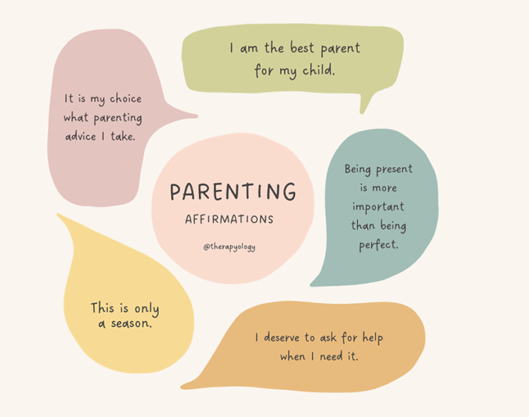
What really matters?
Late
Burning food
Grumpy in the morning
Panic cleaning
Funny
Kind
Great at helping us with our problems
You get how we feel

Slide 22
Key takeaways
Being an ND parent does not equal poor parenting or poor mental health.
One size does not fit all – Do what works for you and your family
It’s OK to ask for help and take time to recharge
Balance, boundaries, buffering and belonging
Acceptance, self-belief and compassion. You are good enough and so are your children.

