Slide 1
Making Sense of the Senses
Nathalie Shek
Advanced Practitioner Occupational Therapist
Sensory Processing and Integration

Slide 2
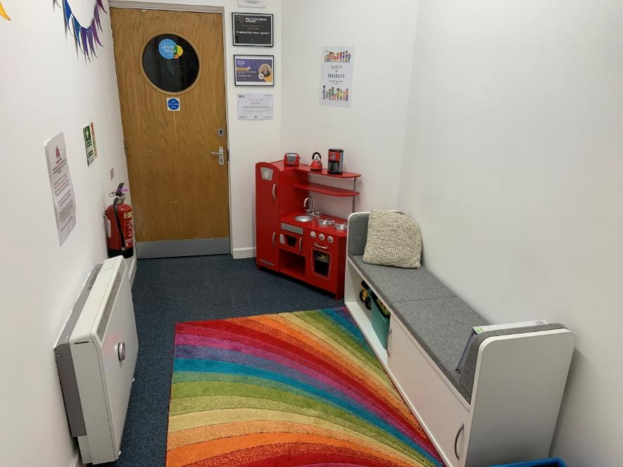
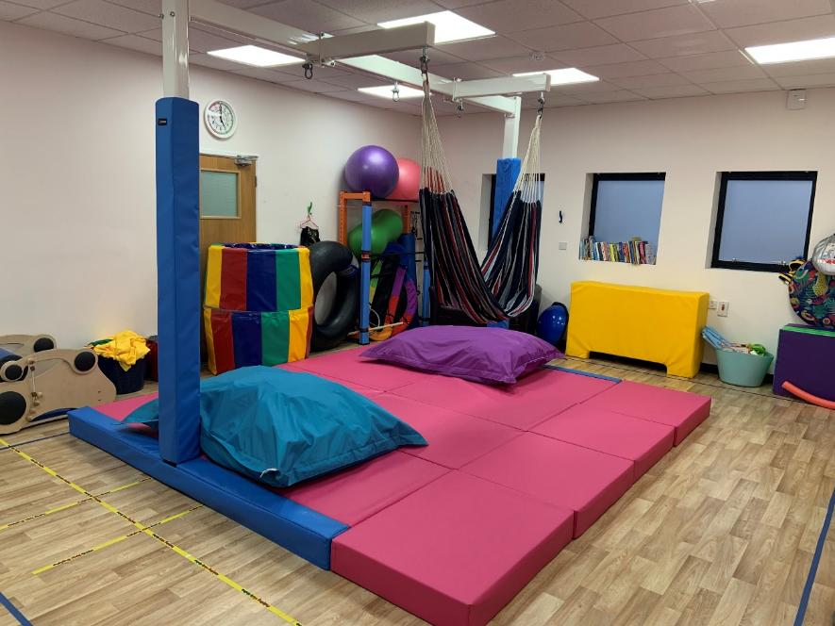
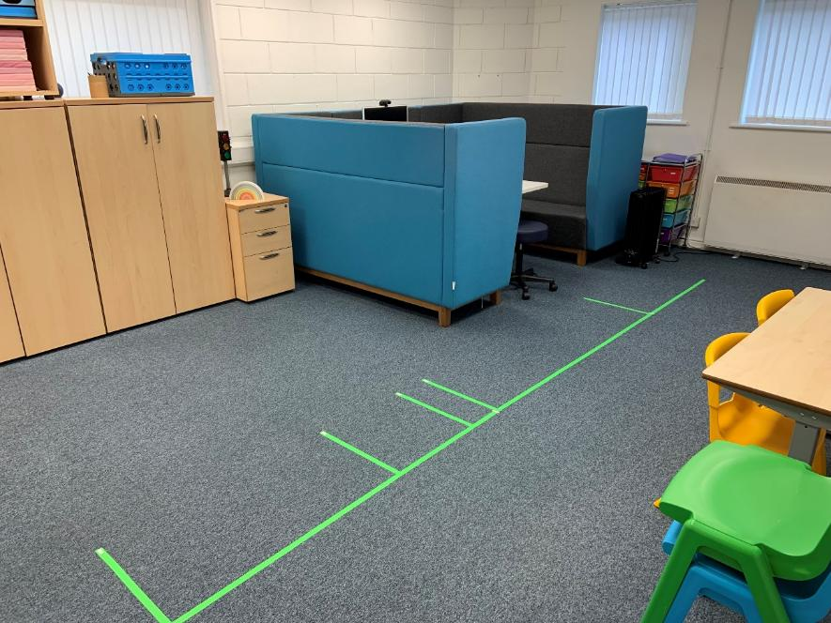
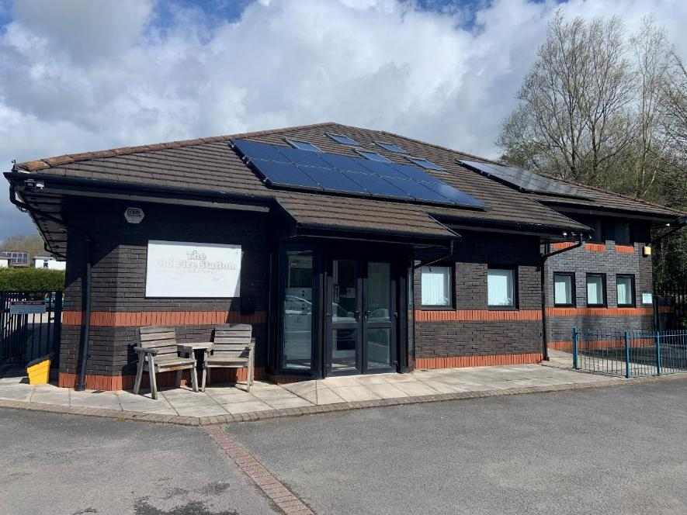
About Helping Kids Shine
Occupational Therapy and Speech and Language Therapy private service, with hopes to grow to further disciplines in the future
Working with Case Managers, Local Authorities, Charitable Organisations, and privately funding families
Based in Bridgend, just off the M4, J36.

Slide 3
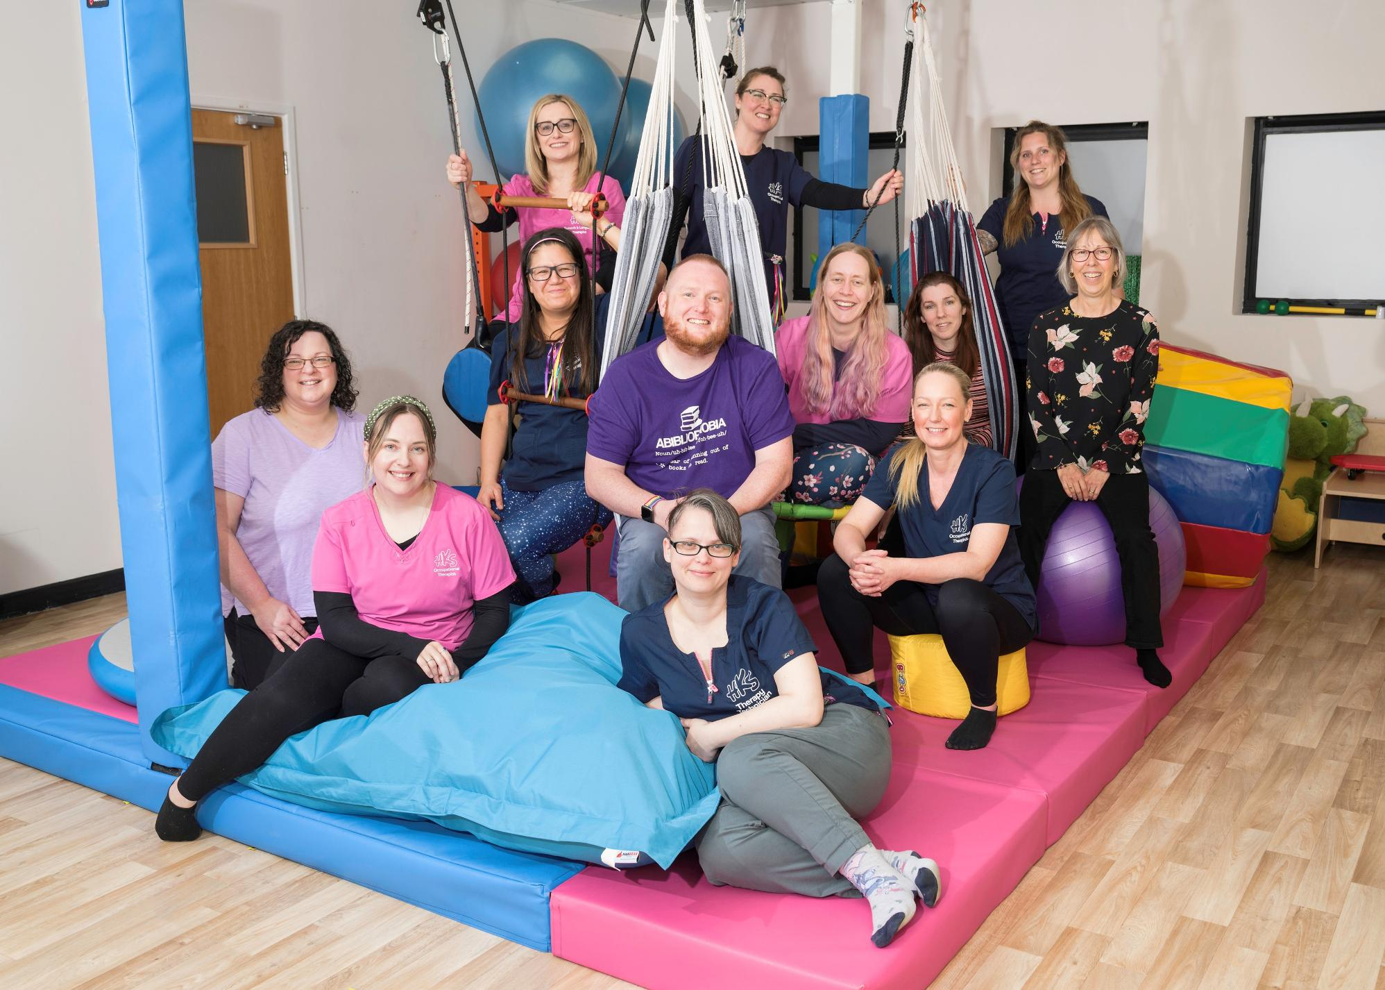
Our Team
We have a growing team at HKS
2 OTs specialising in working with children with physical needs
3 OTs specialising in working with children with neurodivergence and sensory differences
2 Therapy Technicians
1 Speech and Language Therapist (so far!)
Several staff in the Office Team to keep things running smoothly so that we can focus on our clinical work.

Slide 4
Who we work with

Slide 5
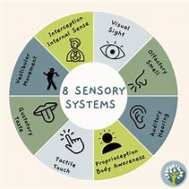
Explore Sensory Processing & Integration
What is Sensory processing and integration?
Gain a basic understanding of the sensory systems
Explore practical ways and strategies for supporting individuals with sensory processing and integration challenges.

Slide 6
Sensory Processing and Integration
“We learn through our senses. What we see, what we hear, what we touch, and
what we experience through the perception of movement of our joints and muscles are our foundations for learning. Sensory integration is a way of looking at how the brain and the body work together to process sensory information”
(Jean Ayres, 1984)

Slide 7
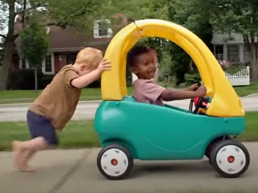
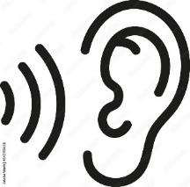
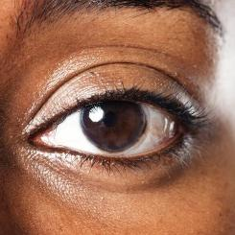
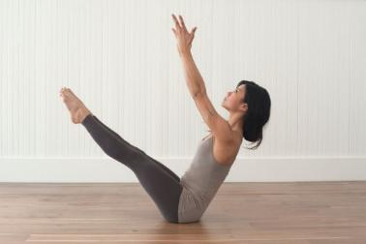
Sensory Processing / Integration
The ability to take in, organise/ process, and then respond to the sensory input in a meaningful and appropriate way
SENSORY PROCESSING DIAGRAM
SENSORY INPUT
BRAIN
ACTION
We then make a meaningful motor, language, social or emotional response
Sensory processing is controlled by the Central Nervous Sytem (CNS).
Sensory Processing difficulties occur when there is a problem in any steps of this phase of processing.
REGISTERS information
ORGANISES information
FILTERS out irrelevant information
INTEGRATES the information
STORES the information
Sensory Processing: Making Sense of the Missing Piece, Bianchini 2013

Slide 8
Foetal Development
Vestibular and hearing organ apparent at 5 weeks gestation.
Taste buds emerge at 8 weeks.
Tactile comes online at 12 weeks.
Vestibular system already functioning at 20 weeks.
At 24 weeks the eyes open and are sensitive to light

Slide 9
Sensory Systems

Slide 10
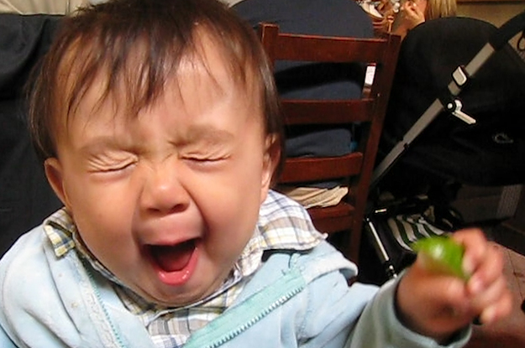
Olfactory & Gustatory
Systems responsible for tasting and smelling
Identification of safe vs. harmful

Slide 11
Visual
This is the system that identifies sights and understands what the eyes see and prepares for a response.
Sufficient ocular control is an essential skill for learning.

Slide 12
Tactile
Two types of Touch receptors:
Protective
Discriminative
Receives sensations of pressure,
vibration, movement, temperature
and pain through the skin, and provides
us with the sense of touch/connection.

Slide 13
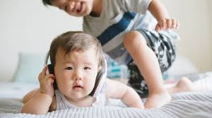
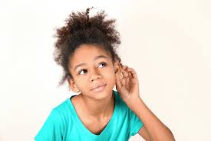
Auditory System
The system responsible for receiving and processing sounds and therefore the sense of hearing and understanding what is heard.

Slide 14
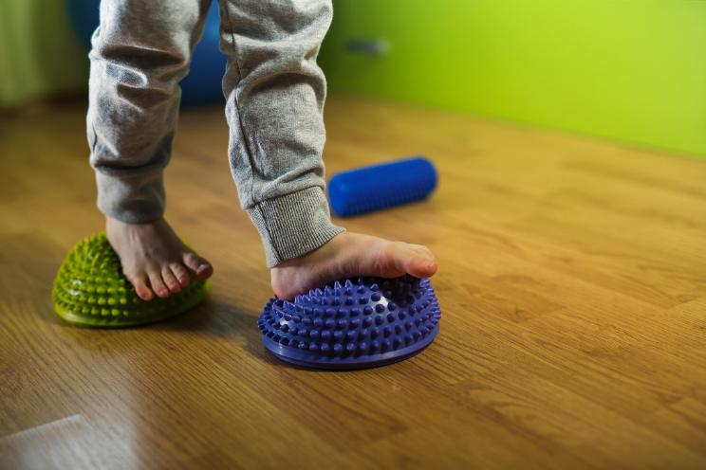
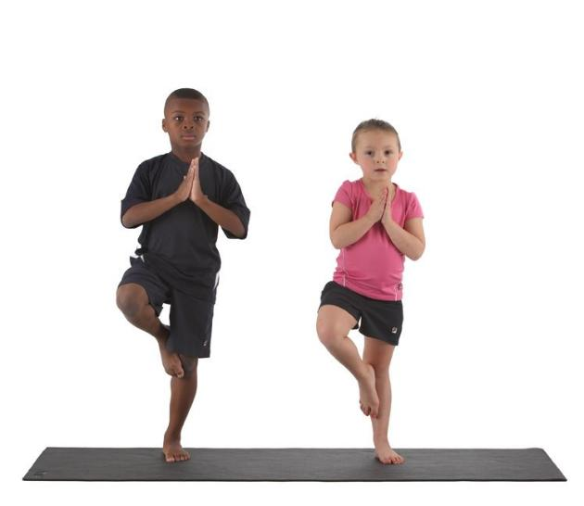
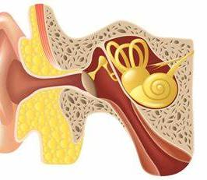
Vestibular System
Coordination of eye control, head movement and posture
Steadies the eyes as head/body moves.
Influences muscle tone and adjusts posture
Interprets input, plays role in motion perception and spatial orientation
Balance and movement sense
Tells you where your body is in relation to gravity
Movement receptors, located in inner ear & are important for posture, muscle tone and bilateral integration.

Slide 15
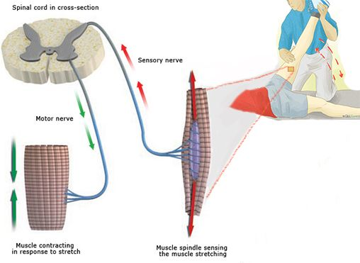
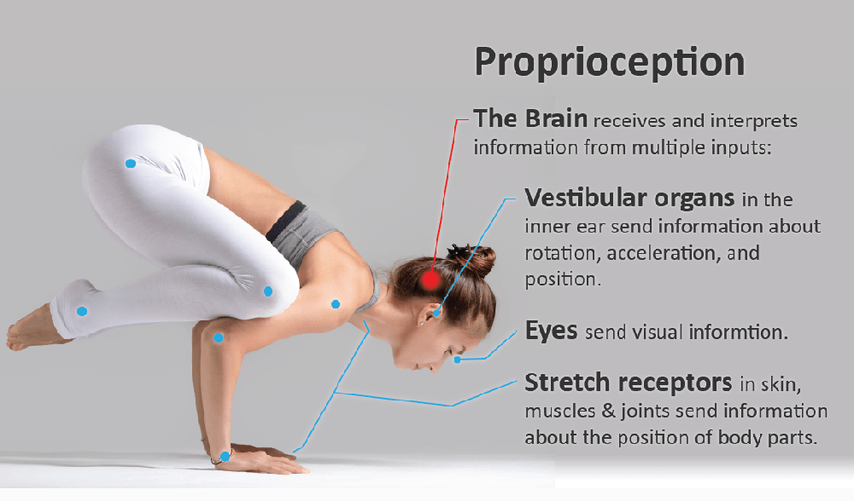
Proprioceptive System

Slide 16
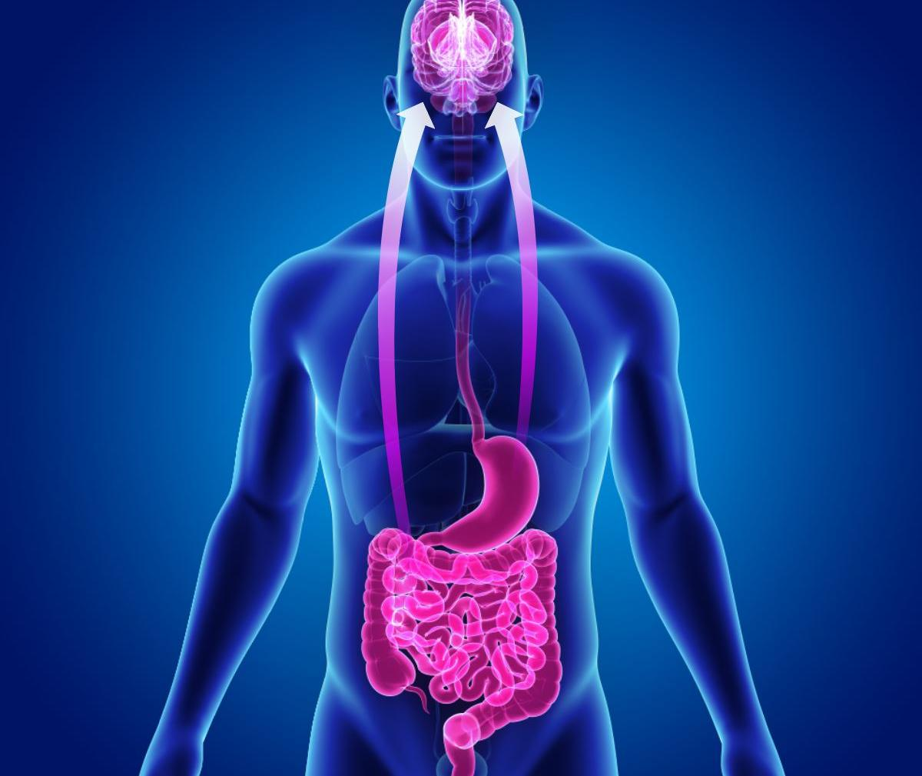
Interoceptive System- Internal Organs
Internal sensory in our organs-stomach, bladder, intestines, heart, lungs
Tells us when we are hungry, thirsty, bladder and bowel needs, tummy ache, tired
Helps to regulate the functions of the body
Is the physical reaction; to pain, bad news, car sickness

Slide 17
Helping us learn about the world around us
When all our sensory systems are working together, we are able to take in sights, sounds, smells, movement and
function well in our lives by learning, loving, interacting and appreciating the world around us.

Slide 18
Regulation – What is it?
“…to adjust, manage or control something so it works well.
It can go by many names, such as “self-control,” “self-management,” “emotional control,” “anger management,” or “impulse control.”
Zones of regulation
“… means feeling calm, balanced, and ready for your day”
Eadaoin Bhreathnach, OT
“refers to a moment of mindful awareness when we are connected to ourselves in the midst of whatever experience we are having”
Lisa Dion, Founder of the Synergetic Play Therapy Institute, regulation

Slide 19
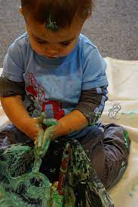
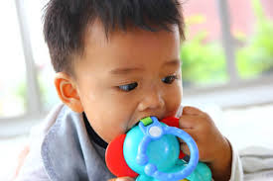
Regulation
How did we learn to use these?
Before birth
Oral motor
Touch
After birth- it is a way, we learn to attach and survive
Start to develop a capacity for self-regulation from 3-5 years old
Need to learn to self regulate to self calm, learn about self and later emotional regulation
We will do whatever we need to self-regulate and it may not always be socially acceptable

Slide 20
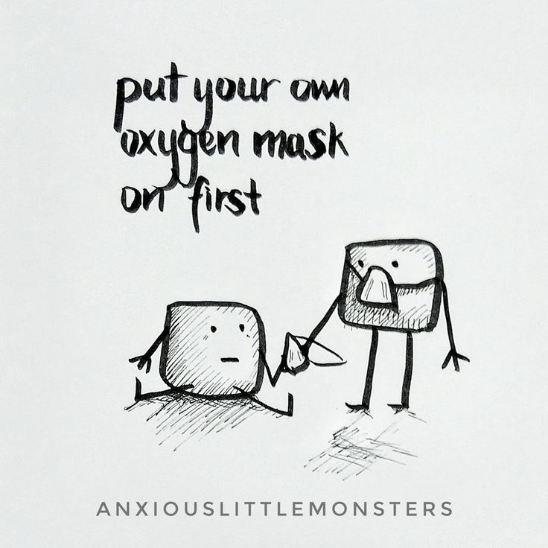
Oxygen Mask Analogy

Slide 22
(Dan Siegal, 1999)

Slide 23
Ref: Kim Barthel

Slide 25
What does it look like when it goes wrong?
Varies greatly in what the symptoms of sensory processing and integration looks like.
Sensory signals do not get organised like they should and there is difficulties responding to sensory input resulting in a “Traffic jam” in the brain.
We see fight, flight and fright responses or maladaptive responses after sensory information.

Slide 26
https://www.youtube.com/watch?v=K2P4Ed6G3gw

Slide 28
Sensory Processing Difficulties (SPD)
5-20% of children have SPD
80-90% of autistic persons have SPD
In specific populations, the prevalence is estimated to be as high as 80% to 100% who have a history of prematurity, foetal alcohol syndrome, or Down Syndrome, just to name a few. (Kong et al, 2018).
40% of children with ADHD also have SPD (Ahn, Miller et. al., 2004).

Slide 29
Attachment & Social Connections
Remember how the brain receives a stimulus and then evaluates whether it is a threat or not?
If it’s a threat, then we go into fight-flight-fright
If not, then we can focus on making social connections
Calm state
Eyes open
Heart rate even
Breathing relaxed
Focused on outside world-inner world calm & full
Muscles relaxed to make expressions- smile
What do we use? Facial expressions, vocalisations and eye contact

Slide 30
Self Regulation
Ways, you can regulate yourself
What do you use?
Visual
Auditory
Touch
Movement
Smell
Taste

Slide 31
Sensory Integration
and
Processing Differences

Slide 32
Sensory processing Differences
Sensory Modulation:
This is how individuals respond to sensory input. Some may be overly sensitive to stimuli, leading to feelings of overwhelm, while others may seek out more intense sensory experiences.
Sensory Discrimination:
This relates to the ability to differentiate between various sensory inputs. Individuals may struggle to distinguish between similar sensory experiences, affecting their interactions with the environment.
Sensory-Based Motor Differences: This is related to when an individual has challenges with their dynamic-postural control, motor skills and coordination, often impacting how individuals navigate their physical world.

Slide 33
Sensory avoiding or over responsiveness?
What it looks like:
Over responsiveness due to too much too soon or for too long to sensory stimuli most people find quite tolerable.
Will often display avoidance behaviours
Will avoid playground activities, get car sick, move slowly for fear of falling even with no real threat.
They may appear aggressive, irritable, anxious, fussy, impulsive when overwhelmed
Keep people at arms length/avoid crowds
Cannot brush hair, teeth, shower
Use extreme measures to control world/rigid routine
Hypervigilant
Wear headphones- all time with no music on
Wear hat or hood – all time
Avoid stairs, elevators, escalators

Slide 34
Sensory avoiding or over responsiveness?
They may be unsociable, avoid group activities, have trouble forming relationships, extremely cautious or afraid of new things
Respond negatively to light or unexpected touch, uncomfortable about clothing, food, may crave deep touch/pressure, may hate haircuts, dentist, brushing teeth
Will avoid walking barefoot or will toe walks
Becomes distressed by noisy environments, humming, singing, self-talk, head banging
Easily over stimulated, over aroused when bombarded by multiple senses
Upset by transitions or unexpected changes

Slide 35
“I pulled away when people tried to hug me, because being touched sent an overwhelming tidal wave of stimulation through my body. I wanted to feel the comforting feeling of being held, but then when somebody held me, the effect on my nervous system was overwhelming”.
“Small itches and scratches. That most people ignored were torture. A scratchy petticoat was like sand paper rubbing my skin raw. Hair washing was also awful. When mother scrubbed my hair, my scalp hurt”
New underwear causes great discomfort. And I have to wash it before I can wear it……I also liked long pants, because I disliked the feeling of my legs touching each other.

Slide 36
Sensory Under Responsive Behaviours
Passive, quiet, withdrawn
Difficult to engage in conversation or other social interactions
Apathetic and easily exhausted
Excessively slow to respond to directions or complete assignments
Poor inner drive, uninterested in exploring

Slide 37
Sensory Seeking or Craving
Driven to obtain sensory stimulation, but getting the stimulation results in disorganisation; and does not satisfy the drive for more
Climbing, running, jumping, crashing, rough housing, pinching, hitting, chewing
Will hum, whistling, grinding teeth, flick or pull ears
Repeatedly touch and feel objects, bump into things, show little reaction to pain, shake hands, rub skin, pick skin, mouth objects

Slide 38
Always on the go

Slide 39
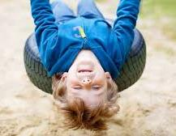
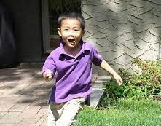
Sensory Seeking
Different from over responsiveness
Intense addiction to sensory stimuli – but causes disorganisation and frenetic behaviour
You think needs more input, then will calm down, but not so, disorganises them more
Input needs to be given in a specific way- structure, boundaries and small doses
Thrill seekers, confrontational, creative and imaginative

Slide 40
Sensory Seeking or Craving (Under Responsive)
Struggles to wait their turn and sit still.
May be very interruptive
Intense and demanding and may find it difficult to become in a calming state
May be prone to be in situations that others perceive as dangerous or disruptive

Slide 41
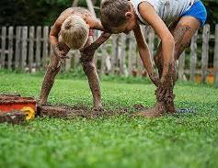
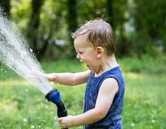
Sensory Craver
What it looks like:
Seeks movement
Extrovert
Intense
Creative
Thrill seeking
Hyperactive – seeking input – but takes little input and can crash easily
Seeks intense activity- mountain biking, sky diving, etc.
Always something in mouth

Slide 42
Loves messy play

Slide 43
What can you do to help?
Increase your knowledge of why your child is behaving the way they are
Become a ‘Sensory Detective’
Try and increase child’s self awareness of how they are feeling and why?
Be aware of your own needs and self-regulation as a caregiver
Help the young person to self regulate through co-regulation
Change the environment

Slide 44
Top Down vs. Bottom Up strategies
Need to engage the parasympathetic nervous system to bring the stress level down
What happens when you tell yourself to calm down? Or someone else tells you?
Brain wired to use self to calm – engage vagus nerve
“Sensory Activities“
Use a multi-sensory approach
Remember the child's best learning sense.
Big Three Power Houses:
Proprioception
Vestibular Input
Touch

Slide 45
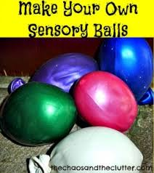
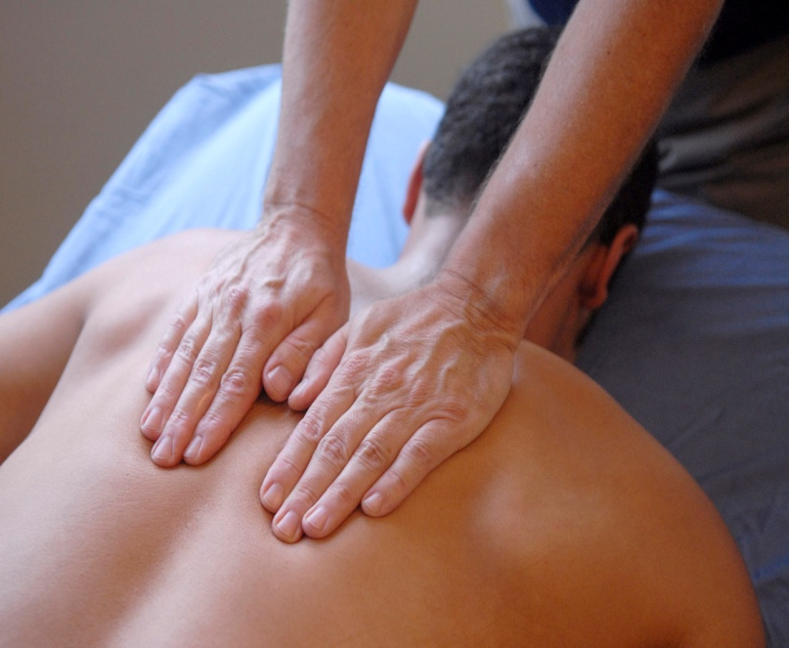
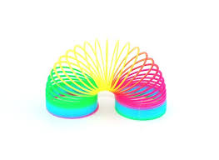
Self Regulation - touch

Slide 46
Self Regulation
Movement /Proprioception/Vestibular /Tactile/Oral/Smells
Back packs, stretching, cocoon pillow, stretch bands,
Rocking/Pacing
Sensory breaks that include walking or running outdoors
Bosu Ball, yoga, gym ball, running, dancing
Weights, weighted balls, Squishes/Hugs
Wall pushups, lifting weights, weighted balls, Body Sox
Whistles, Kazoo, blowing bubbles and sucking thick yoghurt
Squeezing balls, fidgets, flossy sand
Smells such as lavender, cinnamon, bergamot for example
Squeezing and squishing playdough or scented playdough

Slide 47
Self Regulation
Use multiple systems together!
Mouth - oral motor
Suck
Chew
Taste
Bite
Crunch
Blow
Laugh
Sing

Slide 48
Self Regulation
Music –multiple components so impacts multiple areas of the brain.
Rhythm – space between beats
Entrainment - changing heart rate, respiration, brain waves
Tempo- speed, pace, beats
Melody - tune, combinations of tones
Harmony - blending sounds

Slide 49
Proprioception
Activities that send strong message to the brain about the child’s body position have organising effect on the nervous system.
Proprioceptive input helps the child to reach a “just right” state of alertness so they can focus and learn
It is important to include regular proprioceptive activities for children with sensory processing differences.

Slide 50
Examples of ‘heavy work’
If in doubt about which sensory activity always try heavy work.

Slide 51
Deep pressure input
Stamping feet
Hug or chair lifts

Slide 52
Heavy Work
Gross motor activities - walk with a backpack, bike uphill, obstacle courses, stretching exercises
Stirring e.g. cake mix, batter
Heavy muscle activities, including wheelbarrow walking and active jumping e.g. star jumps, creeping and crawling, marching, chair push-ups, lying on stomach with weight on elbows, elastic material wrapped around chair legs for resistance whilst sat in the seat, carrying or stacking books, and helping with over heavy muscle tasks in the classroom.
Deep-pressure touch: wearing weighted vests, weighted lap pad.
Oral motor: chewing on chewing gum (if appropriate), rice cakes, carrots, or other firm and crunchy snacks. Drinking water from sports bottles at their desk can help with focus and organisation.
Oral toys, bubbles, blow paints, and other oral-blowing toys are also great.

Slide 53
Physical activity is regulating
Physical activity stimulates the proprioceptive, vestibular and tactile senses
Proprioception is a magical sense:
anything that “feeds” our muscles and joints can calm us if we are over alert and wake us up if we are under alert
If we are anxious or moving towards fight or flight, proprioceptive activities can help

Slide 55
Auditory – strategies
Provide and encourage deep pressure or proprioceptive activities before and after a noisy event
Wear snug/tight clothing which can at times have a calming effect.
Chew gum, suck on sports bottle or eat chewy or crunchy foods to encourage organizing effect.
Ear defenders but for short periods and very loud events if the child can express

Slide 56
Calming Spaces
It’s vital that a child who has sensory processing difficulties have a way out of an environment that causes them stress.
Each home/school should have a quiet space with minimal visual and auditory stimuli.
a reading corner behind a bookshelf
under a table with pillows or bean bag chair
a rocking chair in a corner behind a curtain
a small tent
a swing that only goes in a linear direction in the classroom
All great ways to provide a calming time.
Children will often choose these areas on their own; make adaptions to make ensure other children are not invading their quiet time.
Let them have a way of telling you they need a break as well before a meltdown occurs.

Slide 57
Other Strategies
Motor planning
To help children with motor planning challenges, try to give short instructions with one step at a time, ask other siblings to model and buddy with a friend.

Slide 58
Quick fixes - fidget and fiddle toys

Slide 59
Incredible 5 Point Scale by Kari and Mitzi Curtis

Slide 60
Sensory ladder examples:
Kath Smith, 2021 and Kari Dunn-Baron, 2003

Slide 61
Sensory ladder
Kath Smith, 2021

Slide 62
Kath Smith, 2021 and Kari Dunn-Baron, 2003

Slide 63
Sensory regulation
It is important that children with sensory difficulties have frequent sensory opportunities throughout the day to help calm and organise or alert them. They also need a trusted, attuned, and regulated adult to guide them.

Slide 64
“There is no one size fits all”

Slide 65
Thank you!
Email: nathalie@helpingkidsshine.co.uk
If you wish to make an enquiry: www.helpingkidsshine.co.uk

Slide 66
Questions?

Slide 67
Additional videos
Sensory Overload
https://www.youtube.com/watch?v=K2P4Ed6G3gw
Experiencing Sensory Overload / Too Much Information and Us
https://www.youtube.com/watch?v=4itIAAG6l8A
Temple Grandin
https://www.youtube.com/watch?v=xbzz6z79mJo

Slide 68
Additional Resources
Book: “Food refusal and avoidant eating in children”
by Gillian Harros and Elizabeth Shea
Childhood Feeding Problems
https://www.ellynsatterinstitute.org/how-to-feed/childhood-feeding-problems/
Free Parent Resources – feeding approaches
https://sosapproachtofeeding.com/free-resources-parent/

Slide 69
Resources
The Explosive Child: https://www.amazon.co.uk/Explosive-Child-Understanding-Frustrated-Chronically/dp/0062270451/ref=sr_1_1?dchild=1&keywords=The%2BExplosive%2BChild&qid=1601404710&sr=8-1
Emotional regulation is also a common problem for children with sensory disorders. This book explores the topic of children whose emotions seem to explode.
Raising a Sensory Smart Child: https://www.amazon.co.uk/Raising-Sensory-Smart-Child-Definitive/dp/0143115340/ref=sr_1_1?dchild=1&keywords=Raising%2Ba%2BSensory%2BSmart%2BChild&qid=1601404763&sr=8-1
Co-written by an occupational therapist, this book shares very practical sensory information and tips for parents.
The Sensory Child: https://www.amazon.co.uk/Sensory-Sensitive-Child-Practical-Out-Bounds/dp/0060527188/ref=sr_1_1?dchild=1&keywords=The%2BSensory-Sensitive%2BChild&qid=1601404818&sr=8-1
This book is another great go-to resource for parents. In particular, for children whose emotional responses seem to be more sensitive. This one is written by a Psychologist.

Slide 70
Resources
Sensational Kids: https://www.amazon.co.uk/Sensational-Kids-Children-Processing-Disorder/dp/039916782X/ref=sr_1_1?dchild=1&keywords=Sensational%2BKids%3A%2BHope%2Band%2BHelp%2Bfor%2BChildren%2Bwith%2BSensory%2BProcessing%2BDisorder&qid=1601404907&sr=8-1
Written by an amazing, experienced Occupational Therapist. This book explores the types of sensory disorders.
My Senses Are Like Cups: https://www.amazon.co.uk/Senses-Are-Like-Cups-Everything/dp/1839978473
What to do when everything feels too much or not nearly enough – by Clare Ward and James Galpin
Building Bridges Through Sensory Integration: https://www.amazon.co.uk/Building-Bridges-Through-Sensory-Integration/dp/1935567454/ref=sr_1_1?dchild=1&keywords=Building%2BBridges%2Bthrough%2BSensory%2BIntegration&qid=1601404963&sr=8-1
The very first book I ever read on this topic, written by a trio of Occupational Therapists, it is helpful to both therapist and parent alike.
Sensory Integration and the Child: https://www.amazon.co.uk/Sensory-Integration-Child-Jean-Ayres/dp/0874244374/ref=sr_1_1?dchild=1&keywords=Sensory%2BIntegration%2Band%2Bthe%2BChild&qid=1601405061&sr=8-1
is written more for Occupational Therapists. However, it is also good for parents as its latest update is more parent-friendly. It is for those who want to understand about sensory integration in-depth.

Slide 71
Apps
Mind shift
Virtual Hope box
Breathing
Anxiety

Slide 72
References
Levine, P.A. (2010) In an Unspoken Voice: How the body releases trauma and restores goodness. North Atlantic Books: USA.
Perry B, Winfrey O (2021) What Happened to You? Conversations on Trauma, Resilience, and Healing. Bluebird, London.
Porges, S. (2017) The Pocket Guide to the Polyvagal Theory: The transformative power of feeling safe. W.W. Norton and Company: London.
Durham University. "Babies learn to anticipate touch in the womb." ScienceDaily. ScienceDaily, 8 October 2013. www.sciencedaily.com/releases/2013/10/131008091727.htm
Ahn, Miller, et al (2004) Prevalence of parents' perceptions of sensory processing disorders among kindergarten children. Available at: https://pubmed.ncbi.nlm.nih.gov/15202626/
Kong, et al (2018) The nature of nuture: Effects of parental genotypes. Available at: https://pubmed.ncbi.nlm.nih.gov/29371463/
Ben-Sasson, et al (2009) A meta-analysis of sensory modulation symptoms in individuals with autism spectrum disorders. Available at: https://pubmed.ncbi.nlm.nih.gov/18512135/

Slide 73
Resources
https://www.amazon.co.uk/Sensory-Team-Handbook-Hands-Processing/dp/098114392X/ref=sr_1_1?dchild=1&keywords=The%2BSensory%2BTeam%2BHandbook&qid=1601405179&sr=8-1
Teacher Carol Stock Kranowitz has written a series of books. They are all very helpful. She uses and expands on the term “out of sync.” She helps answer the common question parents ask, “what is a sensory issue?”
https://www.amazon.co.uk/Sync-Child-Carol-Stock-Kranowitz/dp/0399531653/ref=sr_1_1?dchild=1&keywords=The%2BOut-of-Sync%2BChild&qid=1601405280&sr=8-1
A good first book to read.
https://www.amazon.co.uk/Out-Sync-Child-Has-Fun/dp/0399532714
A book that is full of activities for children with sensory disorders.
Student and teacher perceptions of stability balls as alternative seating in a first grade classroom. Nicole schoolcraft. The journal of teacher action research. Volume 4, Issue 3, 2018, , ISSN # 2332-2233

Slide 74
Resources
Love-Jean-Inspiration-Dysfunction-Integration: https://www.amazon.co.uk/Love-Jean-Inspiration-Dysfunction-Integration/dp/097250981X/ref=sr_1_1?dchild=1&keywords=Love%2C%2BJean%3A%2BInspiration%2Bfor%2BFamilies&qid=1601405116&sr=8-1
Jean Ayres was a pioneering occupational therapist. She developed the theory of sensory integration. This short book captures a series of letters she wrote to her nephew. He struggled with learning. She wrote to support him. It provides additional insights into sensory integration. It is a nice introduction to the topic.

Slide 75
Resources
Parents often wonder, “how do you explain sensory processing disorder to a child?”. Well, there’s help with this book:
The Good Enoughs Get In Sync: https://www.amazon.co.uk/Goodenoughs-Get-Sync-Members-Overcome/dp/1935567160/ref=sr_1_1?dchild=1&keywords=The%2BGoodenoughs%2BGet%2Bin%2BSync&qid=1601405410&sr=8-1
This book is designed for pre-teens to learn about sensory processing disorders. But it is also helpful for parents to read themselves. Furthermore, it is great for parents to read to their children too.
What is sensory integration - https://youtu.be/1_Iuj8dr9oY
101 Activities for Kids in Tight Spaces: https://www.amazon.co.uk/101-Activities-Kids-Tight-Spaces-ebook/dp/B00P5DPWS2/ref=sr_1_1?dchild=1&keywords=101%2BActivities%2Bfor%2BKids%2Bin%2BTight%2BSpaces&qid=1601405456&sr=8-1
I loved this book for its activity ideas. I would scour the book for activities to introduce in therapy in my former occupational therapy practice. However, it truly gives parents helpful things to do with their ‘sensory’ kids!

